Slide 1
Acute Kidney Injury in the ICU
Obiora Udeozo MD
Critical Care and Nephrology

Slide 2
Agenda
Epidemiology & definitions (KDIGO)
ICU-specific pathophysiology (sepsis-associated AKI)
Diagnosis & risk stratification (FST, biomarkers)
Hemodynamic optimization & fluids
Nephrotoxin stewardship & contrast media
When to start KRT (timing), modality & dose
Special topics: metabolic acidaemia, anticoagulation for CRRT
Drug dosing, nutrition, and follow-up after AKI/AKD
Key takeaways & references

Slide 3
Epidemiology & Burden

Slide 4
Epidemiology
AKI occurs in ~1/3 of ICU patients; associated with increased mortality, Length of stay and costs
Substantial proportion progress to Acute Kidney Disease (AKD) or CKD
Sepsis present in ~40-50% of patients with AKI in the ICU
Sepsis is the leading cause of ICU AKI

Slide 5
Epidemiology
ICU patients with AKI who require dialysis (AKI-D), have a reported mortality of 50-60% and some studies showing up to 80% depending on case mix and illness severity
Septic ICU cohorts needing RRT mortality is often >50% at 60-90 days
One year mortality of AKI-D ~50%

Slide 6
Definitions & Staging

Slide 7
AKI Definition (KDIGO)
↑ serum creatinine (SCr) ≥0.3 mg/dL within 48h, OR
Increase in Scr ≥1.5× baseline in 7 days, OR
Urine output <0.5 mL/kg/h for ≥6 hours

Slide 8
AKI Stages (KDIGO)
Stage 1: SCr increase 1.5-1.9 x baseline or > 0.3mg/dl ; Urine output<0.5ml/kg/hr for 6-12hrs
Stage 2: SCr increase 2-2.9 x baseline; Urine output <0.5ml/kg/hr for > 12hrs
Stage 3: SCr increase > 3 x baseline or > 4mg/dl, or initiation of RRT; Urine output<0.3ml/kg/hr or anuria > 12hrs

Slide 9
Common Causes of AKI in the ICU

Slide 10
PRE-RENAL CAUSES
Hypovolemia (hemorrhage, dehydration, overdiuresis
Sepsis (distributive shock): Most common
Cardiogenic shock(MI, arrhythmia, decompensated CHF)
Obstructive shock (massive PE, tamponade)
Renal vasoconstriction(hepatorenal syndrome, intra-abdominal compartment syndrome

Slide 11
Intrinsic Causes
Acute tubular necrosis (ATN)-from prolonged ischemia or nephrotoxin
Nephrotoxins
  Drugs: Aminoglycosides, vancomycin, amphotericin B, cisplatin, calcineuron inhibitors
  Constrast-induced nephropathy
  Hemolysis, rhabdomyolysis
Acute interstitial nephritis (AIN): PCN, NSAIDs
Thrombotic microangiopathies (TTP,HUS, DIC)
Glomerulonephritis/vasculitis (rare)

Slide 12
Postrenal Causes
Catheter obstruction (clot, kinking, blockage)
Prostatic hypertrophy/urethral obstruction
Ureteral obstruction (stones, tumors, retroperitoneal fibrosis)
External compression (pelvic mass)

Slide 13
Sepsis-Associated AKI (SA-AKI)

Slide 14
Pathophysiology of AKI in Sepsis
Maladaptive microcirculatory dysfunction; dysregulated inflammation & tubular stress
Often without overt renal hypoperfusion; macro-hemodynamics can appear 'normal'
Tubular cell cycle arrest & mitochondrial dysfunction are central features

Slide 15
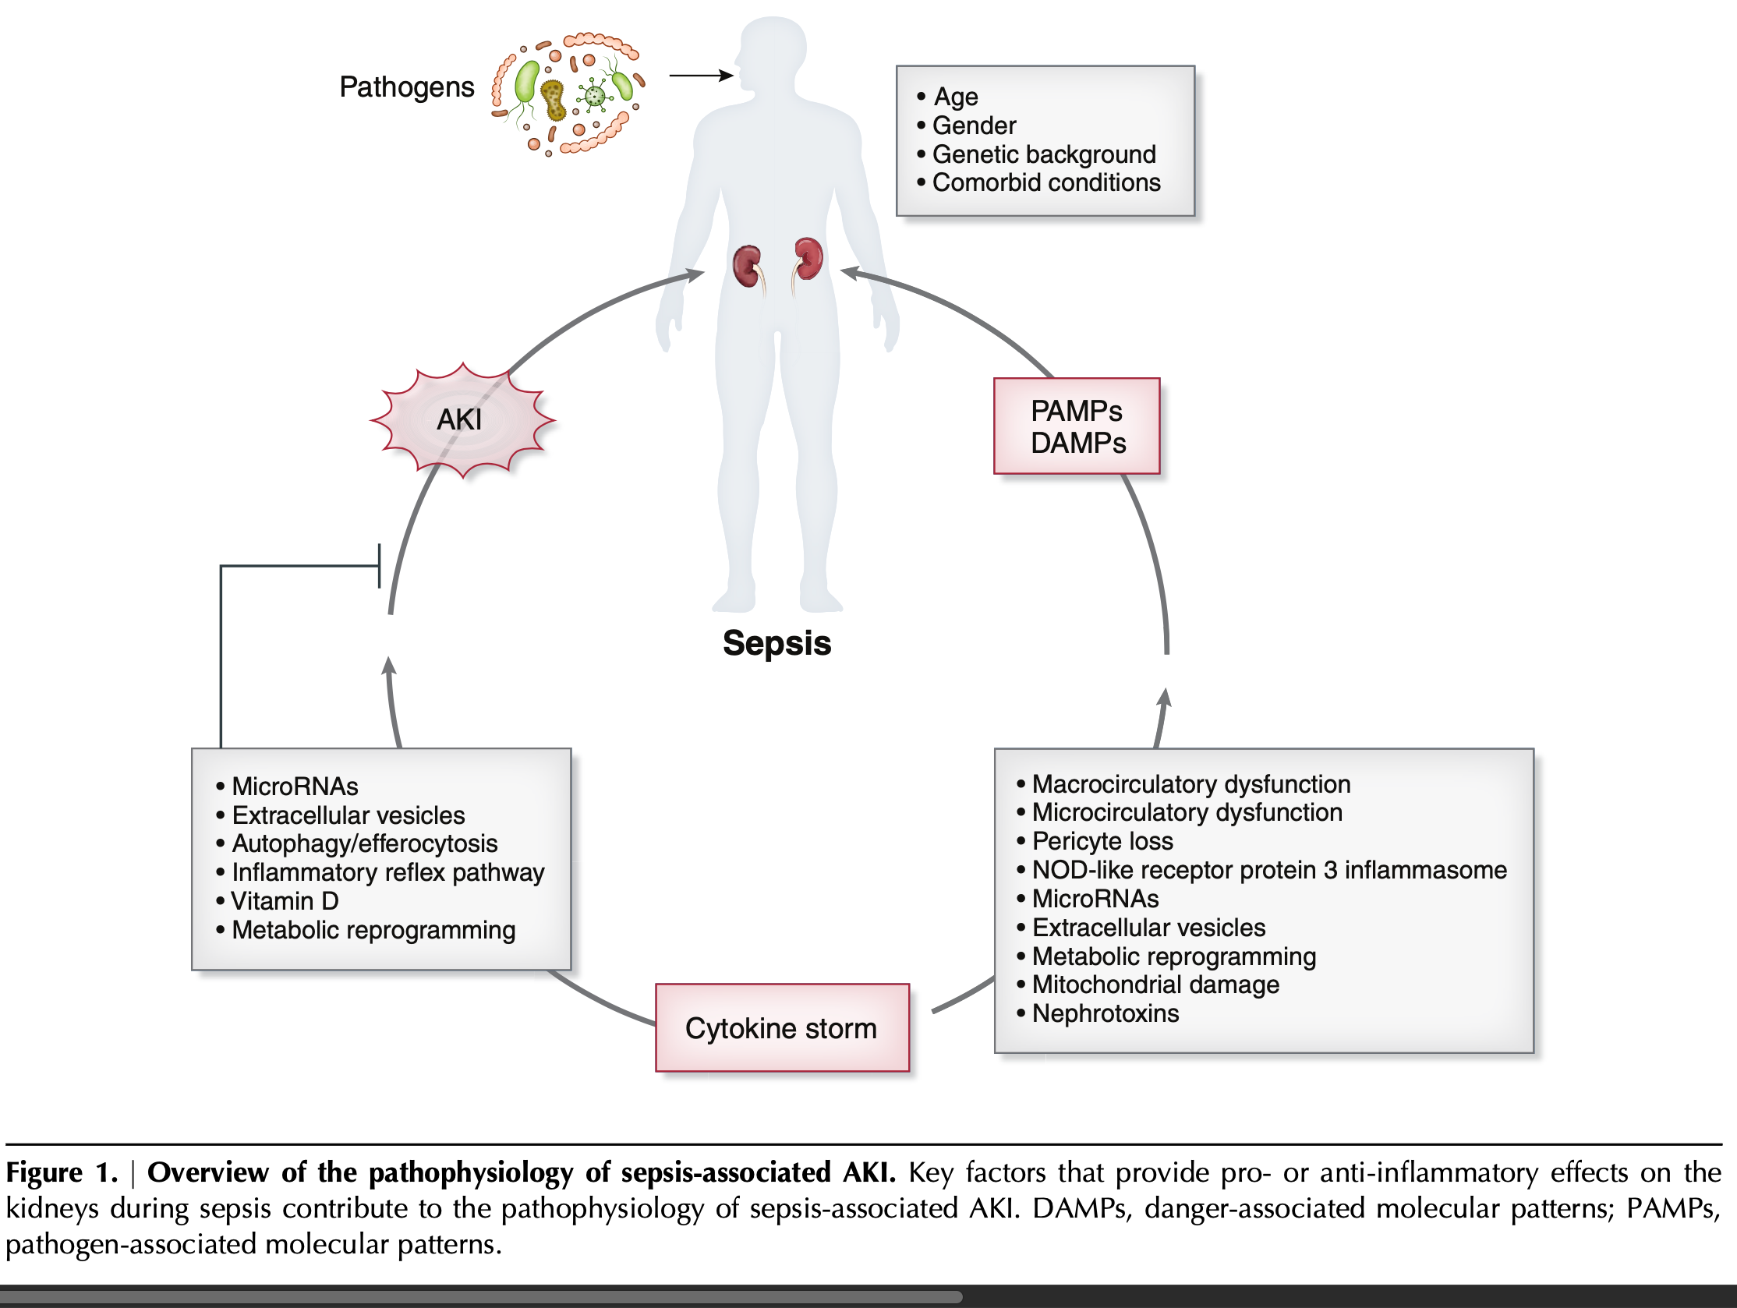

Slide 16
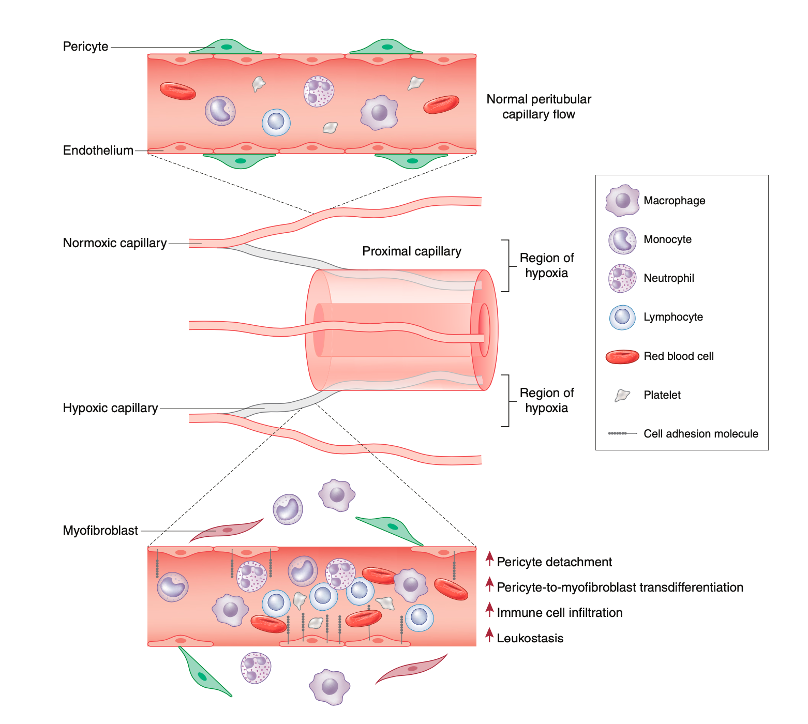

Slide 17
Diagnosis & Workup

Slide 18
Investigations
Confirm oliguria vs retention; bladder scan, catheter patency
Assess hemodynamics, volume status, and exposures (nephrotoxins, contrast)
Urinalysis with microscopy (casts, FeNa/FeUrea context-specific)
Ultrasound for obstruction; POCUS for venous congestion (VExUS) where available

Slide 19
Risk Stratification: Furosemide Stress test (FST)& Biomarkers

Slide 20
Furosemide Stress Test (FST)
Dose: 1 mg/kg IV (naïve) or 1.5 mg/kg (prior loop diuretic exposure)
Urine output ≥200 mL in first 2 hours suggests lower progression risk
Helps identify patients at high risk for AKI progression and need for dialysis

Slide 21
Cell-Cycle Arrest Biomarkers
Urinary Tissue inhibitor of metalloproteinases [TIMP-2]·[IGFBP7] insulin like growth factor binding protein (NephroCheck) identifies high-risk patients.
It’s a marker of cell cycle arrest in renal tubular cells exposed to stress.
Can trigger 'KDIGO bundle' in postoperative/cardiac surgery cohorts
Test performance can vary by setting; combine with clinical judgment

Slide 22
Hemodynamic Optimization

Slide 23
Targets & Vasopressors
Initial MAP target 65 mmHg in septic shock; consider higher MAP if chronic HTN to reduce dialysis risk
Norepinephrine is first-line; add vasopressin if NE-inadequate; epinephrine third-line
Use dynamic assessment of fluid responsiveness; avoid over-resuscitation & venous congestion

Slide 24
Fluids: Type & Strategy

Slide 25
Crystalloid Choice
Balanced crystalloids (e.g., LR, Plasma-Lyte) vs normal saline: Higher mortality with normal saline. (NEJM SMART & SALT-ED)
Large RCTs (PLUS/BASICS) showed no mortality difference; consider chloride load, patient context. NEJM 2022 Finfer et al
Avoid starches; albumin selective use (e.g., hypoalbuminemia with ongoing shock)

Slide 26
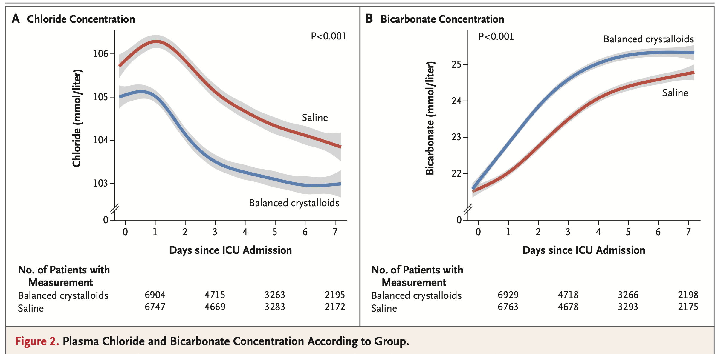
NEJM 2018 SMART & SALT-ED Semler et al

Slide 27
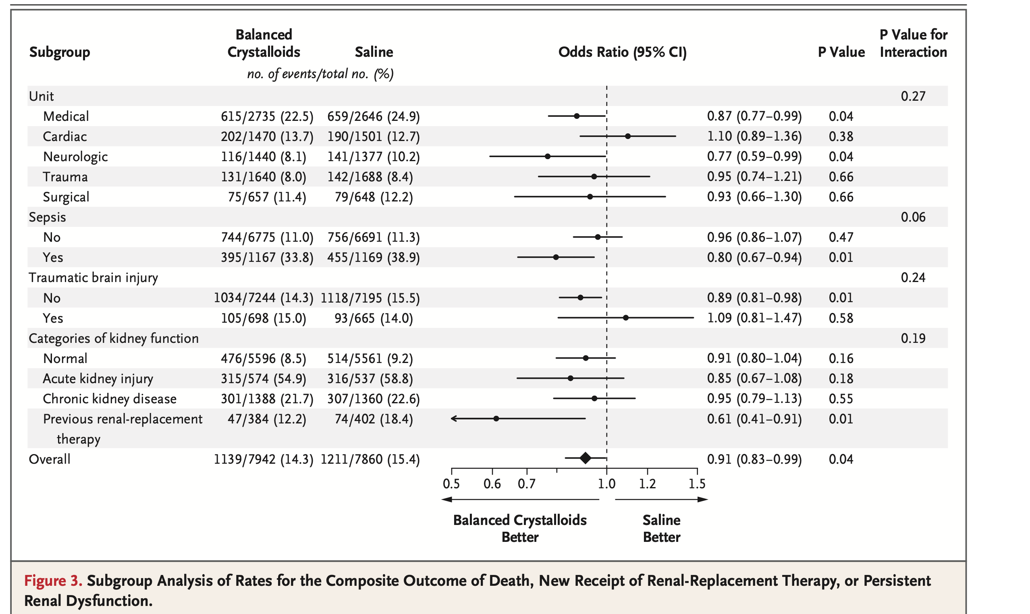
NEJM 2018 SMART & SALT-ED Semler et al

Slide 28
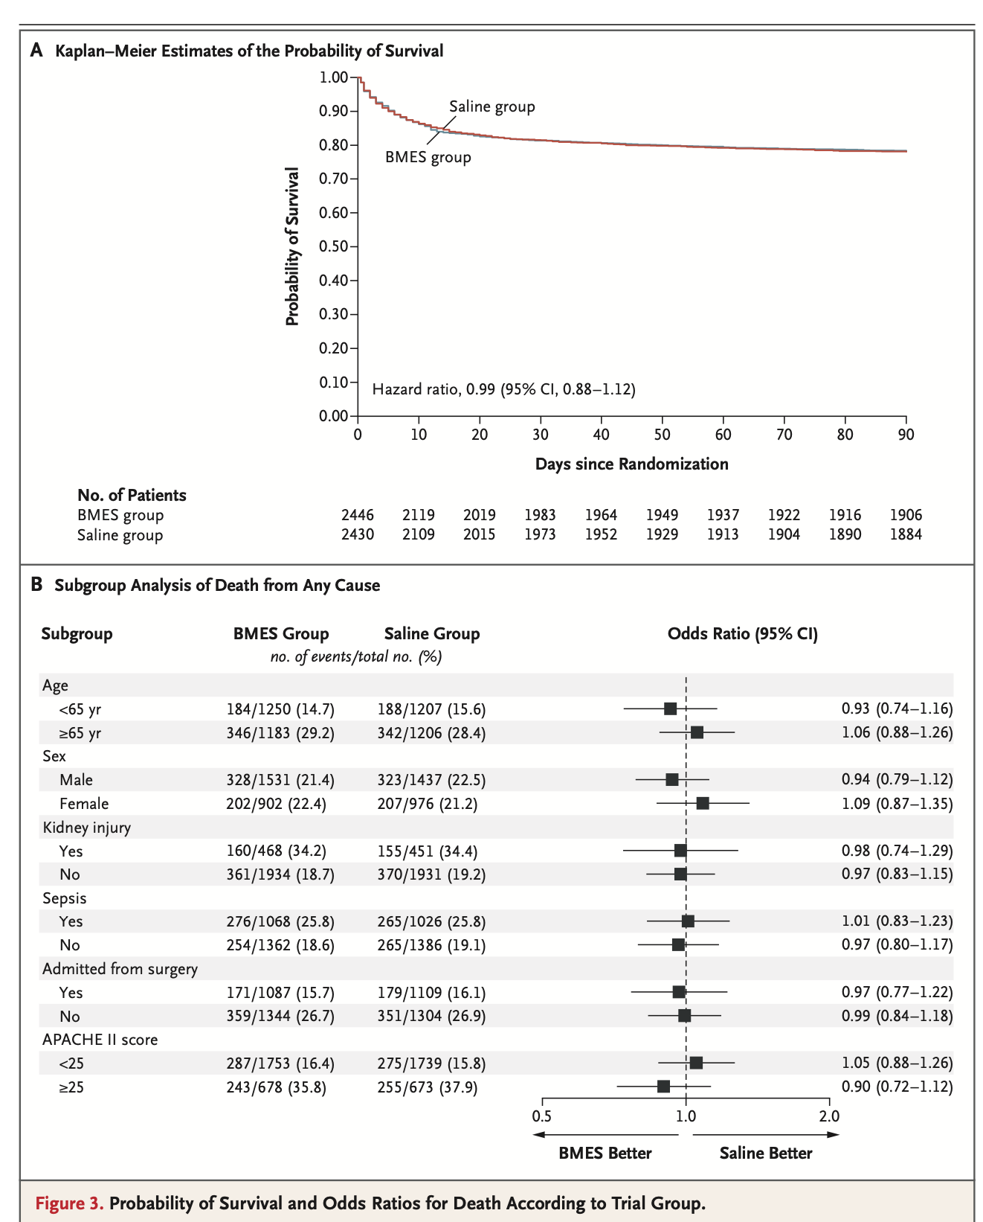
NEJM 2022 Finfer et al

Slide 29
Nephrotoxin Stewardship

Slide 30
Antibiotics & AKI Risk
Vancomycin + piperacillin/tazobactam associated with higher AKI risk vs vancomycin + cefepime/meropenem
Prefer AUC-guided vancomycin dosing; monitor levels and renal function closely
Minimize concurrent nephrotoxins (aminoglycosides, calcineurin inhibitors, IV contrast when avoidable)

Slide 31
Iodinated Contrast in 2025

Slide 32
Current Perspective
Risk of CI-AKI likely overstated with modern low-osmolar agents
Main modifiable strategy: ensure adequate volume status; hold metformin if eGFR <30 with contrast
Avoid routine N-acetylcysteine; consider isotonic fluids pre/post in high-risk (eGFR <30 or AKI)

Slide 33
Metabolic Acidaemia: Bicarbonate?

Slide 34
BICAR-ICU
Severe metabolic acidaemia (pH ≤7.20) subgroup with AKI had ↓ mortality/KRT with bicarbonate infusion
No overall mortality benefit; use in selected patients (stage 2 and 3 AKI) with severe acidaemia + AKI did show mortality benefit
Monitor sodium/volume load and ionized calcium

Slide 35
When to Start KRT (RRT)

Slide 36
Timing Evidence
ELAIN (single-center) suggested early benefit; AKIKI, IDEAL-ICU, STARRT-AKI found no mortality benefit with accelerated/early initiation
Standard/delayed strategies reduce unnecessary KRT without harming survival for many patients
Start immediately for urgent indications (refractory hyperkalemia, severe acidaemia with instability, pulmonary edema, intoxications)

Slide 37
Modality & Dose of KRT

Slide 38
CRRT vs IHD vs SLED
Choose based on hemodynamic stability, cerebral edema, and logistics; no clear survival difference
Prefer CRRT/SLED in unstable shock or raised ICP; transition to IHD as feasible

Slide 39
Dose Targets
Effluent dose ~20–25 mL/kg/h (delivered) for CRRT; higher intensity does not improve outcomes (RENAL, ATN)
Account for downtime/filter clotting to ensure delivered dose meets target

Slide 40
CRRT Anticoagulation

Slide 41
Regional Citrate Preferred
Regional citrate anticoagulation prolongs filter life and reduces bleeding vs systemic heparin in many settings
Monitor ionized calcium pre/post-filter and systemic; adjust citrate and calcium infusions accordingly

Slide 42
Drug Dosing, Nutrition, Follow-up

Slide 43
Drug Dosing
Use AUC-guided vancomycin; adjust beta-lactams to CRRT clearances (consider extended/continuous infusions)
Renally adjust DOACs, LMWH; monitor anti-Xa if needed in CRRT
Consider drug sequestration by filters (e.g., lipophilic, highly protein-bound agents)

Slide 44
Nutrition & Catabolism
Avoid overfeeding; target protein ~1.3–1.5 g/kg/day (up to ~2.0 if on CRRT) based on guidelines
Correct micronutrient losses (e.g., water-soluble vitamins) during CRRT

Slide 45
Post-AKI Follow-up
Reassess kidney function 7–90 days post-AKI to detect AKD/CKD
Optimize BP, glycemic control; avoid nephrotoxins; consider SGLT2i in eligible patients for renal protection

Slide 46
Practical ICU AKI Algorithm

Slide 47
Bedside Checklist
1) Confirm AKI/stage; trend SCr/UO; UA microscopy
2) Assess hemodynamics & congestion; target MAP ≥65 (higher if chronic HTN)
3) Fluid responsiveness-guided boluses; avoid overload; consider balanced crystalloids
4) Stop/replace nephrotoxins; avoid Vanc+Pip-Tazo combo if alternatives exist
5) Consider FST and/or biomarkers for risk stratification
6) Bicarbonate if severe acidaemia + AKI (selected)
7) Start KRT for urgent indications; otherwise standard/delayed strategy reasonable
8) CRRT dose ~20–25 mL/kg/h delivered; citrate anticoagulation preferred
9) Daily de-escalation & drug dose optimization; plan follow-up

Slide 48
Key Takeaways

Slide 49
Five Things to Remember
Target MAP 65 mmHg (↑ if chronic HTN) with norepinephrine-first approach
Use balanced crystalloids when feasible; avoid chloride overload
Be deliberate about nephrotoxins—especially vancomycin + piperacillin/tazobactam
Don’t rush KRT absent urgent indications; dose CRRT ~20–25 mL/kg/h delivered
Consider FST to triage risk; apply prevention bundles in high-risk patients

Slide 50
Selected References

Slide 51
Core Trials & Guidelines (1/2)
KDIGO Guideline (2012); KDIGO AKI/AKD Update Scope (2023)
SSC Adult Sepsis Guidelines (2021)
SMART & SALT-ED (NEJM 2018); PLUS (NEJM 2022); BASICS (NEJM 2021)
STARRT-AKI (NEJM 2020); AKIKI (NEJM 2016); IDEAL-ICU (NEJM 2018); AKIKI-2 (2021)
RENAL (NEJM 2009); ATN (NEJM 2008) – dose

Slide 52
Core Trials & Guidelines (2/2)
BICAR-ICU (Lancet 2018)
TIMP-2·IGFBP7/PrevAKI (Meersch et al. 2017)
Vancomycin + Pip/Tazo AKI risk (meta-analyses 2019–2025)
CJASN 2022 Kuwabara Pathophysiology of AKI in Sepsis
ACR Manual on Contrast Media (2023–2025); Radiology/NKF-ACR 2020 statement

Slide 53
Thanks / Discussion
Cases & questions welcome

