Slide 1
Electrolyte and Metabolic disturbances in the critically ill
Dr. Srilekha Ammapalli, Specialist Intensivist, Mediclinic Welcare hospital, Dubai
MD Anesthesiology (Armed Forces Medical college, Pune)
DM critical care medicine (Tata Memorial Hospital, Mumbai)

Slide 2
Cations:
Sodium
Potassium
Calcium
Magnesium
Anions:
Chloride
Bicarbonate
Phosphate
Lactate
Non- ionic solutes
Glucose
Urea
Brief Physiology
Causes of abnormalities
Diagnosis and evaluation
Management

Slide 3
Sodium
Gibbs-Donnan Effect Anionic plasma proteins attract sodium into the plasma
An equilibrium is reached where the sodium concentration in the plasma remains slightly higher, and the chloride concentration in the plasma is slightly lower (chloride ends up being higher in the interstitial fluid)
Na+/K+ ATPase activity Sodium concentration inside the cell is kept artificially low by the action of Na+/K+ ATPase, which exchanges 3 sodium atoms for every 2 potassium.
60mmol/kg of sodium
Dominant extracellular cation and solute
70 kg male 🡪 4200mmol of sodium 🡪 92g of sodium
70% of this is exchangeable, and the rest is locked up in bone crystals
Extracellular fluid contains 50% of the total body sodium
Intracellular fluid contains 5% of the total body sodium
Remaining in the connective tissue and exchangeable bone reserves

Slide 4
Hypernatremia
Raise in serum sodium concentration to > 145 mmol/ litre
Predominantly a Water problem, than a problem of sodium homeostasis
Decrease in total body water relative to electrolyte content
Impaired thirst and/ or restricted access to water, often exacerbated by pathological conditions with increased fluid loss
Common disorder among elderly patients
Incidence in ICU → 8.9%
Hyperosmolality from the water loss leads to neuronal shrinkage and resultant brain injury
Loss of volume leads to circulatory problems → tachycardia, hypotension

Slide 5
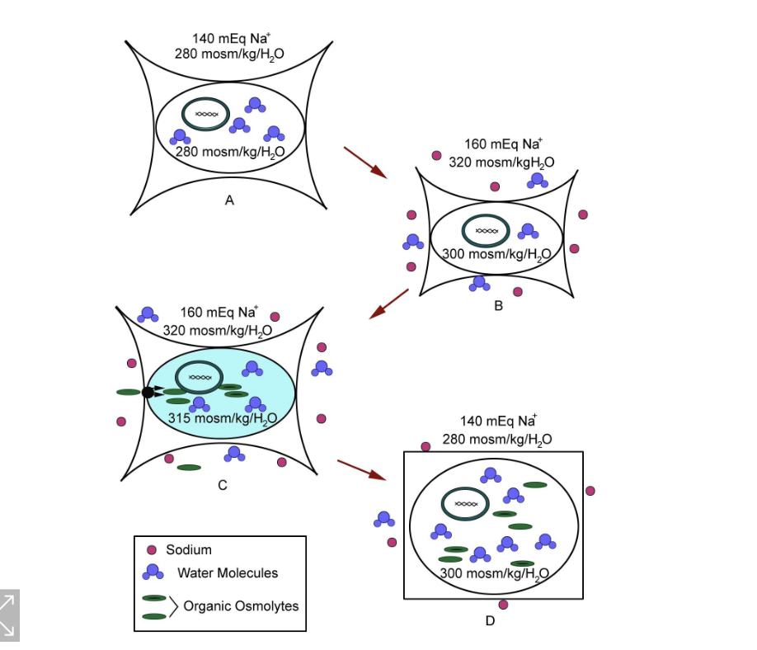
Hypernatremia
Acute symptomatic hypernatremia , occurs in less than 24 hours, should be corrected rapidly
Chronic (> 48 hrs), should be corrected more slowly due to risk of cerebral edema during treatment

Slide 6
The normal plasma osmolality (Posm) lies between 275 and 290 mOsm/kg and is primarily determined by the concentration of sodium salts.
Calculated plasma osmolality: 2(Na) mEq/L + serum glucose (mg/dL)/18 + BUN (mg/dL)/2.8
Regulation occurs by two mechanisms
Changes in water intake → Thirst
Changes in water excretion → Secretion of AVP

Slide 7
AVP
The stimulus for AVP secretion is an activation of hypothalamic osmoreceptors, which occurs when the plasma osmolality reaches a certain threshold (approximately 280 mOsm/kg).
AVP binds to the V2 receptor located on the basolateral membrane of the principal cells of the renal collecting ducts.
G-protein coupled receptor → initiates a signal transduction cascade, leading to phosphorylation of aquaporin-2 and its translocation and insertion into the apical (luminal) membrane, creating "water channels" that enable the absorption of free water

Slide 8
Thirst :
Mediated by osmoreceptors located in the anteroventral hypothalamus.
The osmotic thirst threshold → approximately 288-295 mOsm/kg.
So effective that even in pathologic states in which patients are unable to concentrate their urine and excrete excessive amounts of urine (10-15 L/d), hypernatremia does not develop because thirst is stimulated and body fluid osmolality is maintained at the expense of profound secondary polydipsia

Slide 9
Causes of hypernatremia
Renal free water loss Diuretics (Loop and thiazide diuretics) Osmotic diuresis (Hyperglycemia, mannitol, urea, High protein tube feeding) Post obstructive diuresis Diuretic phase of acute tubular necrosis Extrarenal water loss GI → Vomiting, diarrhea, lactulose, cathartics, nasogastric suction, gastrointestinal fluid drains, fistulas Cutaneous → sweating, burn injuries Pure water deficits Water intake less than insensible losses may result from any of the following: Lack of access to water (through incarceration, restraints, intubation, immobilization) Altered mental status (through medications, disease) Neurologic disease (dementia, impaired motor function) Abnormal thirst (eg, geriatric hypodipsia; osmoreceptor dysfunction (reset of the osmotic threshold); injury to the thirst centers by any lesions to the hypothalamus, including from metastasis, granulomatous diseases, vascular abnormalities, and trauma; autoantibodies to the sodium-level sensor (Na _{x}) in the brain Loss of water through the respiratory tract | Nephrogenic diabetes insipidus Hypercalcemia Hypokalemia Lithium Pyelonephritis Medullary sponge kidney Multiple myeloma Amyloid Sarcoid Central Diabetes Insipidus Traumatic brain injury Pituitary tumour Meningitis Encephalitis Tuberculosis Sarcoidosis Idiopathic Hypertonic sodium gain Administration of hypertonic electrolyte solutions - Eg, sodium bicarbonate solutions, hypertonic alimentation solutions, normal saline with or without potassium supplements Sodium ingestion - NaCl tablets, seawater ingestion Sodium modeling in hemodialysis

Slide 10
Treatment of hypernatremia
Recommendations are as follows:
Establish documented onset (acute, < 24 h; chronic, >24h)
In acute hypernatremia, correct the serum sodium at an initial rate of 2-3 mEq/L/h (for 2-3 h) (maximum total, 12 mEq/L/d).
Measure serum and urine electrolytes every 1-2 hours
Perform serial neurologic examinations and decrease the rate of correction with improvement in symptoms
Chronic hypernatremia with no or mild symptoms should be corrected at a rate not to exceed 0.5 mEq/L/h and a total of 8-10 mEq/d (eg, 160 mEq/L to 152 mEq/L in 24 h).
If a volume deficit and hypernatremia are present, intravascular volume should be restored with isotonic sodium chloride prior to free-water administration

Slide 11
Free water deficit calculation
Adrogue Madias
TBW = Body weight * correction factor
Correction factor is
Adult male: 60% (0.6)
Adult female: 50% (0.5)
Elderly male: 50% (0.5)
Elderly female: 45% (0.45)
Child: 60% (0.6)
Free water deficit = TBW * Current sodium/ Ideal sodium -1)
Change in serum Na⁺ = (infusate Na⁺ - serum Na⁺) ÷ (TBW + 1)

Slide 12
Free water replacement
Common infusates and their Na⁺ contents
Infusate | Sodium concentration (mmol/litre)
D5 water | 0
¼ Normal saline | 34
½ Normal saline | 77
Ringer’s lactate | 130
Normal saline | 154

Slide 13
Free water replacement
In stable patients with chronic hypernatremia, increased enteral free water may be sufficient to correct free water deficit
Most patients, however require parenteral free water replacement with goal
Half of free water deficit in the first 24 hrs
Remaining free water deficit over next 48 hrs

Slide 14
Questions
Calculate the free water deficit for a male patient with hypernatremia with serum sodium of 160mmol/L. (Ideal sodium is 140mmol/L)
What should be the volume of 5% dextrose needed to correct the serum sodium to 140 mmol/L?

Slide 15
Other recommendations
If hypernatremia is accompanied by hyperglycemia with diabetes, when using a glucose-containing replacement fluid, the appropriate use of insulin will help during correction
In hypervolemic and hypernatremic patients who have an impaired renal excretion of sodium and potassium , an addition of a loop diuretic to free water boluses increases renal sodium excretion.
Fluid loss during loop diuretic therapy must be restored with the administration of fluid that is hypotonic to the urine
Once hypernatremia is corrected, treat the underlying cause
Such efforts may include free access to water and better control of diabetes mellitus.
Correction of hypokalemia and hypercalcemia as etiologies for nephrogenic diabetes insipidus may be required. Vasopressin (AVP, DDAVP) should be used for the treatment of central diabetes insipidus.

Slide 16
Hyponatremia
Serum sodium concentration <135 meq/litre
Most common electrolyte abnormality (Prevalence in ICU → 34.3%)
Mild: 130-134 mmol/L
Moderate: 125-129 mmol/L
Profound or severe: < 125 mmol/L
Hypo-osmolality (serum osmolality < 275 mOsm/kg) always indicates excess total body water relative to body solutes
Solute depletion, solute dilution, or a combination of both

Slide 17
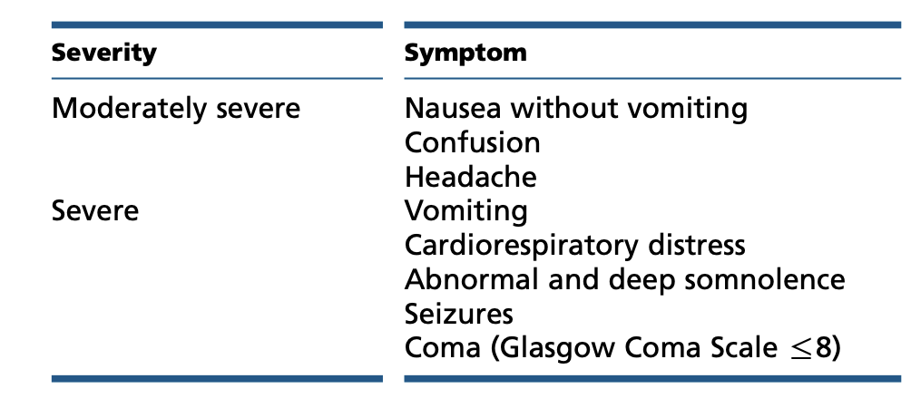

Slide 18
When there is an acute drop in the serum osmolality, neuronal cell swelling occurs due to the water shift from the extracellular space to the intracellular space (ie, Starling forces).
Swelling of the brain cells elicits the following two osmoregulatory responses:
It inhibits both arginine vasopressin secretion from neurons in the hypothalamus and hypothalamic thirst center. This leads to excess water elimination as dilute urine.
There is an immediate cellular adaptation with loss of electrolytes, and over the next few days, a more gradual loss of organic intracellular osmolytes

Slide 19
Euvolemic | Hypovolemic | Hypervolemic
Low urinary sodium | Low urinary sodium | Low urinary sodium
 | Sodium preservation, an appropriate reaction to low blood volume by the kidneys | Inappropriate water retention due to apparent hypovolemia
 | Hypovolemia | Congestive heart failure
 | Vomiting | Cirrhosis
Psychogenic polydipsia | Diarrhea | Nephrotic syndrome
Beer potomania | Blood loss
 | Excessive sweating
 | Burns
 | Pancreatitis
High urinary sodium | High urinary sodium | High urinary sodium
Hypothyroidism | Sodium wasting, the kidneys are responsible in some way | Inappropriate sodium excretion; Usually because the nephron fails at reclaiming sodium
Glucocorticoid deficiency | Thiazide diuretics | Acute renal failure
Hypoadrenalism | Aldosterone deficinecy | Chronic renal failure
SIADH | Renal tubular acidosis
Hypoadrenalism | Cerebral salt wasting
 | OSmotic diuresis
 | Ketonuria
 | Bicarbonate wasting in metabolic alkalosis

Slide 20
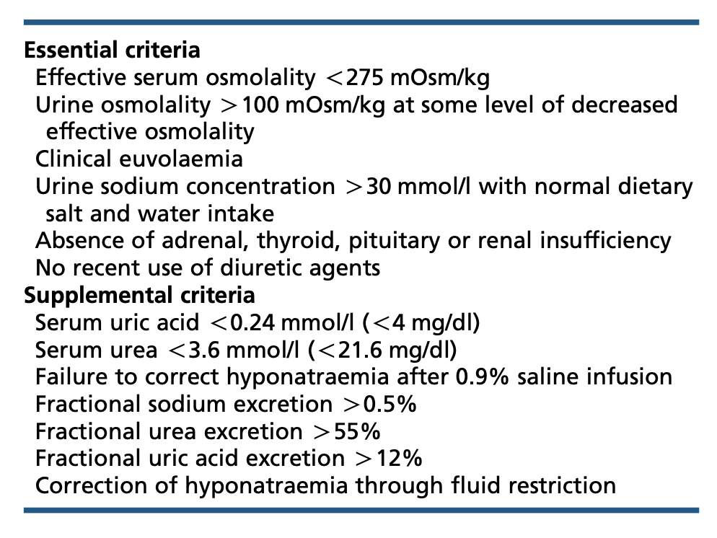
Hyponatremia diagnosis
Diagnosis of SIADH
Normo- osmolar hyponatremia typically occurs due to high triglycerides, high serum protein, and use of glycine (TURP syndrome)
Hyperosmolar hyponatremia occurs due to hyperglycemia, mannitol, sorbitol, maltose, and radiocontrast dye

Slide 21
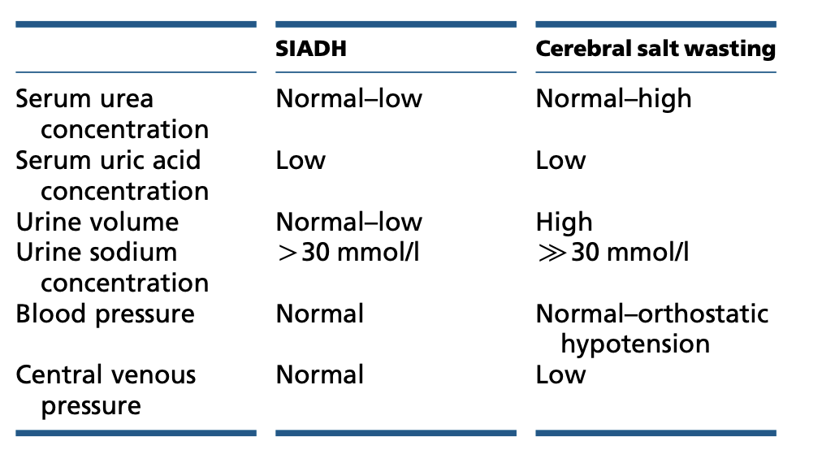

Slide 22
Treatment of hyponatremia
European guidelines

Slide 23
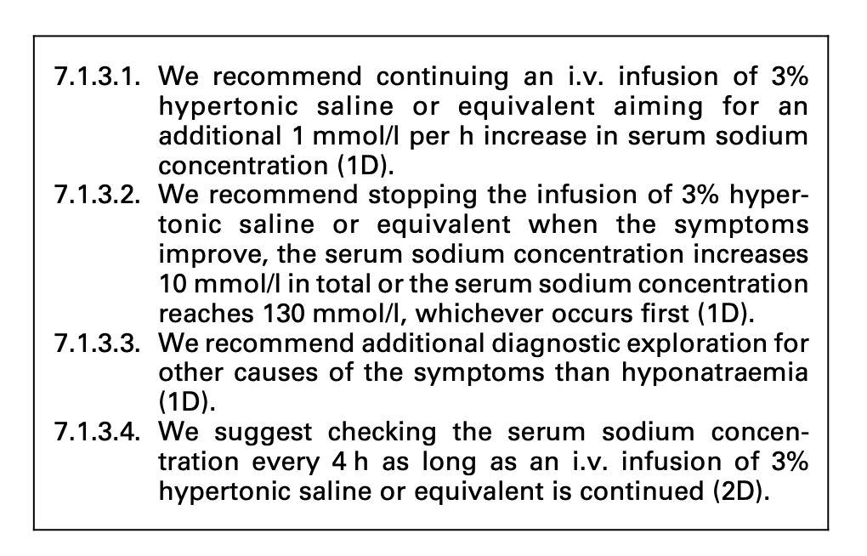
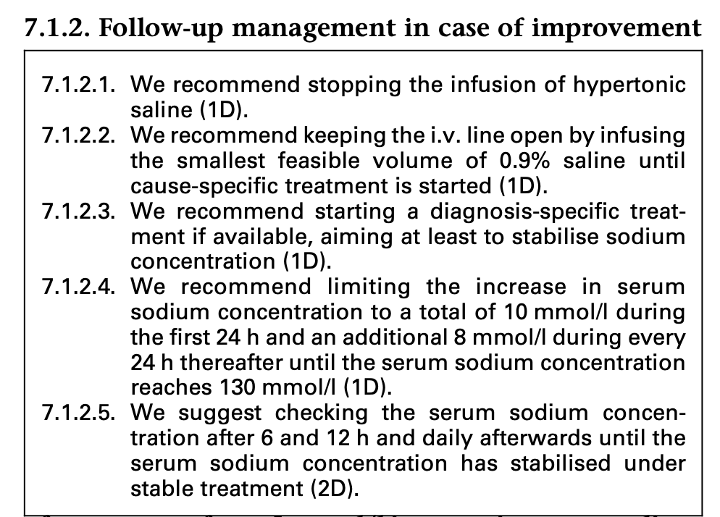
Follow-up management in case of no improve- ment of symptoms after a 5 mmol/l increase in serum sodium concentration in the first hour, regardless of whether hyponatraemia is acute or chronic

Slide 24
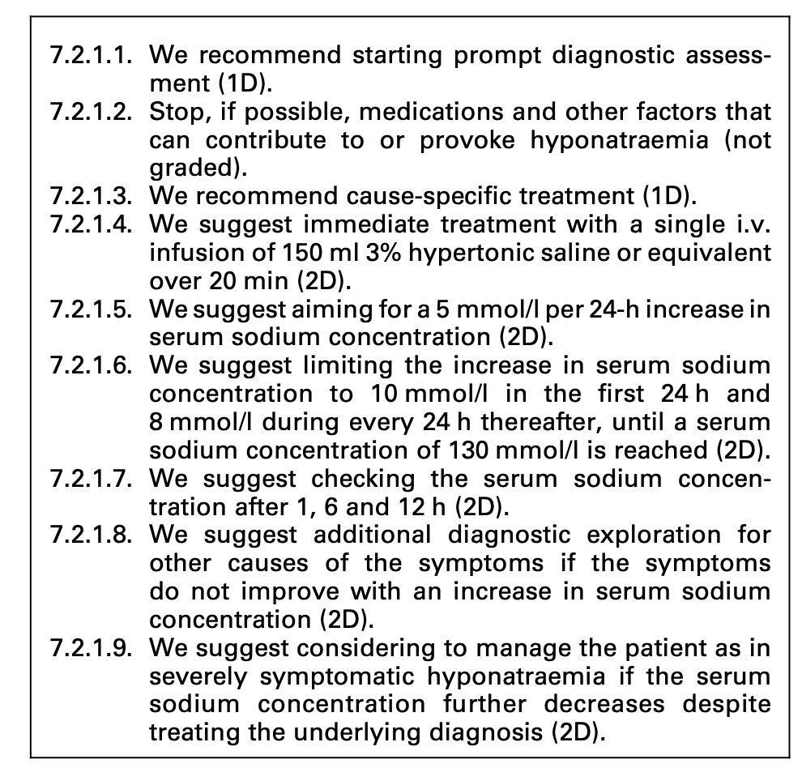
Moderately severe symptoms

Slide 25
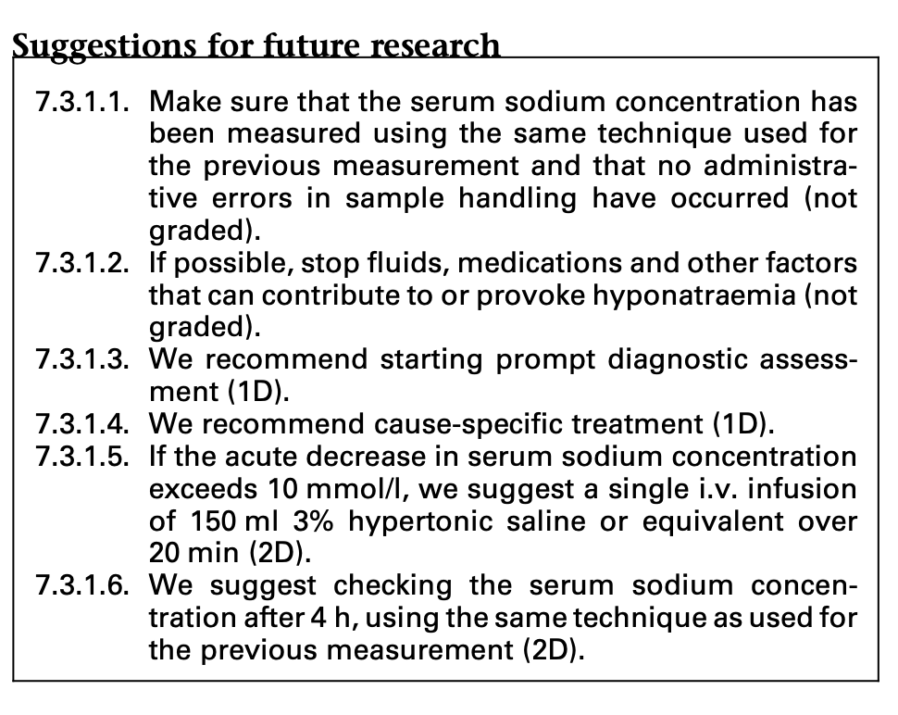
Acute hyponatremia without severe or moderately severe symptoms

Slide 26
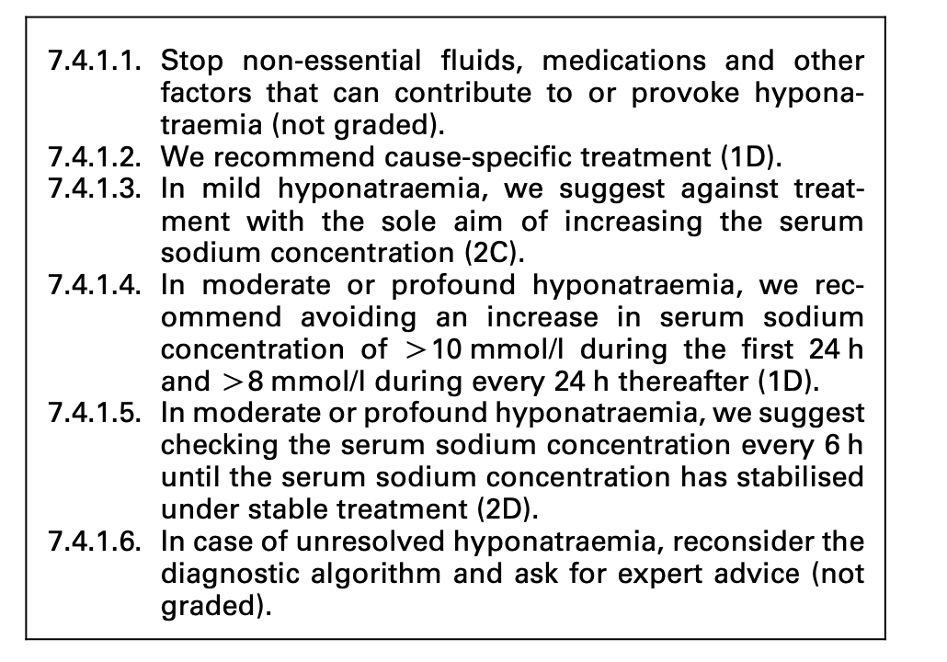
Chronic hyponatremia

Slide 28
Managing overcorrection of chronic hyponatremia
Infusion containing electrolyte free water (10ml/kg) over 1hour with or without 2mcg desmopressin IV every 8 hours
Management of hypovolemic hyponatremia:
Isotonic saline or balanced solution at 0.5 to 1ml/kg/hr
Managment of euvolemic hyponatremia
Fluid restriction (first line)
Urea or loop diuretics + oral nacl (second line)
Do not recommend vaptans
Lithium or demeclocycline is not recommended
Management of hypervolemic hyponatremia
Fluid restriction. Recommend against vaptans or demeclocycline

Slide 29
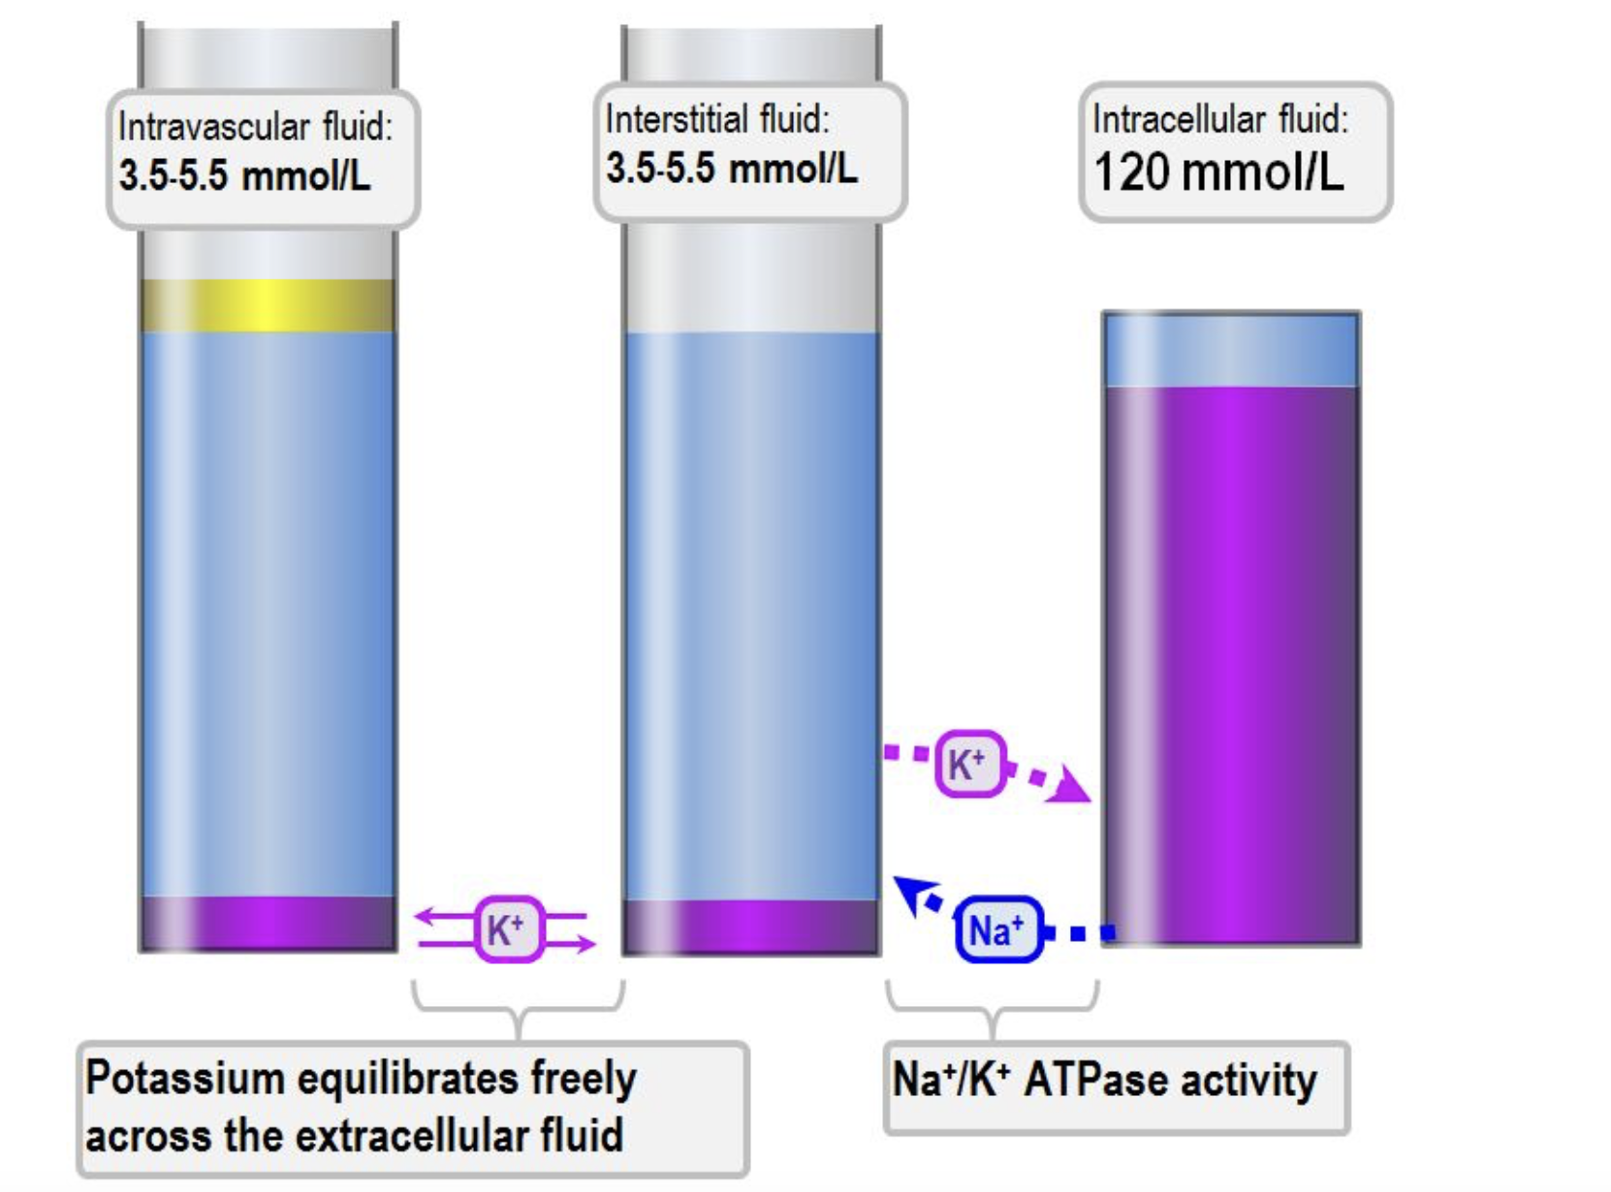
Potassium physiology
40mmol/Kg of potassium. A 70kg male has about 2800mmol, or about 109g of potassium.
Of this, 90% is in the intracellular fluid. This is the only exchangeable potassium.
Extracellular fluid contains 2% of the total body potassium, and bone contains 8%

Slide 30
Regulation of potassium
Intake is not regulated (passive paracellular gut absorption)
Renal elimination is 95% of the total daily potassium excretion.
Transcellular flux maintains homeostasis of the ECF potassium concentration
Physiological role of potassium:
Maintenance of intracellular fluid tonicity / regulation of cell volume
Maintenance of resting membrane potential
Responsible for the excitability of excitable tissues, action potentials etc
Structural function (incorporated into bone, ribosomes, DNA and RNA)
Intracellular and extracellular messenger function (mediator of nociception, inflammation, vasodilation)
Elimination is influenced by:
Oral potassium intake
Produces immediate kaliuresis; intestinal K+sensor is implicated
Aldosterone
Increases renal elimination by increasing the activity of ENaC channels in the nephron
Increases GI elimination in colon (5% of total)
High potassium intake: leads to the increased expression of ROMK channels
High distal sodium delivery: compensatory increase in potassium secretion to maintain electroneutrality.
Acid-base disturbances: metabolic acidosis causes distal potassium secretion to decrease

Slide 31
Hyperkalemia
Artefactual and spurious Delay in separating RBCs Hemolysis High platelet count Excessive potassium intake Blood transfusion Iatrogenic (eg; Infusion) Dietary salt substitutes – Several “no-salt” or “low-salt” substitutes contain about 10-12 mEq of potassium per gram and can be dangerous, especially with diminished kidney function Penicillin G potassium therapy Disorders that can cause type IV renal tubular acidosis, resulting in hyperkalemia, include the following: Diabetes mellitus Sickle cell disease or trait Lower urinary tract obstruction Adrenal insufficiency Primary Addison syndrome due to autoimmune disease, tuberculosis, or infarct Enzyme deficiencies Genetic disorders | Decreased Excretion Potassium sparing diuretics like spironolactone, triamterene, amiloride ACE inhibitors Angiotensin receptor blockers Cyclosporine or tacrolimus Pentamidine Trimethoprim- sulfamethaxazole Mineralocorticoid receptor antagonists NSAIDS Heparin Ketoconazole Hypoadrenalism Renal failure Compartment shift Acidosis Betadrenergic blockade Acute tubular necrosis Electrical burns Thermal burns Cell depolarisation Head trauma Digoxin overdose Fluoride toxicity Cyclosporine Methotrexate Propofol infusion syndrome Rhabdomyolysis Tumor lysis syndrome Succinylcholine Insulin deficiency Hyperkalemic periodic paralysis

Slide 32
Clinical features of hyperkalemia
Neurological effects Paraesthesia Weakness and flaccid paralysis (Diaphragm is usually spared) Loss of reflexes Normal cranial nerves Normal sensory function Biochemical abnormalities Normal anion gap metabolic acidosis (due to decreased renal ammoniagenesis) Cardiovascular effects Hypotension Bradycardia | ECG changes 5.5-6.5 mEq/L. Peaked T waves with a narrow base, best seen in precordial leads ; shortened QT interval; and ST-segment depression. 6.5-8.0 mEq/L, in addition to peaked T waves, the ECG shows the following: Prolonged PR interval Decreased or disappearing P wave Widening of the QRS Amplified R wave Higher than 8.0 mEq/L, Absence of P wave progressive QRS widening, and Intraventricular/fascicular/bundle-branch blocks. The progressively widened QRS eventually merges with the T wave, forming a sine wave pattern. Ventricular fibrillation or asystole

Slide 33
Management of hyperkalemia
Correct Serious Conduction Abnormalities (Calcium)
Calcium is a very useful agent. It does not lower the serum potassium level, but instead is used to stabilise the myocardium, as a temporising measure. Calcium is indicated if there is widening of QRS, sine wave pattern (when S and T waves merge together), or in hyperkalaemic cardiac arrest.
The ‘cardiac membrane stabilising effects’ take about 15-30mins.
Calcium Chloride
Dose: Calcium Chloride 10% 5-10mL
3 x more potent than Calcium gluconate
Complication: severe thrombophlebitis
Calcium Gluconate:
Dose: Calcium gluconate 10% 5-10mL
Less potent, less irritating to veins
Potential Complications of Calcium administration
Bradycardia, hypotension and peripheral vasodilation
Generally these occur if administered too quickly
Avoid in digoxin toxicity (use magnesium as alternative)

Slide 34
Management of hyperkalemia
2. Drive Potassium into the Cell:
Insulin & Glucose
Dose: IV fast acting insulin (actrapid) 10-20 units and glucose/dextrose 50g 25-50ml
Insulin drives potassium into cells and administering glucose prevents hypoglycaemia.
Begins to work in 20-30mins reduces potassium by 1mmol/L and ECG changes within the first hour
Sodium Bicarbonate
Dose: 50- 200mmol of 8.4% Sodium Bicarbonate
Bicarbonate is only effective at driving potassium intracellularly if the patient is acidotic
Begins working in 30-60 minutes and continues to work for several hours.
Salbutamol
Dose: 10-20mg via nebulizer
Beta 2 agonist therapy lower K via either IV or nebulizer route.
Salbutamol can lower potassium level 1mmol/L in about 30 minutes, and maintain it for up to 2 hours.
Very effective in renal patients that are fluid overloaded
3.

Slide 35
3. Eliminate Potassium From the Body:
Calcium resonium
Dose: 15-45g orally or rectally, mixed with sorbitol or lactulose
Calcium polystyrene sulfonate is a large insoluble molecule that binds potassium in the large intestine, where it is excreted in faeces
Effects take 2-3 hours
Frusemide
Dose: 20-80mg depending on hydration status
Potassium wasting diuretic. Helps to urinary excrete potassium in conjunction with hydration or fluid overloaded patients
Normal Saline
Used to help renally excrete potassium, by increasing renal perfusion and urinary output. Cautious use in patients with renal & heart failure
Dialysis
Is the gold standard for removing potassium from the body. Provides immediate and reliable removal.
Can lower potassium by 1mmol/L in first hour and another 1mmol/L over the next 2 hours.

Slide 36
Hypokalemia
Increased excretion Mineralocorticoid excess (endogenous or exogenous) Hyperreninism from renal artery stenosis Osmotic diuresis: Mannitol and hyperglycemia can cause osmotic diuresis Increased gastrointestinal losses Drugs Genetic disorders Gastrointestinal losses, Diarrhea Vomiting, or Nasogastric suctioning Vomiting leads to hypokalemia via a complex pathogenesis. Gastric fluid itself contains little potassium, approximately 10 mEq/L. It produces volume depletion and metabolic alkalosis Volume depletion leads to secondary hyperaldosteronism, which in turn leads to enhanced cortical collecting tubule secretion of potassium in response to enhanced sodium reabsorption. Metabolic alkalosis also increases collecting tubule potassium secretion due to the decreased availability of hydrogen ions for secretion in response to sodium reabsorption. | Endogenous sources of excess mineralocorticoid include the following: Cushing syndrome Primary hyperaldosteronism, most commonly from an adrenal adenoma or bilateral adrenal hyperplasia Seco;o//p;l.ondary hyperaldosteronism from volume depletion, congestive heart failure, cirrhosis, or vomiting Tumor that is producing adrenocorticotropic hormone Genetic disorders Exogenous causes of mineralocorticoid excess include the following: Steroid therapy for immunosuppression Glycyrrhizic acid - Inhibits 11-beta hydroxysteroid dehydrogenase; contained in licorice and Chinese herbal preparations Renal tubular disorders - Type I and type II renal tubular acidosis Hypomagnesemia Extracellular/intracellular shift Intracellular shifts of potassium often are episodic and frequently are self-limited, as, for example, with acute insulin therapy for hyperglycemia. Alkalosis (metabolic or respiratory) Insulin administration or glucose administration (the latter stimulates insulin release) Intensive beta-adrenergic stimulation Hypokalemic periodic paralysis Thyrotoxic periodic paralysis Refeeding: This is observed in prolonged starvation, eating disorders, and alcoholism Hypothermia There is a high prevalence of hypokalemia in patients with severe COVID-19 disease

Slide 37
Hypokalemia
Drugs that can cause hypokalemia include the following: Diuretics (carbonic anhydrase inhibitors, loop diuretics, thiazide diuretics): Increased collecting duct permeability or increased gradient for potassium secretion can result in losses Methylxanthines (theophylline, aminophylline, caffeine) Verapamil (with overdose) Quetiapine (particularly in overdose) Ampicillin, carbenicillin, high-dose penicillins Bicarbonate Antifungal agents (amphotericin B, azoles, echinocandins) ^{[21, 22]} Gentamicin Cisplatin Ephedrine (from Ephedra; banned in the United States, but available over the Internet) ^{[23]} Beta-agonist intoxication | Genetic disorders The following genetic disorders may result in hypokalemia: Congenital adrenal hyperplasia (11-beta hydroxylase or 17-alpha hydroxylase deficiency) Glucocorticoid-remediable hypertension Bartter syndrome Gitelman syndrome Liddle syndrome Gullner syndrome Glucocorticoid receptor deficiency Hypokalemic periodic paralysis Thyrotoxic periodic paralysis (TTPP) Seizures, sensorineural deafness, ataxia, mental retardation, and electrolyte imbalance (SeSAME syndrome)

Slide 38
Physical examination findings
Weakness
Decreased muscle tone
Complications of prolonged hypokalemia
Rhabdomyolysis
Polyuria due to nephrogenic DI
Features of History
Ileus
Failure to wean from ventilation
Coma
ECG findings
Ventricular tachycardia: classically, torsades de pointes
Atrial tachycardias
PR interval prolongation (>200 msec)
P wave amplitude increased (>2.5 mm in limb leads, >1.5 mm in chest leads)
P wave width increased (>120 msec)
u-waves
T-wave inversion
Ectopics (ventricular and atrial)

Slide 39
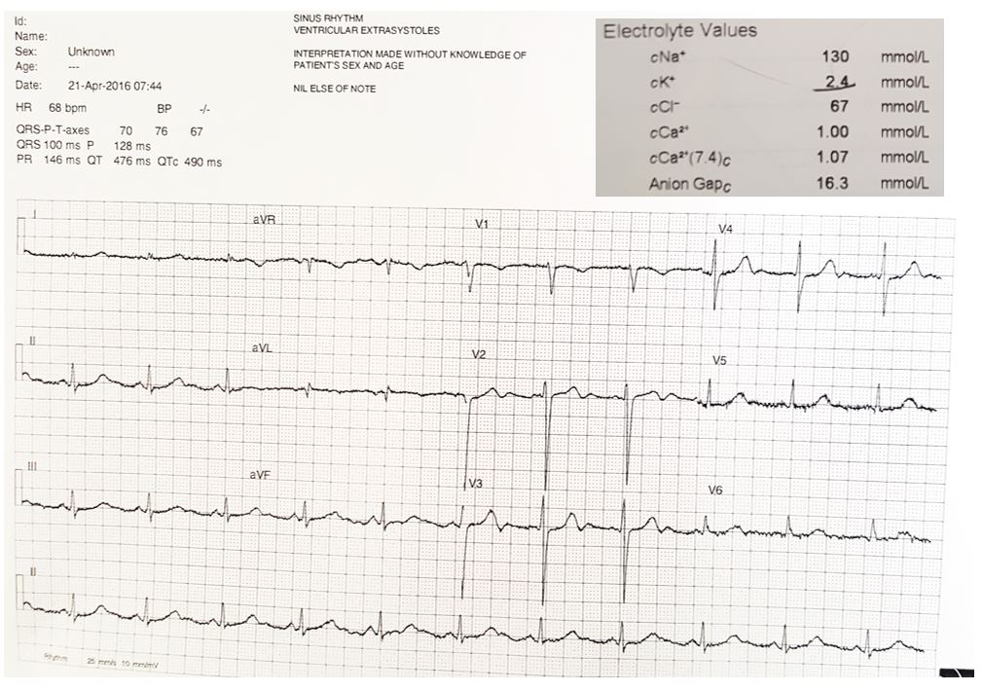

Slide 40
Treatment
Reduction of potassium losses
Replenishment of potassium stores
Evaluation for potential toxicities
Determination of the cause to prevent future episodes
Decreasing Potassium Losses
Measures to identify and stop ongoing losses of potassium include the following:
Discontinue diuretics/laxatives
Use potassium-sparing diuretics if diuretic therapy is required (eg, severe heart failure)
Treat diarrhea or vomiting
Administer H2 blockers to patients receiving nasogastric suction
Control hyperglycemia if glycosuria is present
Replenishment of Potassium
For every 1 mEq/L decrease in serum potassium, the potassium deficit is approximately 200-400 mEq.
this calculation could either overestimate or underestimate the true potassium deficit
Eg: do not overcorrect potassium in patients with periodic hypokalemic paralysis. This condition is caused by transcellular maldistribution, not by a true deficit.

Slide 41
Mild to moderate
Capsules or tablets: 40-100 mEq PO qDay in divided doses; single dose not to exceed 25 mEq to minimize GI discomfort
Oral solution: 40-100 mEq PO qDay in 2 to 5 divided doses; limit single doses to 40 mEq/dose; not to exceed 200 mEq/24hr
Aternatively, 10-20 mEq PO BID/QID (20-80 mEq/day)
Severe hypokalemia
40 mEq PO TID/QID; may also administer 20 mEq PO BID/TID in addition to IV potassium administration with careful monitoring; doses >40 mEq are typically not well tolerated orally, resulting in GI irritation and nausea
IV intermittent infusions
≤10 mEq/hr; repeat as needed based on lab values done frequently; central line infusion and continuous ECG monitoring recommended for infusions >10 mEq/hr
10 mEq of potassium chloride increases serum potassium levels by approximately 0.1 mEq/.L
Dosing based on serum potassium
2.5-3.5 mEq/L: 10 mEq/hr maximum infusion rate; 40 mEq/L maximum concentration; not to exceed 200 mEq dose/24hr
<2.5 mEq/L or symptomatic hypokalemia (excluding emergency treatment of cardiac arrest): 40 mEq/hr maximum infusion rate (central line only) in presence of continuous ECG monitoring and frequent lab monitoring; patients may require up to 400 mEq/24hr
Hypokalemia Prophylaxis: 20-40 mEq PO qDay or divided BID
be gupupuq{G#Yiy;5h84pw6’o iven. Maintain close follow-up care, provide continuous ECG monitoring, and check serial potassium levels.

Slide 42
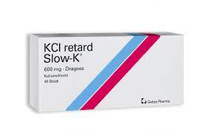
Composition of commonly used potassium supplements
Oral
Potassium chloride (KCl)
Most commonly used formulation.
Especially useful in patients with metabolic alkalosis (since potassium chloride will increase the serum chloride level).
Slow-release microencapsulated (wax-matrix) KCl formulations are suboptimal if an immediate effect is desired. However, they may be better tolerated with less emesis
Potassium citrate
Potassium citrate is equally effective as KCl for the repletion of potassium
Potassium citrate be useful in patients with nonanion-gap metabolic acidosis (NAGMA). The citrate will be converted into bicarbonate, thereby improving the acidosis.
Commonly contains 2 mEq of potassium per ml.

Slide 43
Why should we replace magnesium?
Magnesium is an important cofactor for the use of ATP by exchange pump Na -K - ATPase
Hypomagnesemia impairs Na- k - ATPase, decreases cellular uptake of potassium
Magnesium also decreases renal potassium excretion by influencing the action of the an inward rectifying k channel which is responsible for potassium flow into the lumen to maintain electroneutrality when ENAC channel reabsorbs sodium under the influence of aldosterone

Slide 44
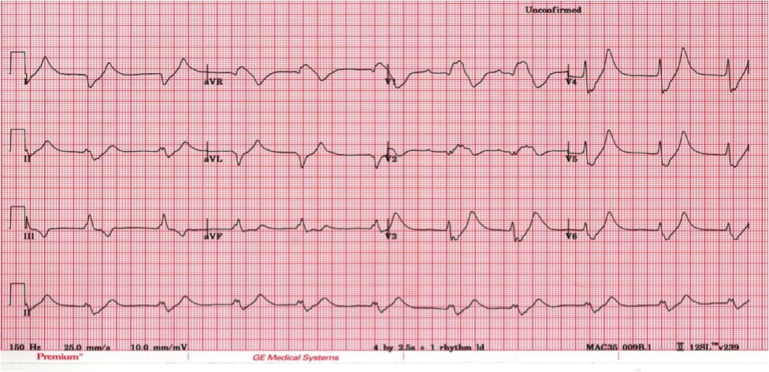
Question no. 3: What is the cause? How do you treat?

Slide 45
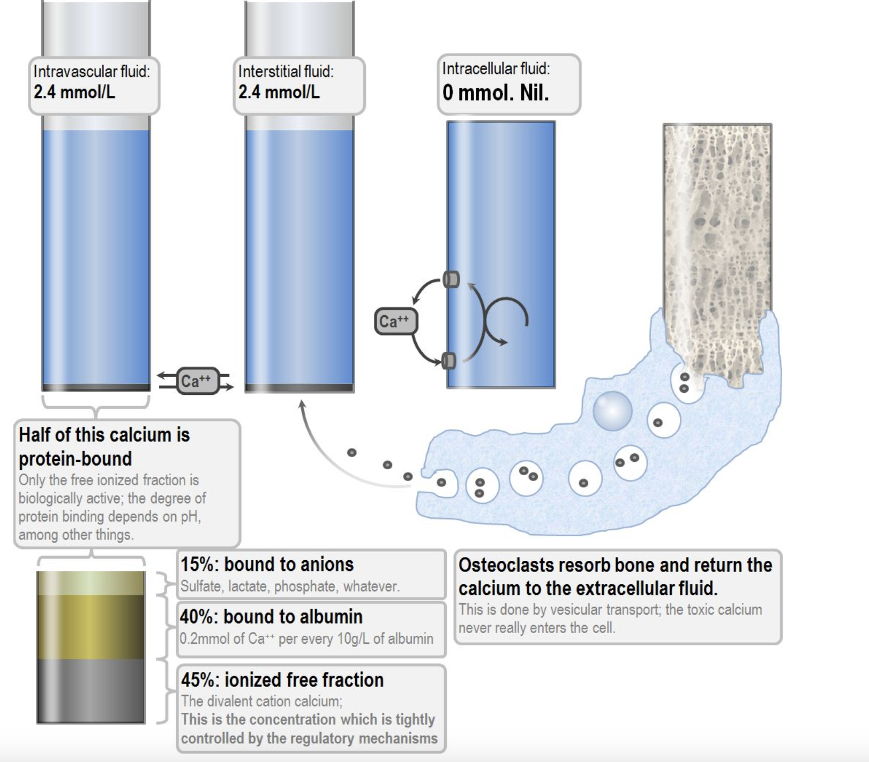
Calcium physiology
360mmol/ kg of calcium in the body → 25 moles of calcium
70 kg male has 25 moles of calcium or 1000 grams
99% in bone, 500mmol is exchanged between bone and ECF over a 24 hr period
30mmol of calcium is in the extracellular fluid, 7mmol is in the circulating blood
Intracellular calcium is minimal, it is an important second messenger
It is kept out of the cell actively by ATP powered pumps; It’s important for it to stay out because it is a second messenger

Slide 46
Calcium metabolism
Vitamin D
Group of related sterols
Cholecalciferol is formed in the skin -> in liver to 25-hyrdroxcholecalciferol -> in kidney proximal tubules to 1,25-dihydroxycholecalciferol -> this then helps calcium Absorption in the intestine.
Controlled by parathyroid hormone
-> increases intestinal absorption of Ca2+ -> increases renal Ca2+ reabsorption -> mobilises bone Ca2+ and PO43
Parathyroid hormone
secretion increased by hypocalaemia & hypomagnesaemia
secretion decreased by hypercalcaemia & hypermagnesaemia
-> mobilses Ca2+ from bone -> increases renal Ca2+ reabsorption -> increases renal PO43 excretion -> increases formation of 1, 25-dihyroxycholecalciferol.
Calcitonin
antagonist of parathyroid hormone
secreted by the parafollicular cells of the thyroid gland in response to: – hypercalcaemia – catecholamines – gastrin
-> inhibits the mobilisation of bone Ca2+ -> increases renal Ca2+ and PO43- excretion

Slide 47
Calcium disorders
Effective serum calcium concentration in a critically ill patient is best determined by ionised calcium concentration
For every change in albumin by 1gram/dl, the total calcium concentration changes by 0.8 mg/dl
Highly regulated cation
An important second messenger
Involved in: cell death, duration and strength of cardiac muscle contraction, muscle contraction in blood vessels, airways and uterus, coagulation, bone metabolism, neurotransmitter and hormone release
Ionized Ca2+ concentration is inversely related to pH -> an increase in pH results in a decrease in ionized Ca2+

Slide 48
Causes of hypercalcemia
PTH mediated hypercalcemia increased calcium absorption from the intestine. Non PTH mediated hypercalcemia Hypercalcemia associated with malignancy: Generally worsens until therapy is provided Result of increased osteoclastic activity within the bone. Two mechanisms Extensive localized bone destruction may result from osteolytic metastasis of solid tumors. Malignant cells may release local osteoclastic activating factors. PTH related protein This protein is a humeral factor that acts on the skeleton to increase bone reabsorption; it acts on the kidney to decrease excretion of calcium. The gene that produces this protein is present in many malignant tissues. | Granulomatous disorders: High levels of calcitriol may be found in patients with sarcoidosis and other granulomatous diseases. the increased level of calcitriol results from production within the macrophages, which constitute a large portion of some granulomas. Iatrogenic: In some cases, elevation of calcium is a known adverse effect of appropriate dosage. In other cases, large ingestions must be taken to induce the increase in calcium levels. Obtain a complete review of current medications for patients presenting with hypercalcemia. Record any vitamin use Neoplasms (nonparathyroid) - Metastasis to the bone from breast, multiple myeloma, and hematologic malignancies (Breast cancer is one of the most common malignancies responsible for hypercalcemia.) Nonmetastatic (humoral-induced) - Ovary, kidney, lung, head and neck, esophagus, cervix, lymphoproliferative disease, multiple endocrine neoplasia, pheochromocytoma, and hepatoma Pharmacologic agents - Thiazide, calcium carbonate (antacid), hypervitaminosis D, hypervitaminosis A, lithium, milk-alkali syndrome, and theophylline toxicity Endocrinopathies (nonparathyroid) - Hyperthyroidism, adrenal insufficiency, and pheochromocytom Familial hypocalciuric hypercalcemia Tertiary hyperparathyroidism - Post renal transplant and initiation of chronic hemodialyis

Slide 49
Clinical manifestations of hypercalcemia
Cardiovascular Shortened QT interval on ECG Arrhthymias (rare unless on digitalis) Bradycardia Hypertension Bundle branch/AV blocks Neuromuscular Emotional lability Confusion Delirium Psychosis Stupor Muscle weakness Headache Seizures (rare) | Renal Polyuria Polydispsia Nocturia Hypercalciuria Nephrolithiasis Nephrocalcinosis Renal failure Gastrointestinal Nausea/vomiting Anorexia Constipation Abdominal pain Peptic ulcers Pancreatitis Skeletal Bone pain/arthralgia Osteopenia/osteoporosis in cortical bone (often seen in wrist)

Slide 50
Hypercalcemia treatment
Dilute serum calcium
Rehydration with IV fluids
Decrease calcium resorrtion from bone
Calcitonin
Bisphosphonates
Gallium nitrate
Mithramycin (for malignant disease)
Decrease calcium resorption from the renal tubules
Loop diuretics (this has fallen out of favour)
Calcitonin
Decrease calcium absorption from the gut
Corticosteroids (also they decrease the 1,25-dihydroxyvitamin D production by monocytes within granulomae)
Forcibly remove excess calcium from the circulation
Haemodialysis
EDTA administration (as chelating agent)

Slide 51
Causes of hypocalcemia
Low parathyroid hormone Primary hypoparathyroidism (i.e. destruction of the parathyroid glands) Surgical: post-operative hypoparathyroidism Autoimmune Storage disease, eg. haemochromatosis or Wilsons'\ HIV infection Dysregulation of PTH secretion Congenital Hypomagnesemia Sepsis | High or normal parathyroid hormone Vitamin D deficiency "True" deficiency (i.e. malabsorption or inadequate UV light) Insufficient synthesis (eg. renal failure) Altered protein binding Alkalosis PTH resistance Hypomagnesemia Chelation or depletion Hyperphosphataemia Tumour lysis syndrome (which causes hyperphosphataemia) Acute pancreatitis Depletion in coagulopathy Consumption by osteoclastic bone metastases Drugs Phenytoin Fluoride toxicity Foscarnet EDTA Citrate Phosphate Bisphosphonates

Slide 52
Clinical features of hypocalcemia
Mild hypocalcemia
Generalised myalgia
Twitching, fasciculations
QT prolongation
Chvostek’s sign
Confusion, delirium, psychosis
Severe hypocalcemia
Carpopedal spasm (Trousseau’s sign)
Tetany and seizures
Papilloedema, raised intracranial pressure
Cardiac arrhythmias, esp. Torsades
Hypotension

Slide 53
Hypocalcemia treatment
Control the underlying disease
If mild symptoms only, give enteral calcium
If severe symptoms, give parenteral replacement
10ml of 10% cacl2
1ml cacl2 = 27.2 mg ca
1ml calcium gluconate = 9.3 mg ca
May require vitamin D supplementation

Slide 54
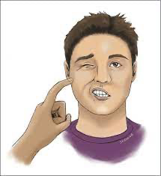
Question no.4: What is this?

Slide 55
Magnesium
1.5 to 2.5mg/dl
Forgotten cation
second-most abundant intracellular cation
Role in many functions of the cell, including energy transfer, storage, and use; protein, carbohydrate, and fat metabolism; maintenance of normal cell membrane function; and the regulation of parathyroid hormone (PTH) secretion.
Lowers blood pressure and alters peripheral vascular resistance.
Almost all enzymatic processes using phosphorus as an energy source require magnesium for activation.
Involved in nearly every aspect of biochemical metabolism
Blocks neurosynaptic transmission by interfering with the release of acetylcholine.
May interfere with the release of catecholamines from the adrenal medulla.
Has been proposed as an endogenous endocrine modulator of the catecholamine component of the physiologic stress response.

Slide 56
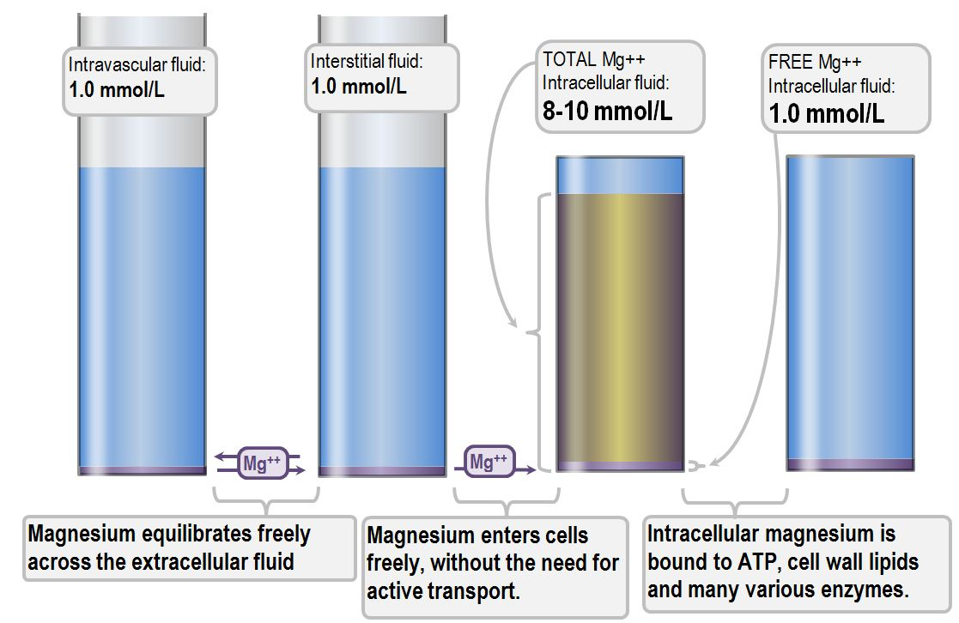
15mmol/ kg
70kg male → 1050mmol → 700g
60% locked in bone
39% intracellular, 1% extracellular (Only 10mmol)
40% of serum mg is protein bound

Slide 57
Hypomagnesemia
Increased Loss Gastrointestinal loss GIT fistulas Prolonged nasogastric suction Diarrhoea Pancreatitis Renal loss Renal tubular acidosis Diuretic phase of acute tubular necrosis Thiazide diuretics Loop diuretics Alcoholism Hypercalcemia Nephrotoxic drugs, eg. aminoglycosides, amphotericin, cyclosporin etc. Primary renal magnesium wasting (a congenital disorder) Sequestration and chelation Pancreatitis (saponification in fat) Post-operative (chelation with fatty acids) Post cardiopulmonary bypass (adsorption into circuit) Foscarnet (chelation) | Decreased intake Poor intake Fasted patient Improperly prescribed parenteral nutrition Poor absorption Malabsorption syndromes, eg. coeliac disease Short-bowel syndrome Weird congenital disorders of selective magnesium malabsorption Unclear association with low magnesium Hyperthyroidism Conn’s syndrome Diabetes mellitus Hyperaldosteronism

Slide 58
Clinical features
Symptoms Physical signs Confusion Delirium Tremors Seizures Tachyarrhythmias (particularly VT and VF) Tetany Chvostek sign Trousseau sign | ECG changes Widening QRS complexes Peaking T-waves (which vanish in very severe hypomagnesemia) Prolonged PR interval Associated biochemical abnormalities Hypokalemia, refractory to replacement Hypocalcemia Low parathyroid hormone levels (in spite of hypocalcemia) Low Vitamin D levels

Slide 59
Causes of hypermagnesemia
Increased intake Magnesium infusion Massive oral ingestion Unregulated absorption (eg. with peptic ulcer) Milk-alkali syndrome Compartment shift or leak Tumour lysis syndrome Rhabdomyolysis Acidosis (shift out of cells) | Decreased loss Renal failure Primary hyperparathyroidism (reabsorption in the tubule) Lithium therapy Hypoadrenalism Familial hypocalciuric hypercalcemia

Slide 60
Clinical features of hypermagnesemia
Serum magnesium level | Physiological effects
1.8 to 2.0 mmol/L | Antiarrhythmic effects Inhibition of parathyroid hormone secretion Ileus Hypocalcemia
2.0 to 4.0 mmol/ L | Hyporeflexia Muscle weakness Nausea Flushing Headache Lethargy, somnolence
4.0 to 6.0 mmol/ L | Respiratory failure Hypotension Bradycardia Decreased level of consciousness Bladder paralysis
6.0 to 10mmol/ L | Apnea Coma PArasympathetic blockade Complete heart block Cardiac arrest

Slide 61
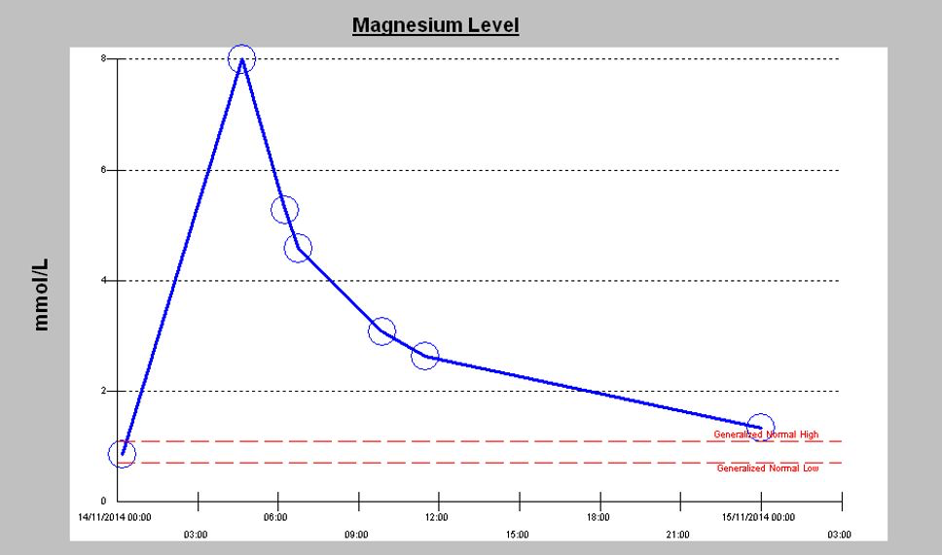
Management of hypermagnesemia
Renal clearance is so rapid that the concentration falls rapidly even from extremely toxic levels. However, in renal failure patients this is not going to happen, and alternative measures must be taken.
IV calcium as an antagonist to the ill effects of magnesium
Insulin and glucose to promote magnesium entry into cells
Haemodialysis

Slide 62
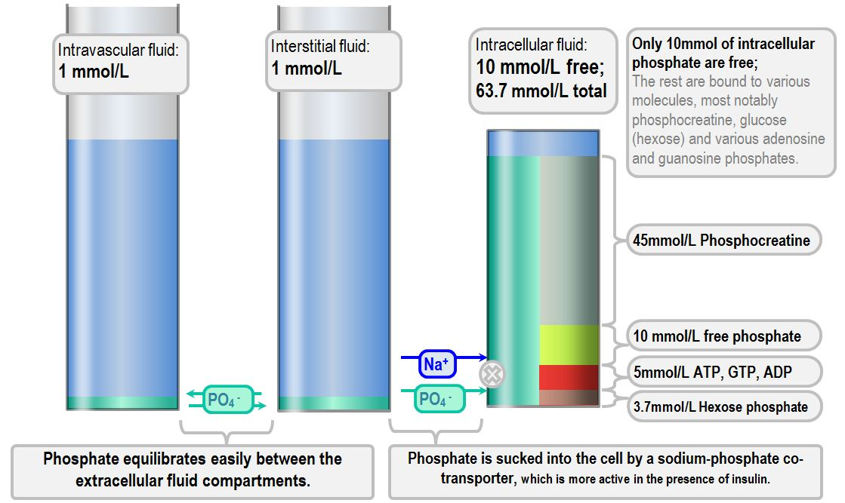
Phosphorous
Most abundant intracellular anion
Important intracellular buffer
320mmol/ kg
70 kg male → 22.5 moles = 700g
85% in bone as hydroxyapatite matrix

Slide 63
Excessive phosphate intake:
Excessive oral or rectal use of an oral phosphate-saline laxative
Excessive parenteral administration of phosphate
Milk-alkali syndrome
Vitamin D intoxication
Medications containing phosphorous
Paroxetine
Amlodipine
Lisinopril
Sitagliptin
Decreased phosphate excretion
Acute kidney injury or chronic kidney disease
Hypoparathyroidism
Pseudohypoparathyroidism
Severe hypomagnesemia
Tumoral calcinosis
Bisphosphonate therapy
Phosphate shift from intracellular to extracellular space
Rhabdomyolysis
Tumor lysis
Acute hemolysis
Acute metabolic or respiratory acidosis
Spurious
Blood sample taken from line containing heparin or alteplase
High concentrations of paraproteins [
Hyperbilirubinemia
In vitro hemolysis
Hyperlipidemia

Slide 64
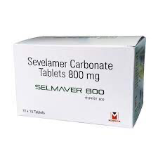
Management
Diagnosis of the cause
Limitation of phosphate intake
Enhancement of renal excretion of phosphate
Phosphate binders
Aluminum-containing phosphate binders
Calcium-containing phosphate binders
Phosphate binders that contain no aluminum or calcium →
Sucroferric oxyhydroxide (Velphoro)
Sevelamer (Renagel)
Lanthanum carbonate (Fosrenol)
Ferric citrate (Auryxia)

Slide 65
Hypophosphatemia
Serum phosphate < 2.5mg/dl
Transcellular shift | Renal loss | GI loss | Decreased intake
Acute alkalosis | Hyperparathyroidism | Malabsorption | Malnutrition
Carbohydrate | Diuretic use | Diarrhea | TPN
Drugs (insulin) | Hypokalemia | Intestinal fistulas
 | Hypomagnesemia | Antacids
 | Steroid

Slide 66
Hypophosphatemia
Clinical manifestations include
Muscle weakness, respiratory failure, paresthesias, lethargy, disorientation, coma and seizures
Associated symptoms include
Impaired renal tubular function, impaired vasopressor responses, hepatic dysfunction, immune dysfunction, hemolysis, impaired platelet function

Slide 67
Hypophosphatemia treatment
Control the underlying disease
If mild symptoms, give enteral phosphorous replacement
If severe symptoms, give parenteral phosphorous replacement
KH2PO4 – 10mmol of phosphate and 10mmol of K in 10mL
NaKH2PO4 – 13.4mmol of phosphate, 21.4mmol Na+, 2.6mmol K in 20mL
Frequent reevaluation of serum phosphorous levels is recommended
Phosphorous serum level <0.5 mg/dL: 0.5 mmol/kg IV infused over 4-6 hr
Phosphorous serum level 0.5-1 mg/dL: 0.25 mmol/kg IV infused over 4-6 hr
Prevention of hypophosphatemia (eg, in TPN): 20-40 mmol/day IV admixed in TPN is typical dose, but adjustment according to electrolyte levels is ongoing

Slide 68
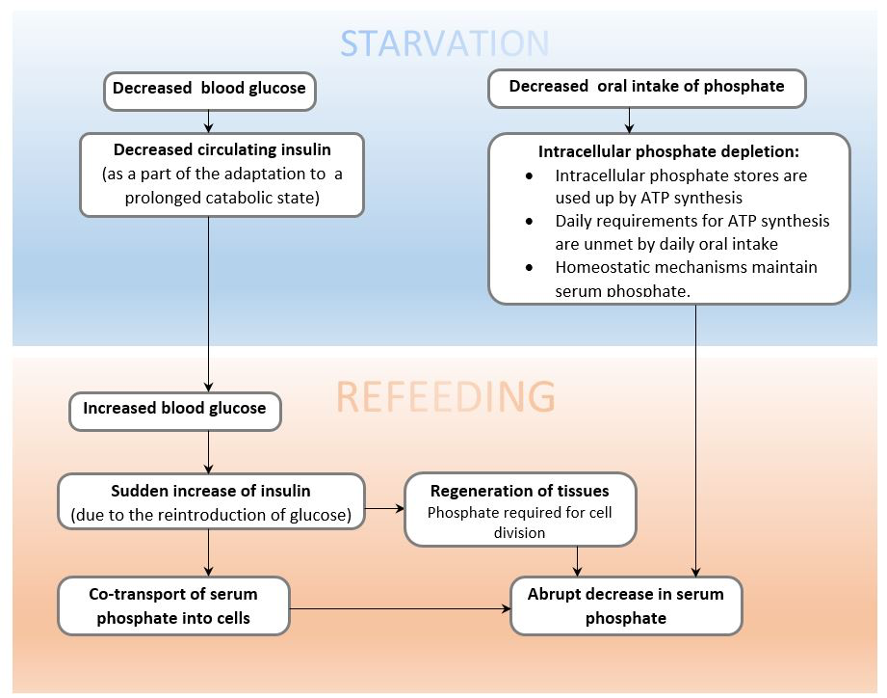

Slide 69
Question no.5
What are the three biochemical abnormalities that are associated with refeeding syndrome?

Slide 70
Metabolic acidosis
High anion gap MUD PILES Methanol and other toxic alcohols Uraemia Diabetic (or other ) ketoacidosis Pyroglutamic acidosis Iron overdose Lactic acidosis Ethylene glycol Salicylates | Normal anion gap PANDA RUSH Pancreatic secretion loss Acetazolamide Normal saline intoxication Diarrhea Aldosterone antagonists Renal tubular acidosis Ureteric diversion Small bowel fistula Hyperalimentation (TPN)

Slide 71
Diagnostic approach to metabolic acidosis
Calculate the anion gap: (Na+ + K+) - (Cl- + HCO3-)
The anion gap achieves a diagnostic classification of metabolic acidosis
A raised anion gap identifies unmeasured anions (eg. lactate, ketones, metabolic byproducts of toxic alcohols) as potential causes of the acidosis
A normal anion gap identifies changes in chloride and bicarbonate as causes of the metabolic acidosis
Calculate the delta ratio:
Delta ratio = (change in anion gap) / (change in bicarbonate)
The delta ratio quantifies the contribution to the acidosis of unmeasured anions and the chloride-bicarbonate balance
This way, mixed acid-base disorders may be revealed.
0.4 = normal anion gap metabolic acidosis
0.4-0.8 = mixed high and normal anion gap acidosis exists.
0.8-1.0 = purely due to a high anion gap metabolic acidosis*
1.0-2.0 = still purely a high anion gap metabolic acidosis
Over 2.0 = high anion gap acidosis with pre-existing metabolic alkalosis

Slide 72
3. Measure urinary electrolytes and calculate the urinary anion gap (for normal anion gap metabolic acidosis)
Urinary anion gap can be used to differentiate between gastrointestinal and renal causes for the normal anion gap metabolic acidosis.
A high urinary anion gap suggests that there is a renal cause for the acidosis (i.e. that chloride and ammonium excretion is inappropriately low)
A low or negative urinary anion gap suggests that there is an appropriate attempt to excrete chloride and ammonium, and that the cause of acidosis is extrarenal.
4. Measure the serum osmolality and calculate the osmolar gap
The osmolar gap will reveal whether there are osmotically active substances in the bloodstream which are not measured as a part of the normal biochemistry. These may be responsible for the raised anion gap metabolic acidosis.
The osmolar gap may narrow the list of differentials
The osmolar gap may be elevated even when no acidosis (eg. Mannitol)

Slide 73
Consequences of Metabolic Acidosis
Respiratory consequences:
Increased respiratory stimulus
Increased work of breathing
Right shift of the oxyhaemoglobin dissociation curve (i.e. a decreased affinity of haemoglobin for oxygen)
Cardiovascular consequences:
Decreased cardiac output
Increased propensity to arrhythmias
Decreased systemic vascular tone and arterial vasodilation
Decreased responsiveness to catecholamines
Pulmonary vasoconstriction
Neurological consequences:
Cerebral vasodilation, thus increased intracranial pressure

Slide 74
Electrolyte changes
Hyperkalemia
Hypercalcemia
Effects on renal function and fluid balance
Increased renal ammonia production
Increased renal tubular ammonia secretion
Thus, increased renal oxygen demand
Diuresis (eg. due to osmotic effect of "gap" anions)

Slide 75
Consequences of metabolic acidosis
Gastrointestinal consequences
Decreased stomach emptying
Nausea and vomiting
Decreased splanchnic perfusion
Haematological consequences
Coagulopathy (due to impaired clotting factor function) -
Impaired platelet aggregation (due to effects of hyperchloraemia)

Slide 76
Causes of lactic acidosis (Cohen Wood’s calssification
Type A lactic acidosis: impaired tissue oxygenation Shock: Circulatory collapse Regional ischaemia Severe hypoxia Severe anaemia Carbon monoxide poisoning Type B1 lactic acidosis, due to a disease state Malignancy: Thiamine deficiency Ketoacidosis/ HONK Septic shock Impaired hepatic or renal clearance Clinical features of ascites, encephalopathy, icterus, and deranged LFT D- Lactic acidosis | Type B2 drug-induced lactic acidosis Beta-2 adrenoceptor agonists Metformin Isoniazid Cyanide (and by extension nitroprusside) Xylitol, sorbitol, fructose Propofol The toxic alcohols eg. methanol Paracetamol Salicylates NRTIs (nucleoside reverse transcriptase inhibitors) Type B3 : inborn errors of metabolism Numerous possible defects: Pyruvate dehydrogenase deficiency Electron transport chain enzyme defects G6PD

Slide 77
Mechanisms responsible for lactic acidosis in sepsis
Circulatory failure due to hypoxia and hypotension
Endogenous catecholamine release and use of sympathomimetics
Microvascular shunting
Inhibition of pyruvate dehydrogenase by endotoxin
Coexistent liver disease
Slowed hepatic blood flow, impairing clearance

Slide 78
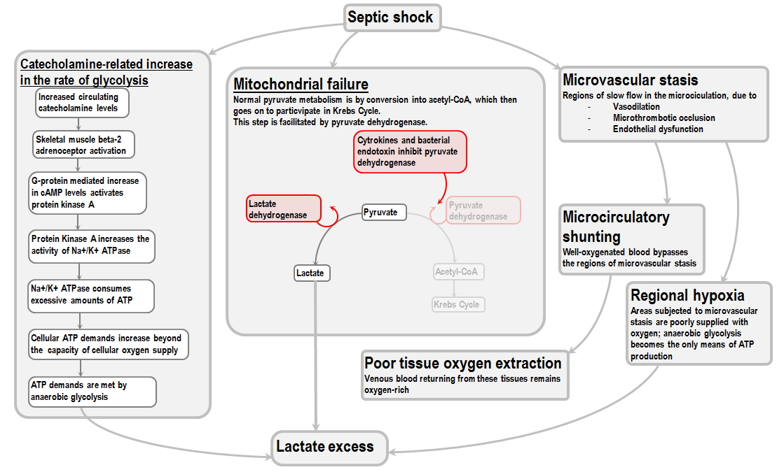

Slide 79
Evidence for monitoring lactate in critical illness
It correlates well with mortality in sepsis: patients with a presenting lactate over 4.0mmol/L were almost five times more likely to die (Mikkelsen et al. 2009)
High levels may reveal underlying "occult" sepsis in otherwise stable patients Rivers et al, 2001
It is associated with a poor prognosis in trauma. Specifically, failure to normalise the lactate over the first 2 days is associated with worse organ failure and increased mortality Manikis et al 1995
It predicts poor recovery from cardiac arrest. Survivors and patients with good neurological outcome had lower lactate levels at 0, 12 and 24 hours (Donnino et al, 2015)
It acts as a trigger for liver transplantation: lactate predicts non-survivors from paracetamol toxicity earlier than the King's College Criteria (Bernal et al, 2002)
However, somehow the effect of adding lactate to the King's College Criteria actually decreases their diagnostic odds ratio slightly, from about 27 to about 26. (Craig et al, 2018)

Slide 80
D - lactate
Malabsorbed carbohydrate is fermented in the colon, producing an excess of D-lactate.
This has been a well-recognised problem in ruminants, where it is associated with
"ruminal carbohydrate overload".
Normally, humans have a great capacity to metabolise D-lactate (the hepatic metabolism of lactate does not discriminate between isoforms)
In specific circumstances, D-lactate can be overproduced in the bowel, leading to toxicity
Neurological disturbances:
Confusion or encephalopathy
Slurred speech
Obtundation
Ataxia
Coma
Cardiovascular disturbances Arrythmias
Heart block
Asystole

Slide 81
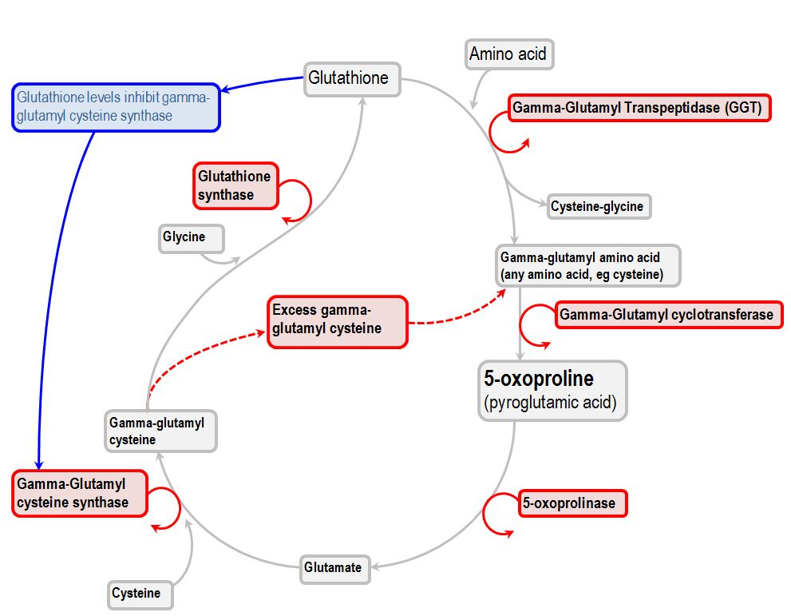
Pyroglutamic acidosis
Pyroglutamic acid is produced from γ-glutamyl cysteine by the enzyme γ-glutamyl cyclotransferase
When glutathione levels are low, the activity of γ-glutamyl cyclotransferase is increased, resulting pyroglutamic acid accumulation.
Glutathione is acutely depleted by paracetamol and sepsis; it can also be chronically depleted in liver disease and malnutrition
Dysfunction of 5-oxoprolinase due to flucloxacillin, vigabatrin, netilmicin, inherited enzyme deficiency, gender specific difference in enzyme activity can also contribute
Diminished 5- oxoporoline clearance can occur due to renal failure

Slide 82
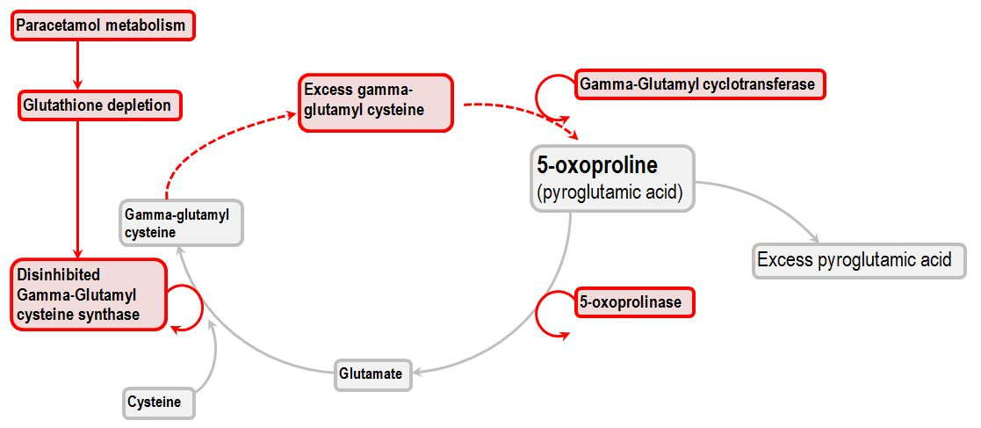

Slide 83
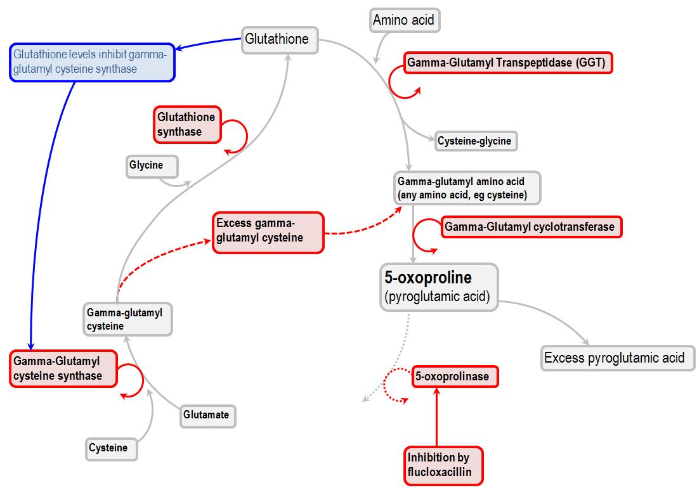

Slide 84
Management
The cessation of the causative agents (flucloxacillin and paracetamol)
Glutathione repletion (with N-acetylcysteine)
Protection of satisfactory diuresis (5-oxoproline is cleared renally)

Slide 85
 | Starvation ketoacidosis | Alcoholic ketoacidosis | Diabetic ketoacidosis
Trigger | Prolonged starvation for > 3days | Starvation following a binge of alcohol | Inadequate insulin supplementation in the face of increased requirements. eg. sepsis
Mechanism | Diminished intake of carbohydrates leads to decreased insulin levels, and thus ketogenesis Ketogenesis occurs in the absence of adequate hepatic glycogen stores | Diminished intake of carbohydrates leads to decreased insulin levels, and thus ketogenesis Hepatic metabolism of ethanol depletes NAD+and increases NADH levels, favouring conversion of acetoacetate into β-hydroxybutyrate | In the absence of insulin, and the presence of stress hormones and glucagon, hepatic lipid metabolism switches to ketogenesis

Slide 86
Characteristic features | Mild acidosis Low ketone levels Anion gap may be normal Blood sugar level is frequently low Patient is neither a diabetic nor an alcoholic | Moderate acidosis β-hydroxybutyrate is the most prevalent ketone species BSL is frequently low | Severe acidosis May be mixed high and normal anion gap (ketones are excreted along with strong cations; SID decreases as a result) Severe dehydration
Management | Recommencement of nutrition results in a release of insulin Refeeding syndrome may occur | Recommencement of nutrition results in a release of insulin Severe acidosis - usually requires insulin/dextrose infusion Refeeding syndrome may occur | Insulin/dextrose infusion Volume replacement: Electrolyte replacement

Slide 87
Sodium bicarbonate: indications and application
Indications:
Acceptable Hyperkalaemia
Treatment of sodium channel blocker overdose with ECG features (e.g. tricyclic overdose)
Urinary alkalinisation (salicylate poisoning)
Normal anion gap metabolic acidosis
Debatable
Cardiac arrest with severe acidosis
DKA with severe acidosis
Restoration of completely depleted buffer systems (eg. HCO3- level approaching 0)
Pulmonary hypertension and severe right heart failure

Slide 88
Adverse effects of sodium bicarbonate administration
Peripheral vein thromobophlebitis
Hypernatremia
Volume overload
Hypokalemia
Ionised hypocalcemia
Left shift of oxyhaemoglobin dissociation curve
Impaired clearance of lactate (by disinhibition of glycolysis)
Intracellular acidosis
Hypercapnea

Slide 89
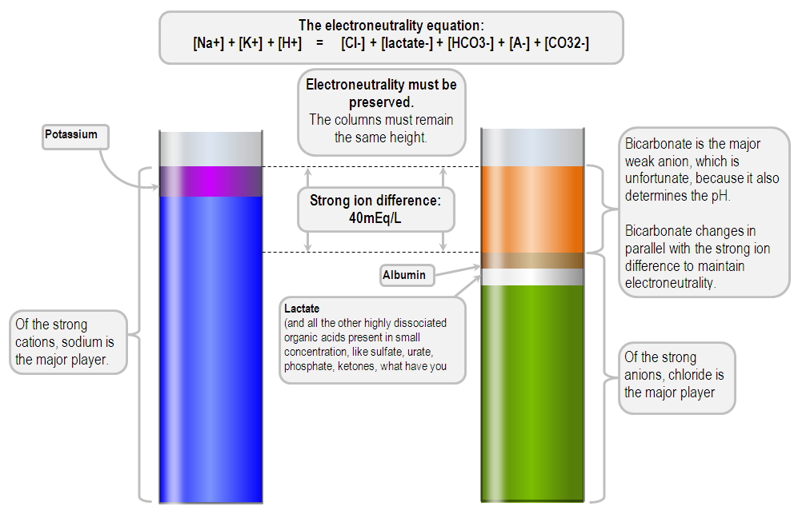
Strong ion difference

Slide 90
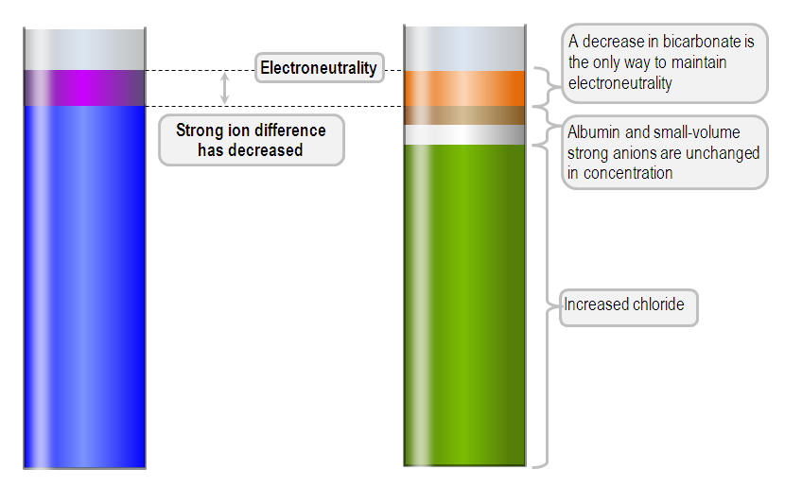
Normal anion gap metabolic acidosis

Slide 91
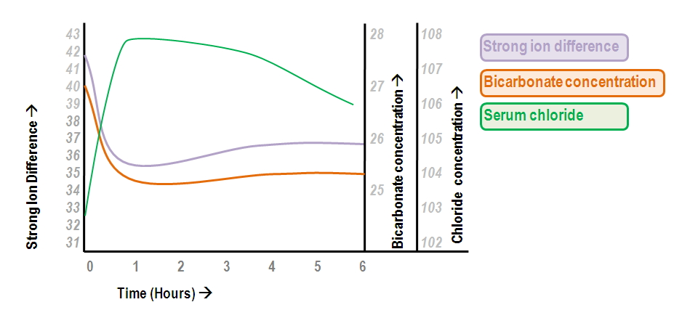
Normal saline intoxication
Every bag of saline increases the serum chloride by 3mmol/ l. In stewarts’ terms, normal saline has a SID of 0 mmol/ L, and thus adding it to a body fluid will decrease the strong ion difference. The SID of Hartmanns on the other hand is 28 mmol/ L, and hence it has a gentler acidifying effect

Slide 92
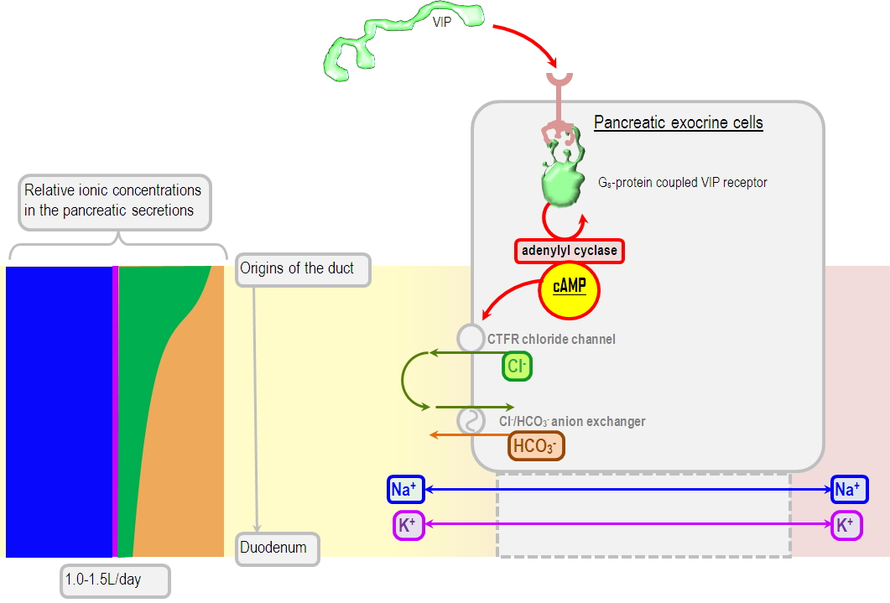
Pancreaticoenteric fistula as a cause of normal anion gap metabolic acidosis

Slide 93
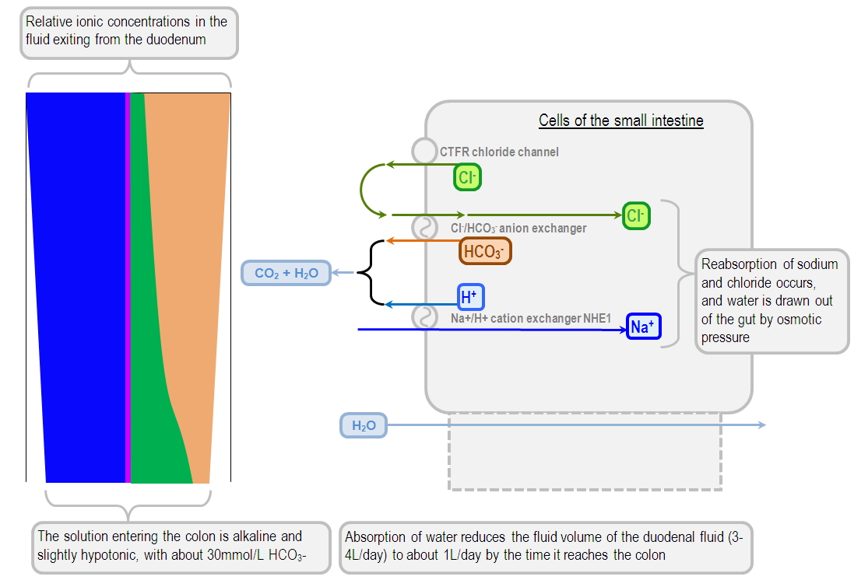
High output small bowel fistula

Slide 94
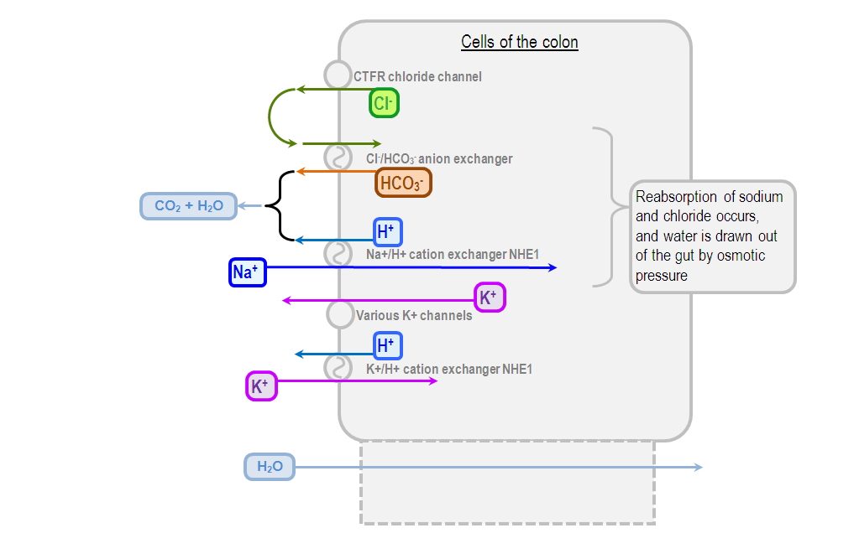
Diarrhea

Slide 95
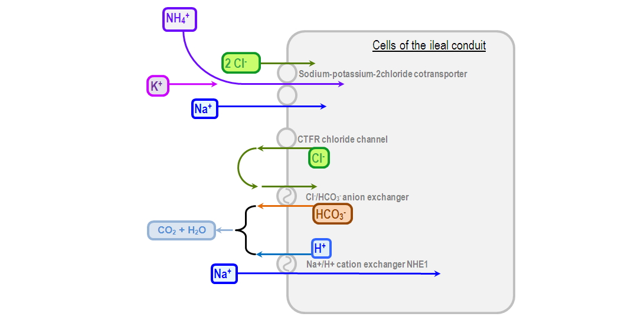
Ureteric diversion

Slide 96
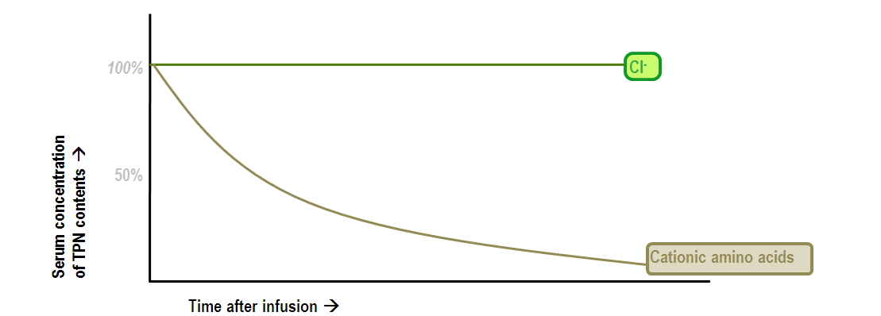
Hyperalimentation acidosis due to TPN

Slide 97
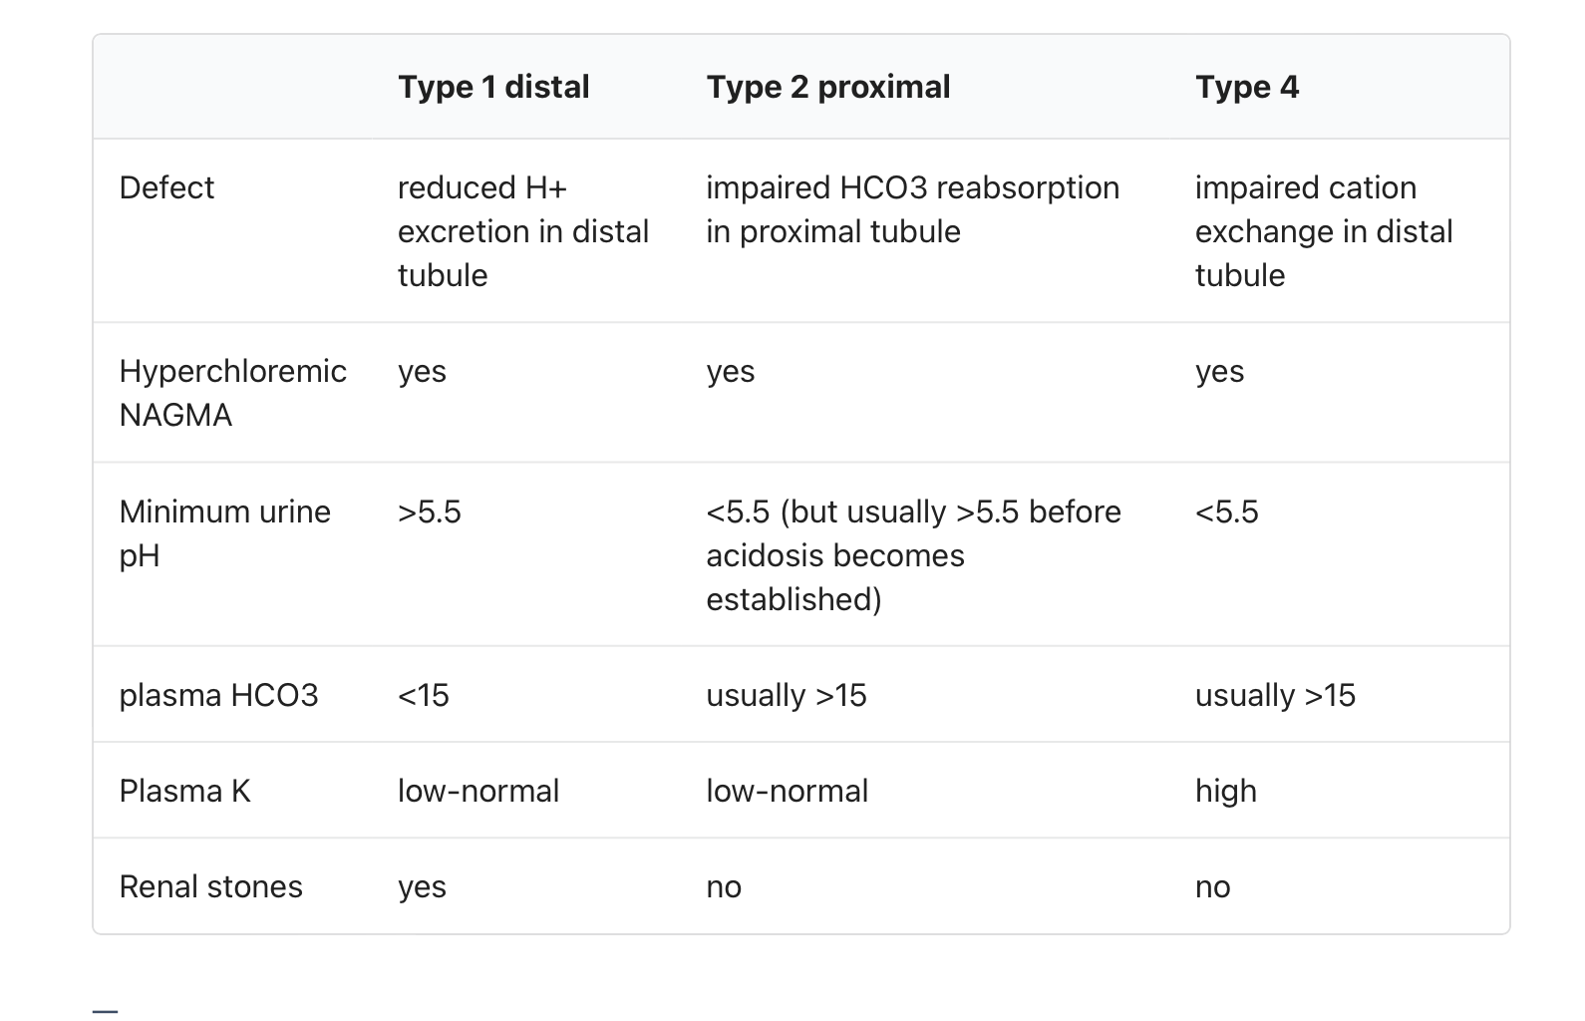
Renal tubular acidosis

Slide 98
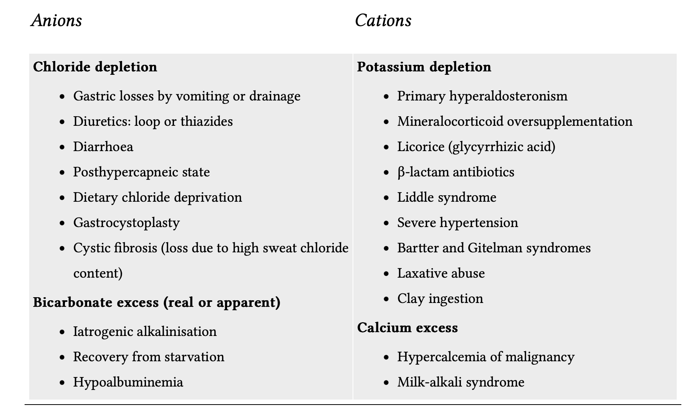
Metabolic alkalosis

Slide 99
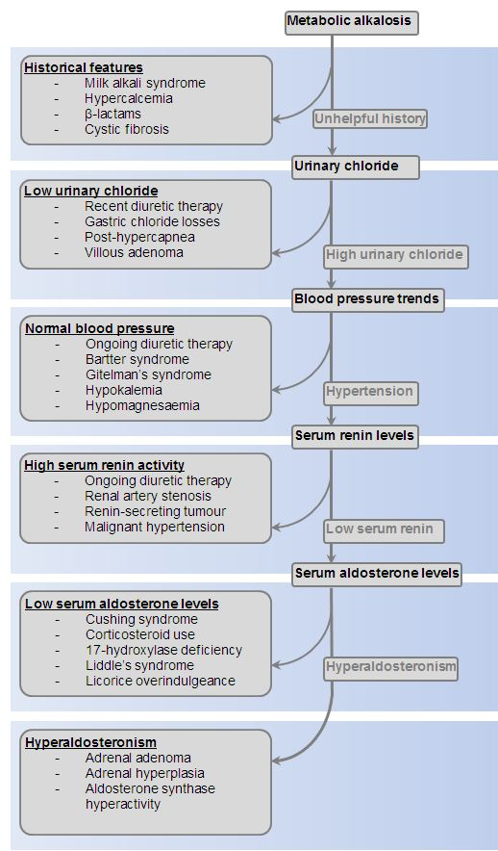

Slide 100
Management of metabolic alkalosis
Correct volume depletion - ideally with normal saline
Correct hypokalemia - ideally with potassium chloride
Alternative strategies if the patient is fluid-overloaded:
Acetazolamide (prevent reabsorption at the proximal tubule)
Hydrochloric acid (HCl)
Infusions of cationic amino acids such as lysine and arginine - these amino acids are typically available a hydrochloride solutions; when they are metabolised, only chloride remains.
Correction of hypoalbuminaemia (albumin is anionic, and together with phosphate represents Atot; hypoalbuminaemia contributes to alkalosis)

Slide 101
Respiratory consequences:
Decreased respiratory drive stimulus
Thus, pulmonary atelectasis
Increased V/Q mismatch due to impared hypoxic pulmonary vasoconstriction
Left shift of the oxyhaemoglobin dissociation curve
Cardiovascular consequences:
Decreased cardiac output due to decreased contractility
Arrhythmias
Neurological consequences
Neuromuscular overexcitability
Decreased cerebral blood flow due to cerebral vasoconstriction
Seizures
Electrolyte changes
Hypocalcemia
Hypokalemia

Slide 102
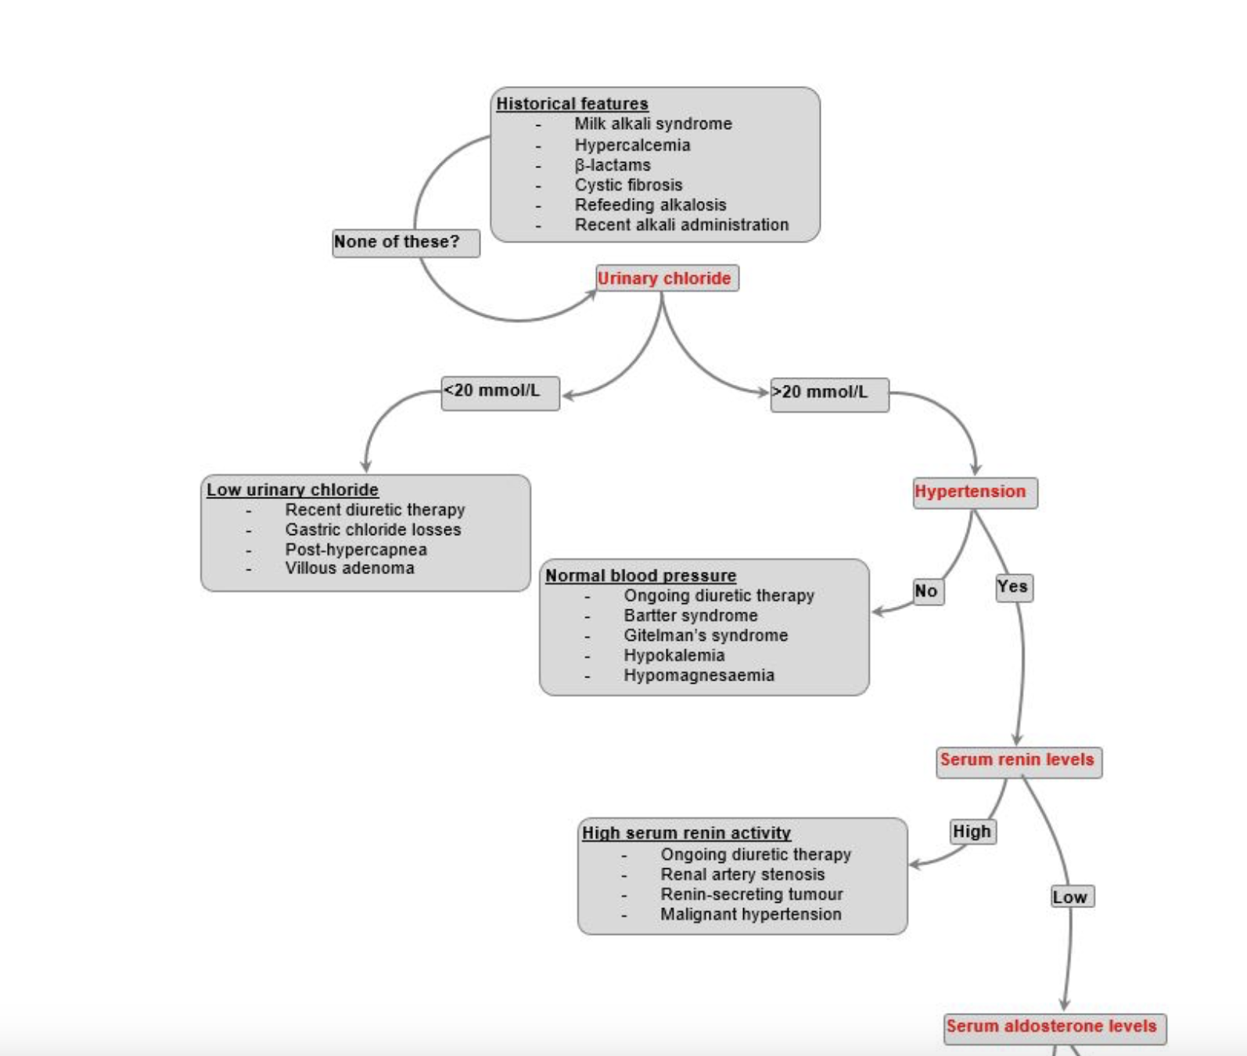

Slide 103
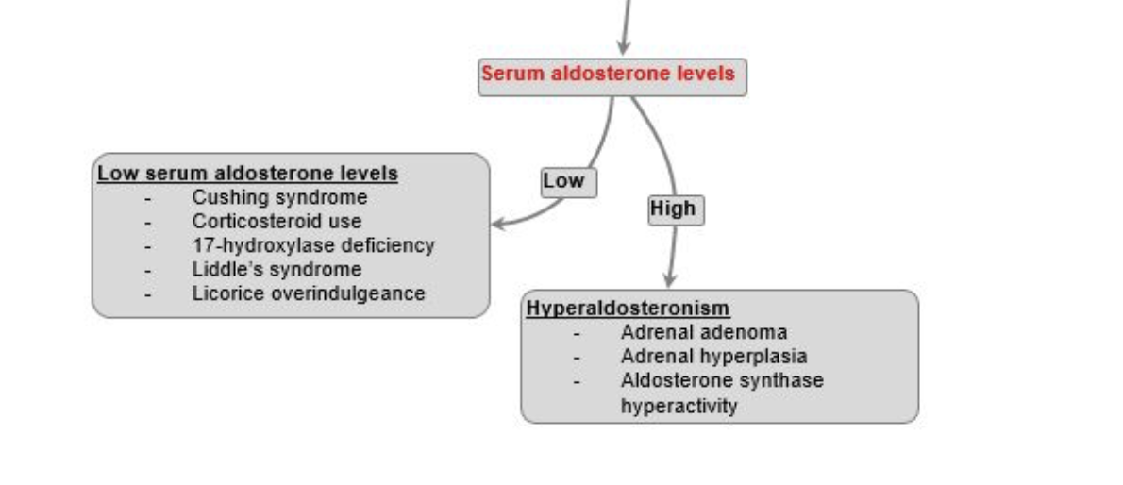

Slide 104
Question 6
Which of the following metabolic abnormalities is caused by excessive vomiting?
High anion gap metabolic acidosis
Combined High and normal anion gap metabolic acidosis
Metabolic alkalosis
Normal anion gap metabolic acidosis

