Slide 1
Fluid Therapy in the Critically Ill
Segun Olusanya
Consultant in Intensive Care Medicine
St. Bartholomew’s Hospital, London, UK

Slide 2






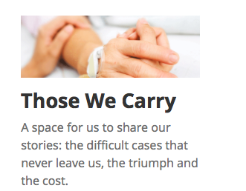








DECLARATIONS OF INTEREST

Slide 3
Aims and Objectives
Discuss the rationale for fluid therapy in the critically unwell
To discuss the different fluids available and their pros and cons
To discuss some of the evidence to support current practice with fluids

Slide 4
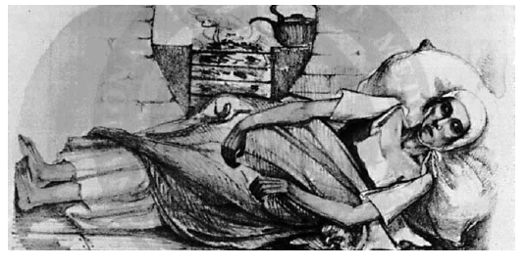
BACKGROUND
IV fluids resuscitation is a basic part of all medicine, and especially intensive care

Slide 5
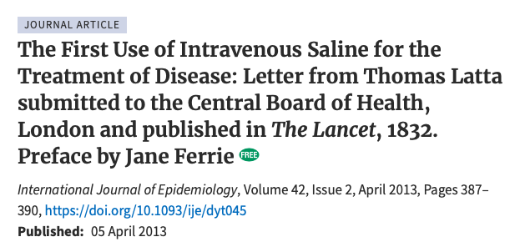

Slide 6
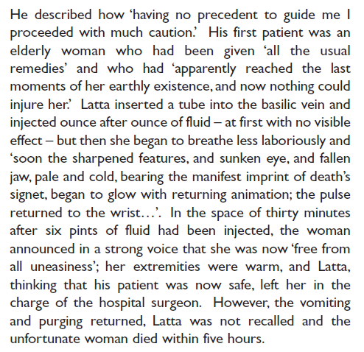

Slide 7
Balanced solution
Slowly- “ounce after ounce”
Looked for clinical improvement
Stopped when she looked better

Slide 8
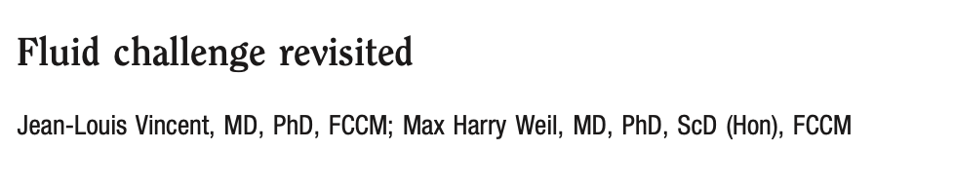
Type
Rate
Outcome
Limitations

Slide 9
Uses of IV fluids
Resuscitation
“Maintenance”
Carrier for drugs/therapeutic agents
Procedural

Slide 10
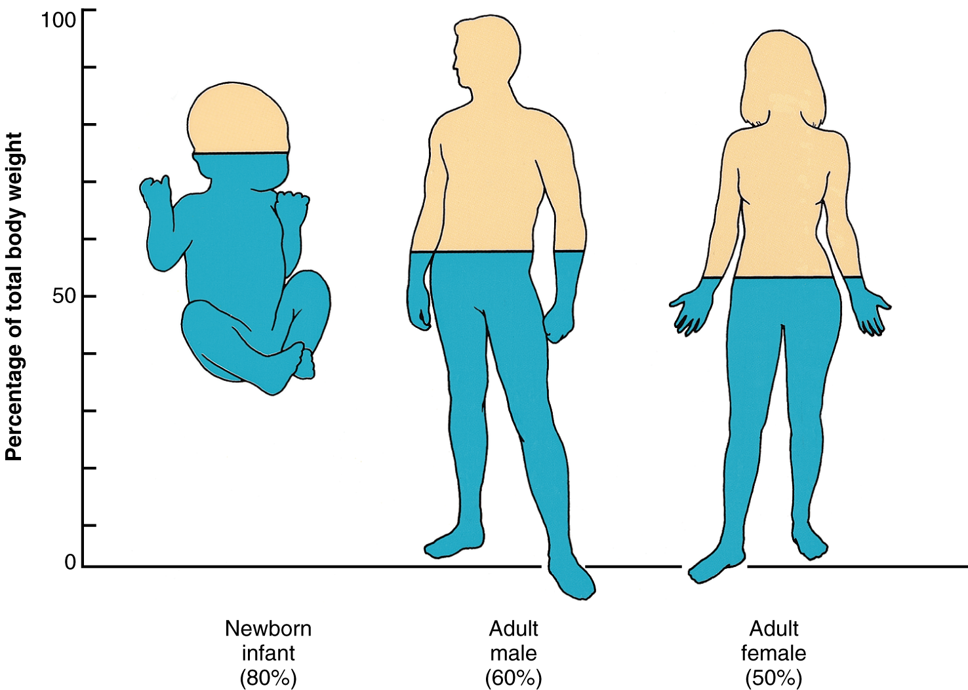
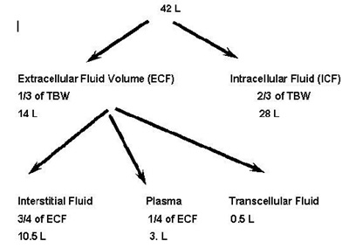

Slide 11
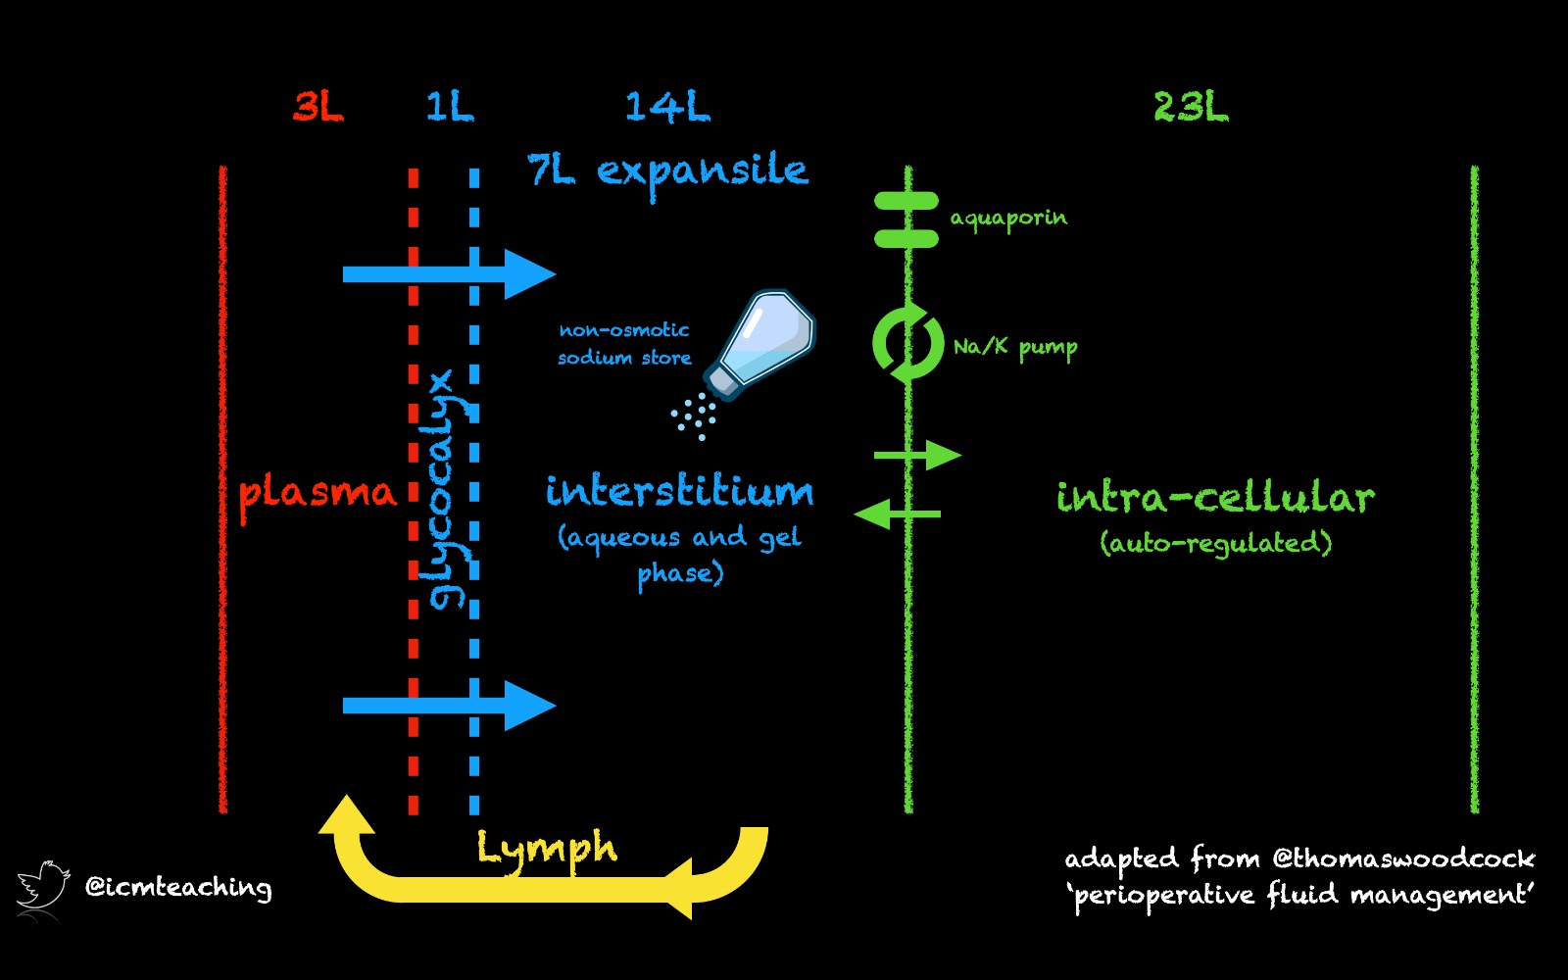

Slide 12
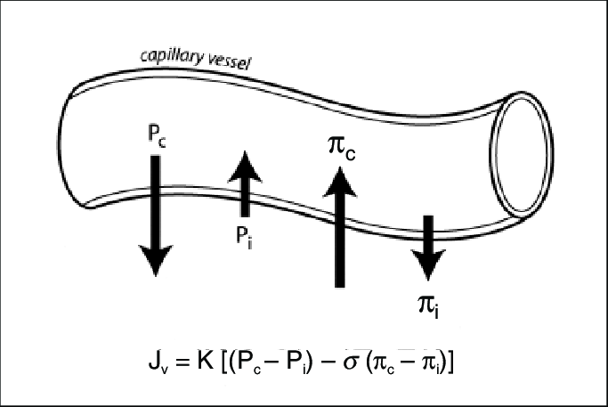

Slide 13
WHY?
SHOCK
HYPOVOLAEMIC
CARDIOGENIC
OBSTRUCTIVE
DISTRIBUTIVE

Slide 14
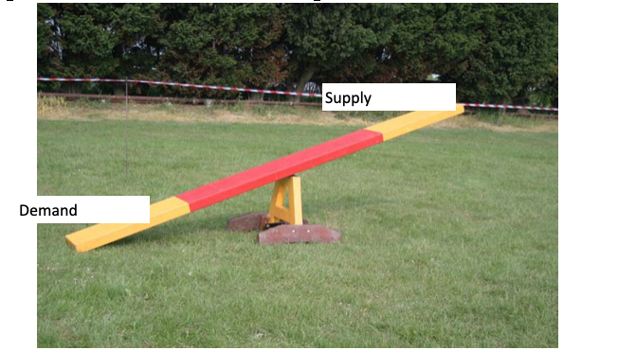

Slide 15
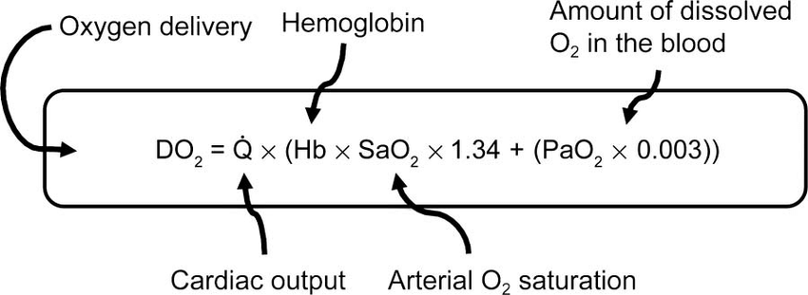

Slide 16
Management of Shock
Treat the cause
Treat the cause
Treat the cause
(Provide organ support to address the supply/demand imbalance while you treat the cause)

Slide 17
Organ Support in shock
Fluids (including blood)
Vasoactive agents
Mechanical support

Slide 18
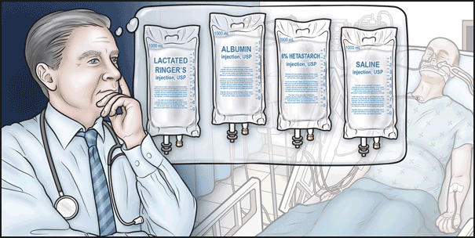
(From https://www.nejm.org/doi/story/10.1056/feature.2013.09.11.14

Slide 19
Crystalloids | Colloids
0.9% Saline | Hydroxyethylated starch
Ringer’s lactate/Hartmann’s | Gelatins
Other balanced solutions e.g Plasmalyte | Albumin
Bicarbonate | (Blood products)
Dextrose solutions
Dextrose/saline mix
Hypertonic saline

Slide 20
CRYSTALLOID
A substance that, when dissolved, forms a true solution and is able to pass through a semipermeable membrane

Slide 21
COMPARISON OF CRYSTALLOIDS
 | 0.9% “normal” saline | Hartmann’s solution | Plasmalyte | Dextrose + 0.45% saline | 1.26% sodium bicarbonate
Sodium | 154 | 130 | 140 | 77 | 150
Potassium |  | 4 | 5
Calcium |  | 2.7
Magnesium |  |  | 3
Chloride | 154 | 109 | 98 | 77
Lactate |  | 28
Acetate |  |  | 27
Bicarbonate(mM) |  |  |  |  | 150
Gluconate (mM) |  |  | 23
Glucose (g/L) |  |  |  | 50
pH | 5.5 | 6.5 | 7.4 | 4 | ??
Osmolality | 308 | 273 | 294 | 406 | 300
Notes:
Plasma osmolality 275-290

Slide 22
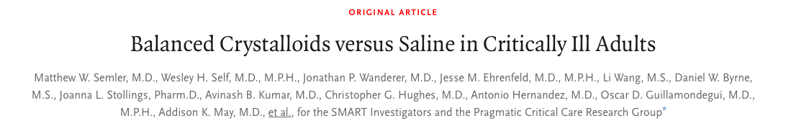
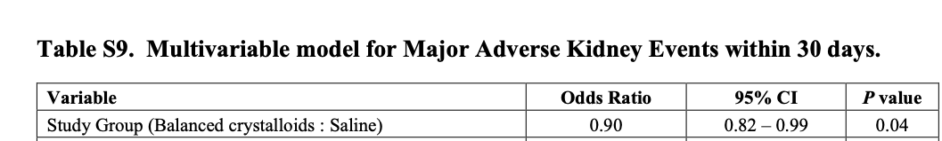

Slide 23
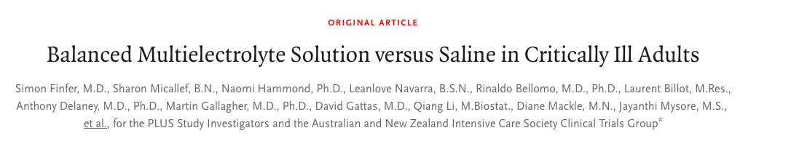
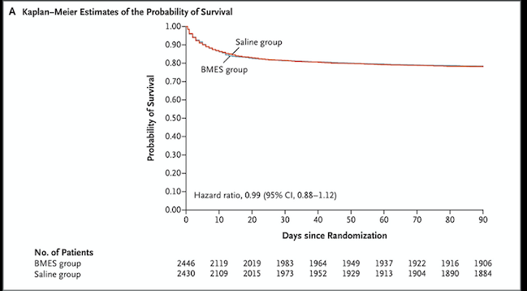

Slide 24
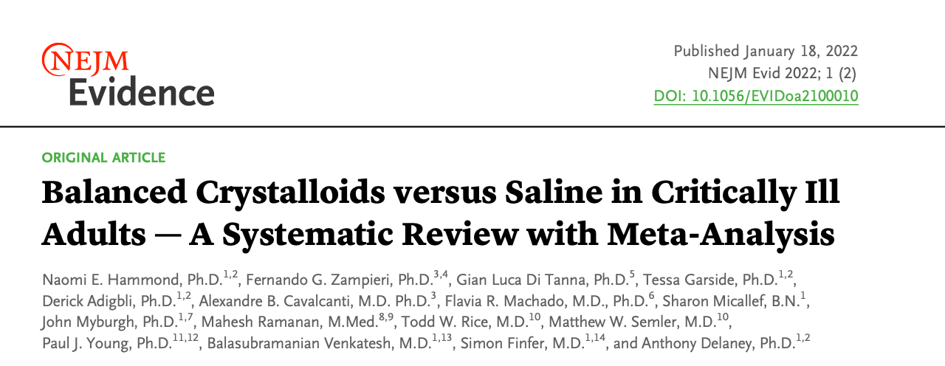
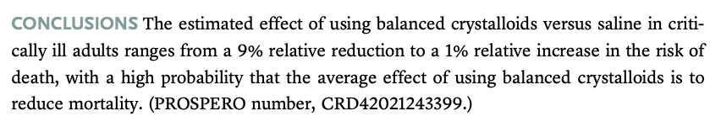

Slide 25
COLLOIDS
“A mixture in which one substance consisting of microscopically dispersed insoluble particles is suspended throughout another substance”

Slide 27
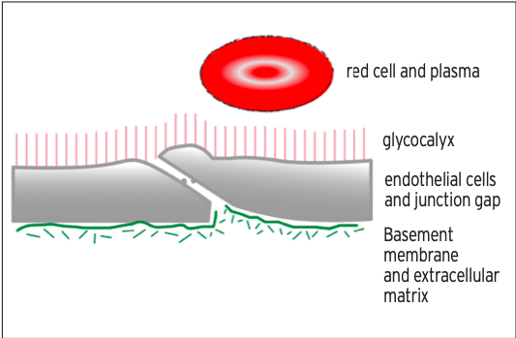

Slide 28
STARCHES
Hetastarch
Pentastarch
Synthetic colloid
Excreted in urine
Taken up by reticuloendothelial system
Plasma half life 5 days (hetastarch) or 6 hours (pentastarch)

Slide 29
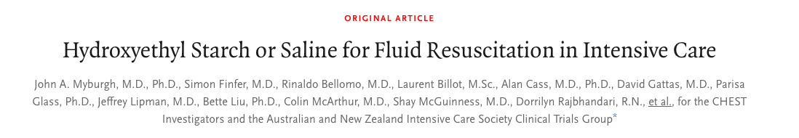
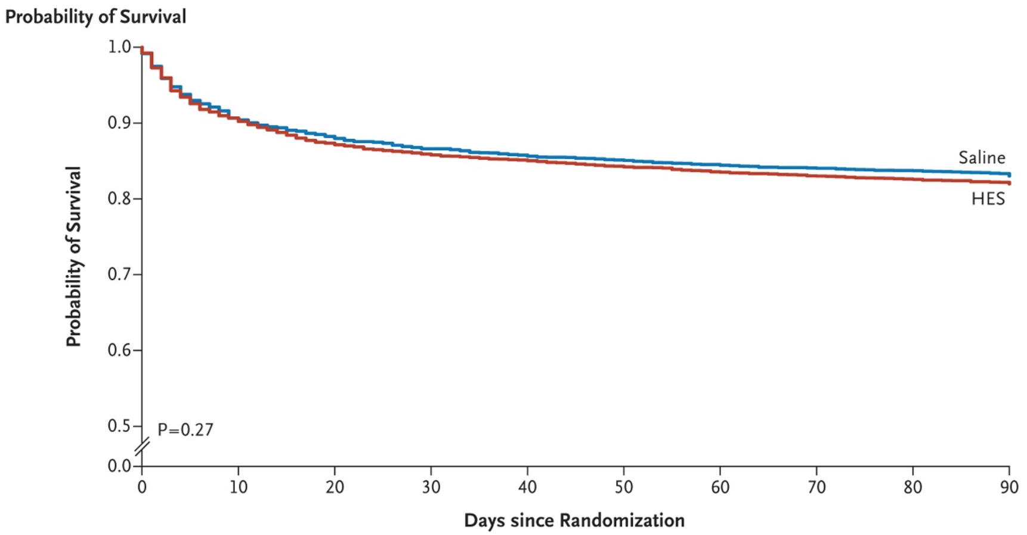
Hetastarch associated with greater need for renal replacement therapy
No clinical benefit over 0.9% N. Saline
Notes:
ANZIC, 32 ICUs 2009-2012

Slide 30
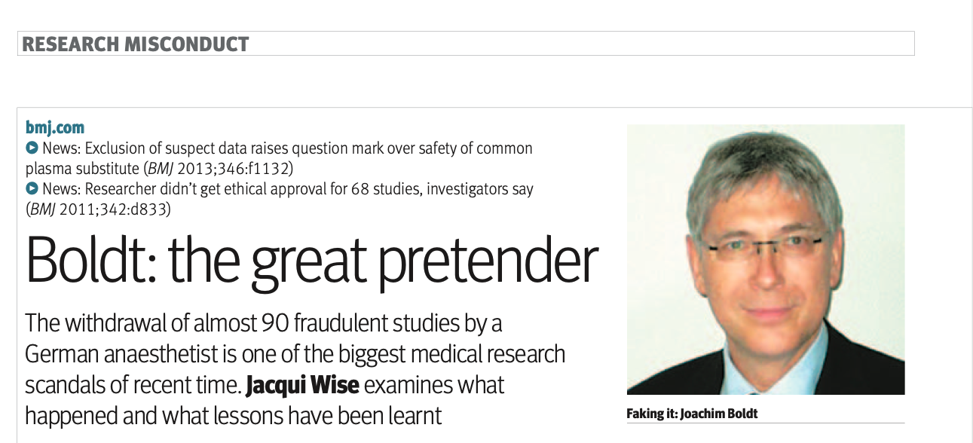

Slide 31
GELATINS
4% succinylated bovine gelatin
Gelofusine
Isoplex
Synthetic colloid
Excreted by the kidney
Plasma half life 2.5 hours
Systematic reviews of previous studies
-increased risk of anaphylaxis
-higher mortality, AKI, RRT
-impaired coagulation

Slide 32
ALBUMIN
Natural protein (derived from plasma, serum or normal placentas)
4.5% and 20% solutions
Half life 20 days in body, 1.6 hours in plasma

Slide 33
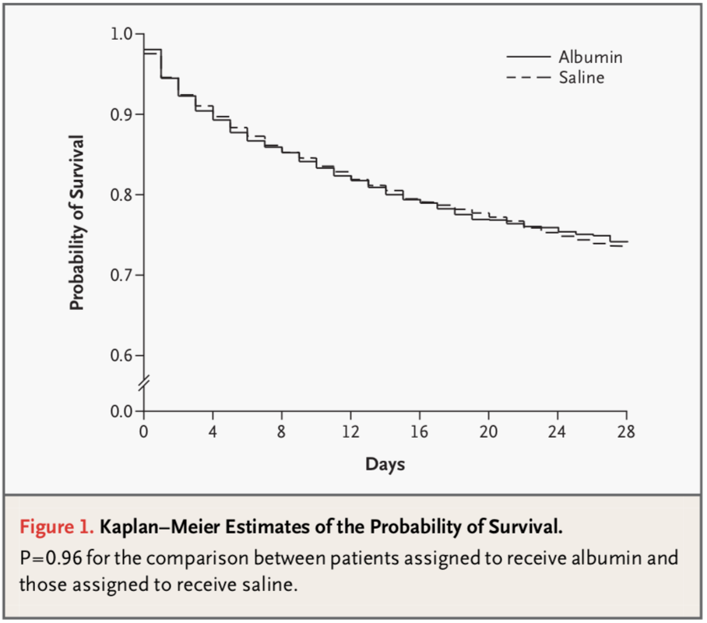
SAFE study
No difference when 4% albumin is used for fluid resuscitation when compared to 0.9% sodium chloride.
4% albumin should be avoided in head injuries.
Notes:
6,997 patients randomized to 4% albumin vs normal saline
28-day mortality- 1o
Defended short term safety profile of HAS

Slide 34
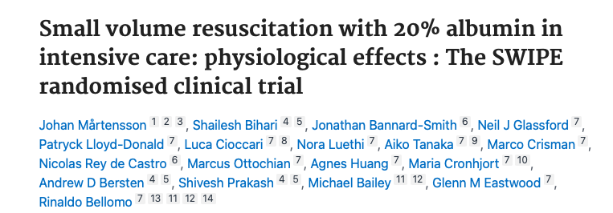
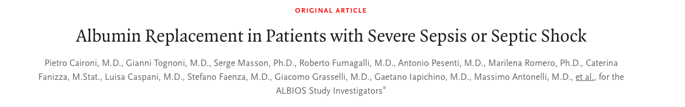

Slide 35
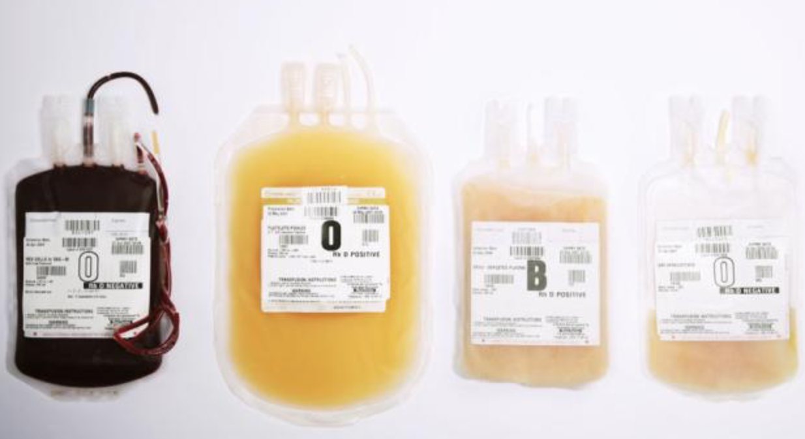
Blood and other blood components
According to specific component deficiencies- MH protocol, guidelines, hematology
Thresholds highly debated
TRALI vs TACO
SHOT- publication led to 2/3RD reduction in TRALI
Notes:
SHOT- 1996, hemovigilance, analysing reactions and adverse effects of transfusion from all blood components. Recommendations to improve patient safety

Slide 36
How much fluid?
Can run patients “full” with a high cardiac output and vasodilated
Can run patients “dry” and need some intoropy/vasoconstriction
Risks vary, no method clearly superior
Be careful about your targets:
  Blood pressure (Swing on arterial line)
  CVP/RAP rise

Slide 37
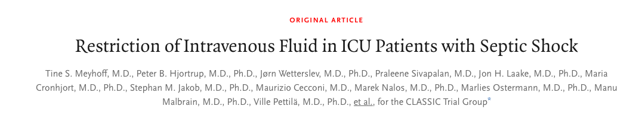
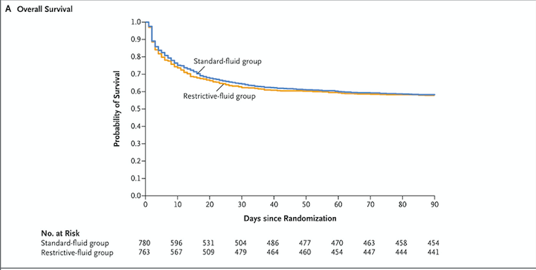

Slide 38
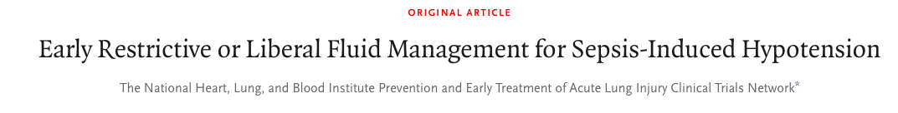
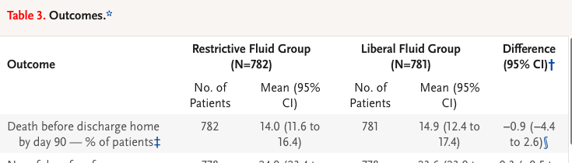

Slide 39
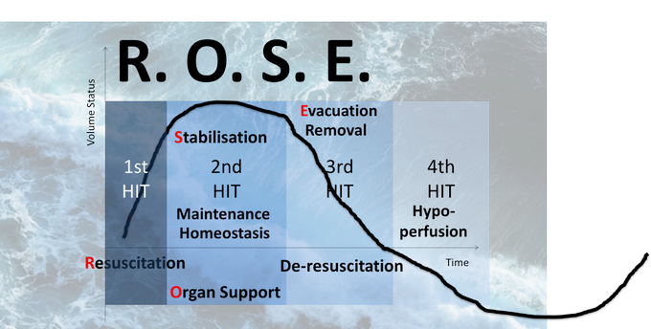
(Courtesy Prof Manu Malbrain)

Slide 40
Maintenance fluids
Designed to account for daily fluid losses
In awake patients usually covered by enteral intake/thirst
In other patients
Nutrition (enteral/parenteral)
Fluid therapy
(Drugs)

Slide 41
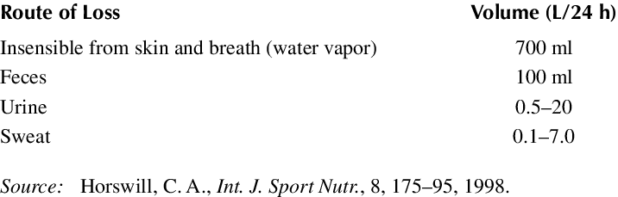

Slide 42
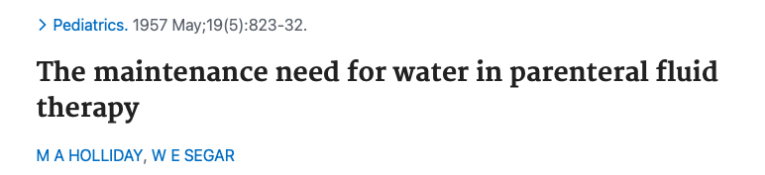
  4ml/kg/hr (1st 10kg)
  2ml/kg/hr (next 10kg)
  1ml/kg/hr (for every kg above 20
  About 1.5ml/kg/hr in an average adult

Slide 43
Maintenance fluids
Maintenance fluids should prevent low cardiac output states but not be excessive
When you assess a patient think of:
  Underlying cardiac function
  Presence of pulmonary and peripheral oedema
  Fluid losses
  Other pathologies present that influence goals
  How you will assess response to fluid?
    Cardiac output monitor
    Vital signs (Heart rate, Blood pressure)
    Markers of cardiac output (Venous saturations, lactate, cerebration, capillary refill, peripheral temperature)
    Markers of organ function (e.g. urine)

Slide 44
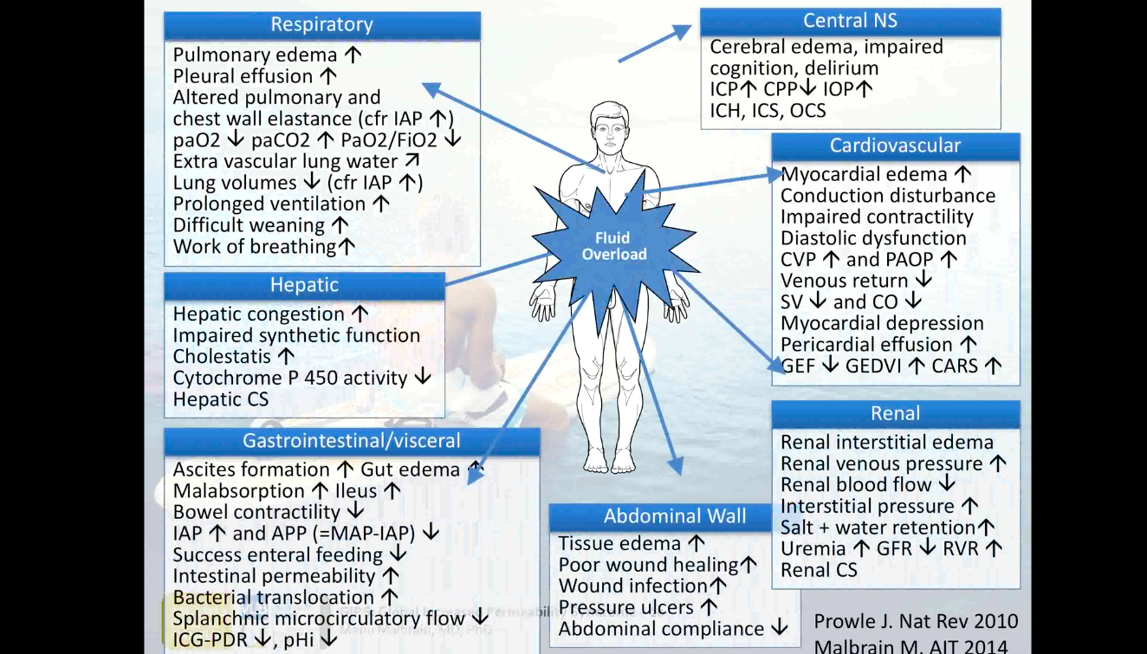
(Courtesy Prof Manu Malbrain)

Slide 45
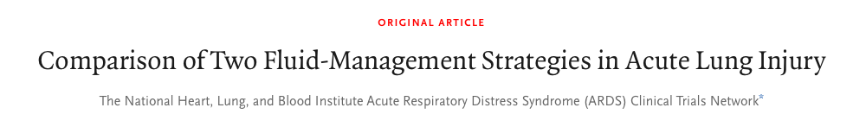
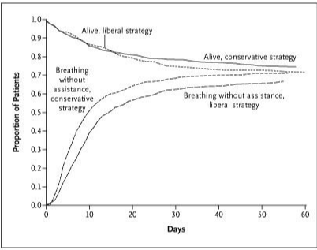

Slide 46
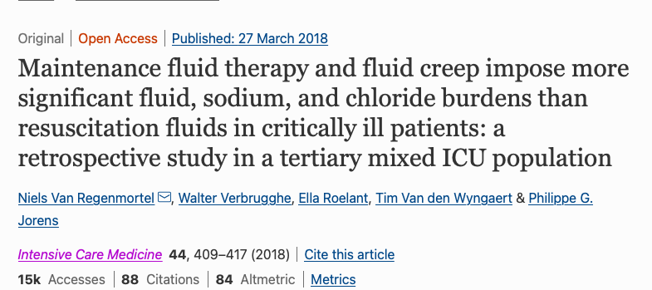

Slide 47
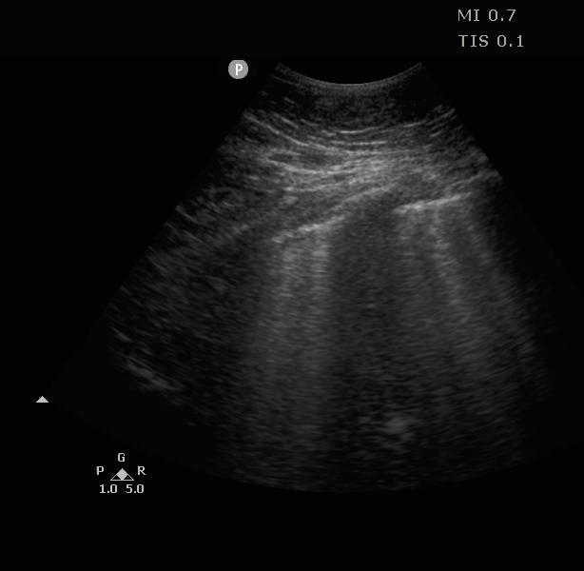
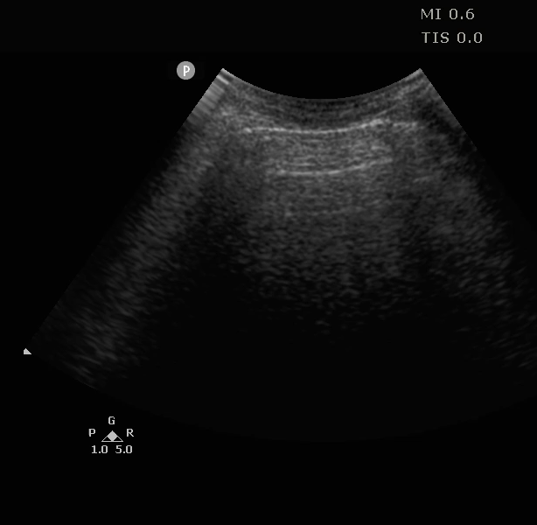
POINT OF CARE ULTRASOUND

Slide 48
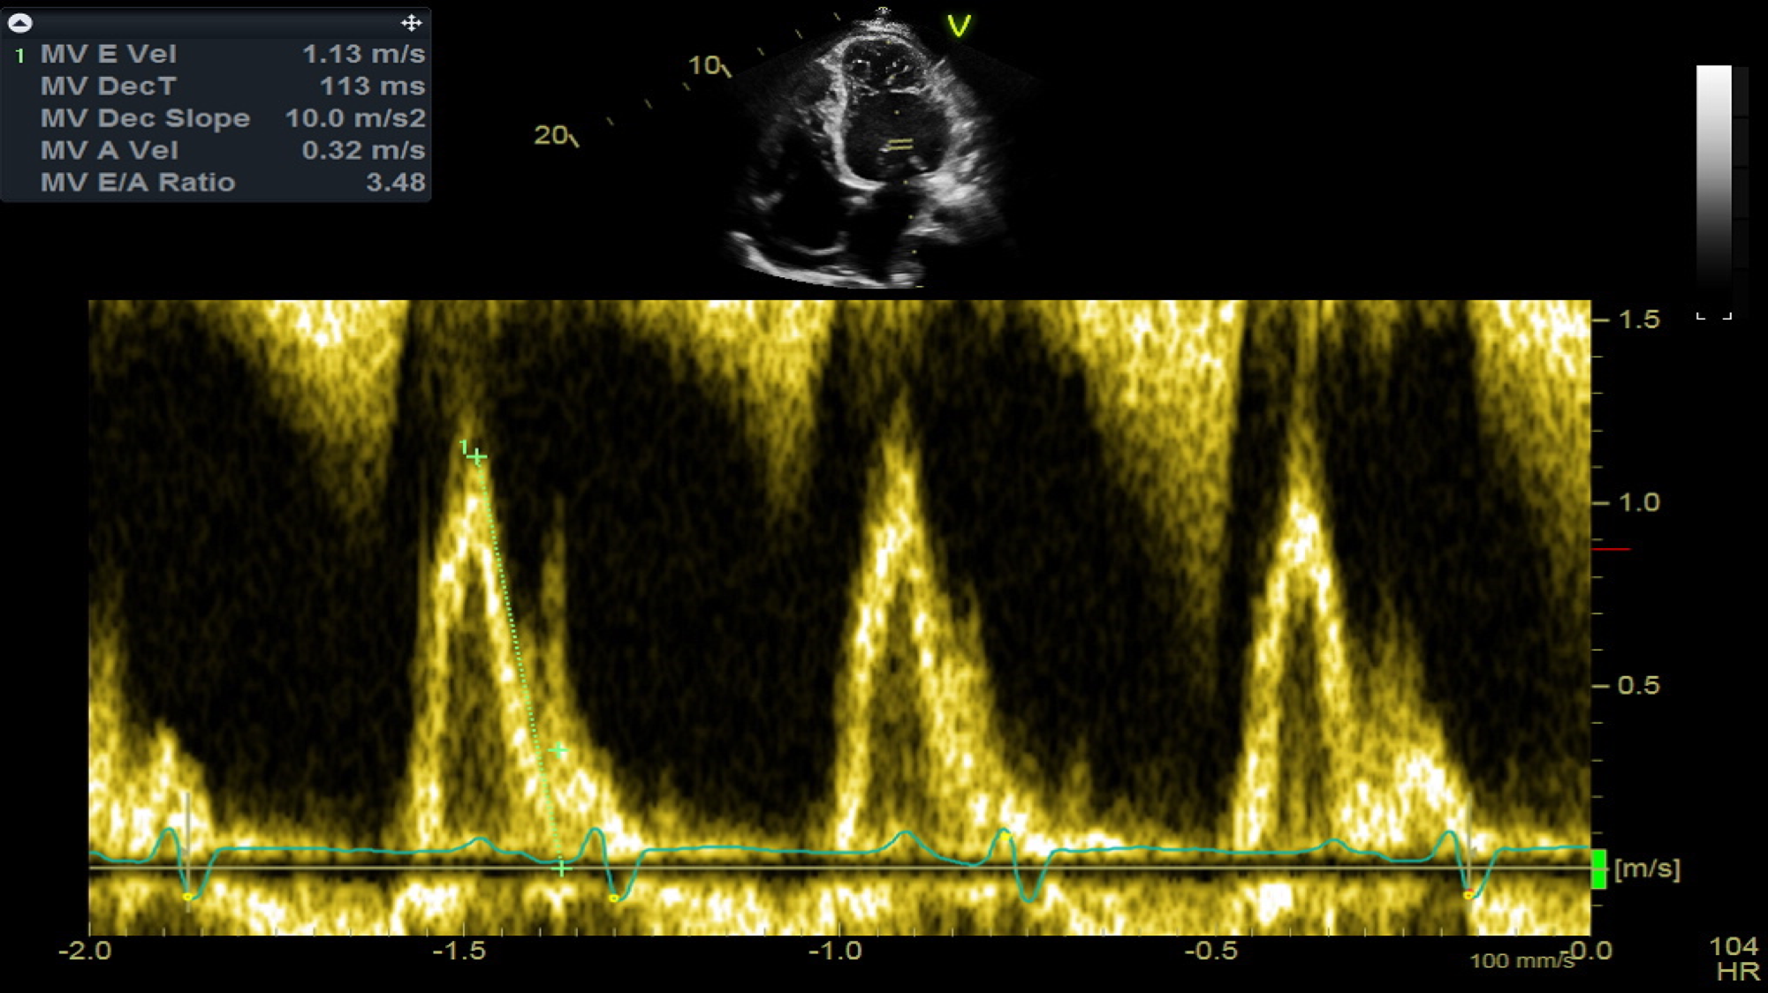
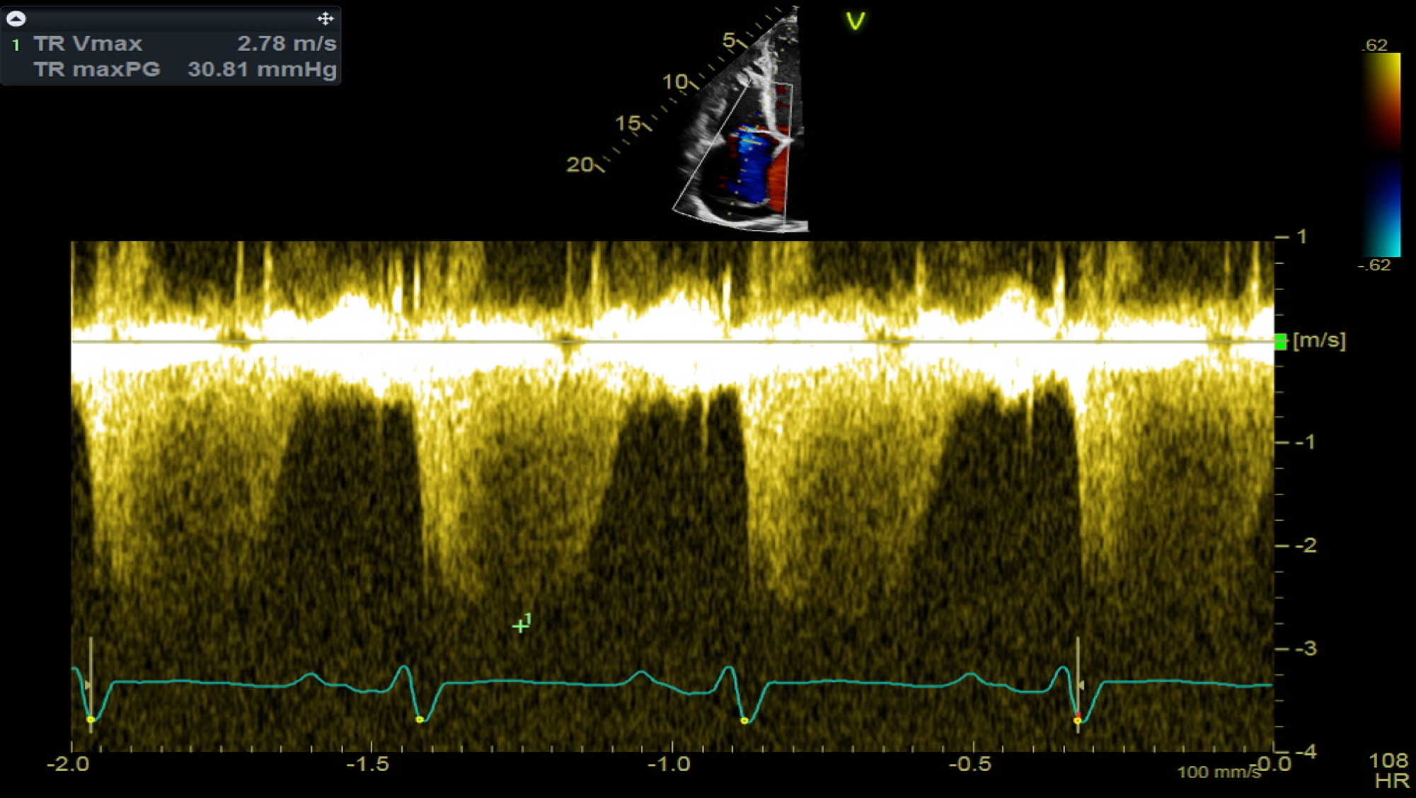
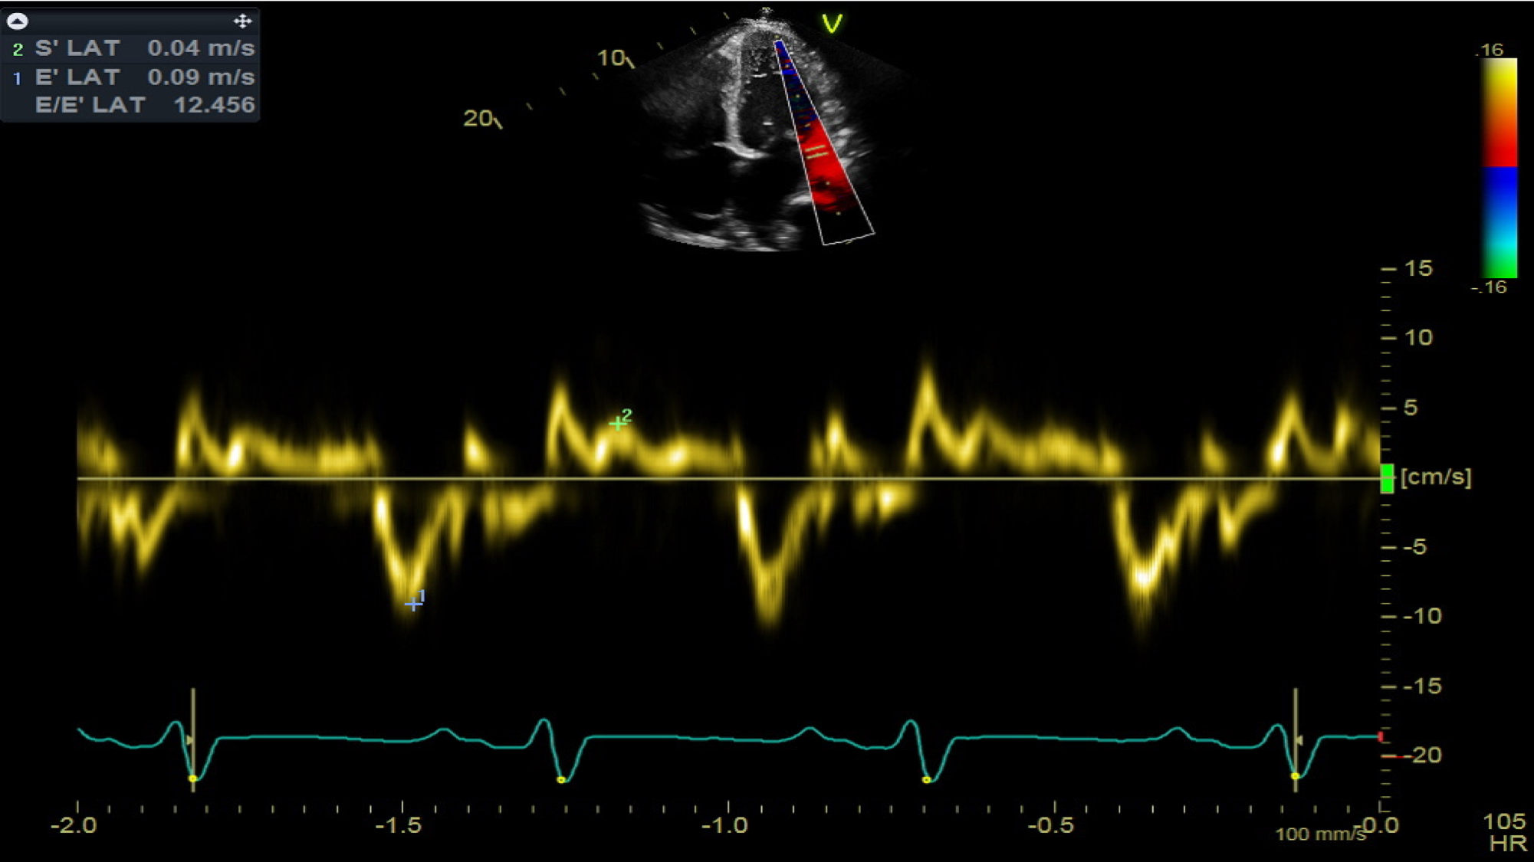
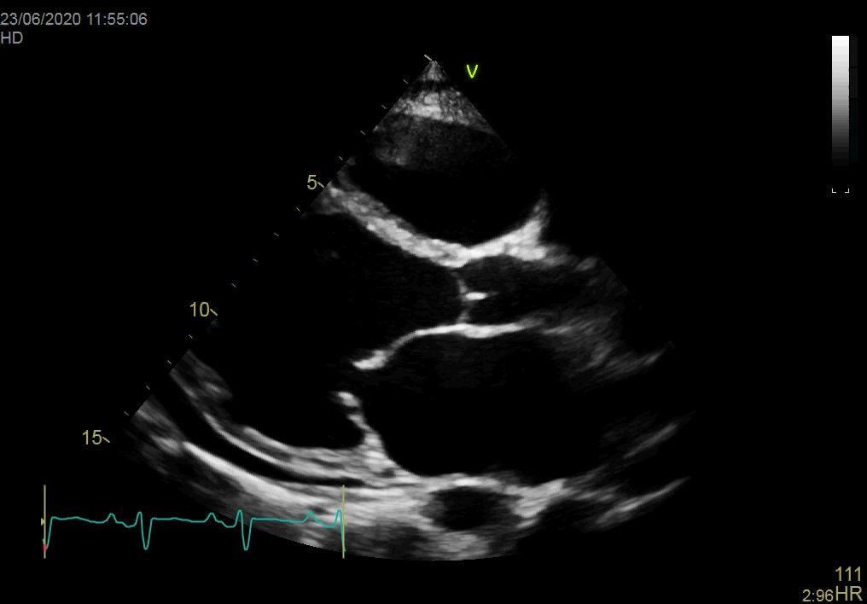

Slide 49
CONCLUSIONS
Fluids are drugs
Assess the need for fluids carefully
Crystalloids and colloids are our main groups
The type, rate, outcomes, and limits of each fluid therapy should be decided before prescribing
Balanced crystalloids may be advantageous in most patients
Fluid overload and fluid creep can cause as much harm as hypovolaemia

Slide 50
Conclusions
“ I don’t care if you use dog’s urine, as long as you use it carefully”
  Professor Malcolm Fisher, Consultant Intensivist, Head of Intensive Care, Royal North Shore Hospital, Australia

