Slide 1
Antibiotic therapy in the ICU
Dr.Srilekha Ammapalli MD DM
Specialist criticalcare, Mediclinic Welcare hospital

Slide 2
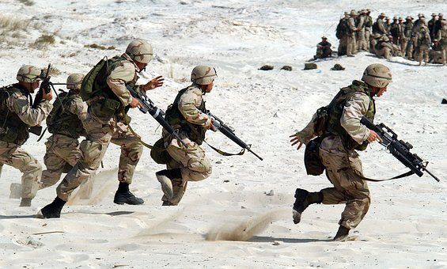
Objectives
Know the enemy
Know the weapon
Formulate the plan based on the possible enemy

Slide 3
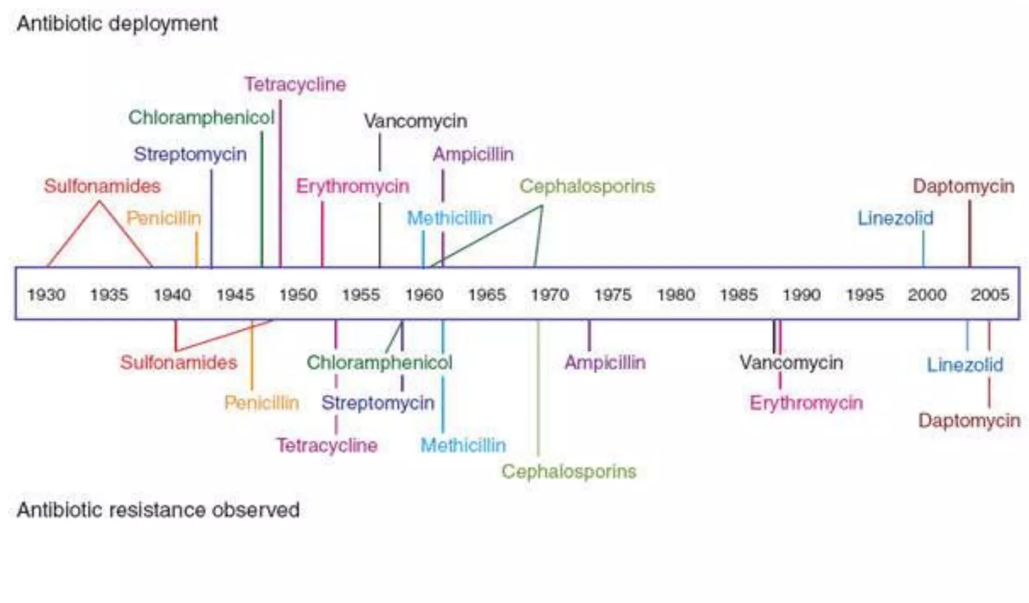
How strong is our enemy?

Slide 4
Some are born great!!
Some have greatness thrusted upon them
Some achieve greatness!

Slide 5
Objectives
Know the enemy
Know the weapon
Know the plan

Slide 6
Cell wall structure

Slide 7
Gram positive
Cocci
Bacilli
Catalase positive
Staphylococci
Streptococci
Coagulase positive
Aerobic
Anaerobic
CONS
Novobiocin sensitivity
Staphylococcus aureus
No hemolysis (gamma)
Partial hemolysis (alpha)
Complete hemolysis (Beta)
Staphylococcus epidermidis
Optochin sensitive
Listeria
Bacillus
Corynebacterium
Clostridium
BAcitracin sensitive
Staphylococcus saprophyticus
Streptococcus agalactiae
Streptococcus viridans (unencapsulated)
Streptococcus pneumonia (encapsulated)
Streptococcus pyogenes
Non enterococcus
Streptococci. bovis
Enterococcus fecalis, fecium

Slide 8
Other gram negative bacilli with special growth requirements
Hemophilus species
Campylobacter species
Legionella pneumophila
Bordetella species
Brucella species
Francisella
Helicobacter pylori
Gram Negative
Bacilli
Cocci
Anaerobic
Aerobic
Aerobic
Anaerobic
Veillonella spp
Neiserria Gonorrhea
Neisseria Meningitidis
Moraxella catarrhalis
Glucose fermentation
Bacteroides spp.
Prevotella spp.
Porphyromonas spp
Fusobacterium spp
Fermenters
Non fermenters
Oxidase test
Negative
Positive
Oxidase test
E.coli
Klebsiella
Salmonella spp
Shigella spp
Yersinis spp
Proteus spp
Providencia spp
Enterobacter spp
Serratia spp
Citrobacter spp
Morganella spp
Pasteurella spp
Vibrio spp
Aeromonas
Plesiomonas
Negative
Positive
Enterobacteriacae
Stenotrophomonas maltophila
Acinetobacter speccies
Pseudomonas aeruginosa

Slide 9
Gram positive bacteria | Gram negative bacteria | Atypical bacteria
Staphylococci | Enerobacteriacae² | Legionella
Pneumococci | Pseudomonas | Chlamydia
Other streptococci¹ | Neisseria | Mycoplasma
Enterococci | H. influenzae | Brucella
Listeria monocytogenes | Campylobacter jejuni³ | Rickettsia
Bacillus anthracis | Helicobacter pylori
 | Acinetobacter
Anaerobic bacteria | Spirochetes | Mycobacteria
Clostridia⁴ | Treponema pallidum | M.tuberculosis
Bacteroides | Borrelia Burgdorferi | M.leprae
 | Leptospira interrogans | M.avium complex
S.pyogenes, s.agalactiae, s.viridans
E.coli, klebsiella, proteus spp, salmonella, shigella spp
V.cholera
C.perfringens, C.tetani, C.botulinum, C.difficile

Slide 11
Objectives
Know the enemy
Know the weapon
Know the tricks of how to attack

Slide 12
Classification of antibiotics based on mechanism of action
Cell wall | Protein synthesis | DNA replication
Beta lactam antibiotics | Rifamycins | Sulfadrugs
Penicillins | Aminoglycosides | Quinolones
Cephalosporins | Macrolides | Metronidazole
Carbapenems | Tetracyclines/ Glycylcyclines
Monobactams | Chloramphenicol
Glycopeptides | Clindamycin
Daptomycin | Linezolid
Colistin/polymyxin B | Nitrofurantoin

Slide 13
Gram positive
Very active
Go
Gram Negative
STOP
Atypical
CAUTION
Anaerobic

Slide 14
Beta lactams
They all share a common structure, the beta lactam ring
They attach to the penicillin binding proteins on the cell membrane and inhibit the third stage of cell wall synthesis
Generally bactericidal
3 general mechanisms of bacterial resistance
Decreased penetration to the target site or increased efflux from the target site
Alteration of the target site
Inactivation by a bacterial enzyme

Slide 15
Antibiotics acting on the cell wall
Natural penicillins
Antistaphylococcal penicillins
Aminopenicillins
Aminopenicillins + Beta lactamase inhibitors
Extended spectrum penicillins
Extended spectrum penicillins + Beta lactamase inhibitors
The Penicillins

Slide 16
Natural penicillins
Penicillin G and Penicillin V are the natural penicillins
Natural penicillins
Bacterial class | Active against
Gram positive bacteria | Streptococcus pyogenes Viridans group streptococcus Some streptococcus pneumoniae Some enterococci Listeria monocytogenes Some staphylococcus aureus Some CONS
Gram Negative bacteria | Neisseria meningitidis Neisseria gonorrhoeae (except penicillinase producing))
Anaerobic | Clostridia species (except clostridium difficile) Actinomyces Israelii Anaerobic streptococci (Peptococcus, Peptostreptococcus)
Spirochetes | Treponema Pallidum Leptospira spp
CAUTION
STOP
CAUTION
STOP

Slide 17
Antistaphylococcal penicillins (Penicillinase resistant penicillins)
Nafcillin, oxacillin → parenteral cloxacillin and Dicloxacillin→ oral
Addition of an isoxazolyl side chain prevents hydrolysis
of beta lactam ring by penicillinases
Methicillin, the first agent is not used due to interstitial nephritis
Antistaphylococcal penicillins
CAUTION
Bacterial class | Active against
Gram positive bacteria | Penicillinase producing staphylococci Some staphylococcus epidermidis Streptococcus spp (less active than natural penicillins) No action against enterococci
STOP
STOP
STOP

Slide 18
Aminopenicillins (Second generation penicillins)
Amoxicillin-clavulanate — In addition covers
Most strains of oxacillin sensitive staphylococcus aureus
Betalactamase producing h.influenzae
Some Beta lactamase producing entrobacteriacae
Ampicillin and Amoxicillin
Amino group was added
Able to penetrate the porin channel of gram negative bacteria but are not stable to beta lactamases and staphylococcal penicillinases
Bacterial class | Active against
Gram positive bacteria | Streptococcus pyogenes Viridans group streptococcus Some streptococcus pneumoniae Many enterococci (Ampicillin) Listeria monocytogenes
Gram Negative bacteria | Neisseria meningitidis Some Haemophilus influenzae (Non betalactamase producing) Some enterobacteriaceae
Anaerobic | Clostridia spp (Except c.difficile) Actinomyces Israelii
Spirochetes | Borrelia burgdorferi
Aminopenicillins
CAUTION
CAUTION
CAUTION
STOP

Slide 19
Carboxy penicillins
Piperacillin-tazobactam —
Beta lactamase producing staphylococcus aureus
Beta Lactamase producing H.influenza
Neisseria gonorrhoeae
Beta Lactamase producing enterobacteriaceae
Anaerobes including bacteroides fragilis
Not effective against piperacillin resistant pseudomonas
Carbenicillin, Ticarcillin
Also penetrate the porin channel of gram negative bacteria
Carboxyl group increases resistance to chromosomal beta lactamases (compared to aminopenicillins)
Extended spectrum penicillins
Bacterial class | Active against
Gram positive bacteria | Streptococcus pyogenes Viridans group streptococcus Some streptococcus pneumoniae
Gram Negative bacteria | Neisseria meningitidis Haemophilus influenzae Most enterobacteriaceae Pseudomonas aeruginosa
Anaerobic | Clostridia spp (except c.difficile) Bacteroides spp.
CAUTION
CAUTION
CAUTION
STOP

Slide 20
Ureidopenicillins and piperazine penicillin
Addition of ureido group produces Azlocillin and Mezlocillin
Addition of ureido and piperazine group produces piperacillin
Klebsiella, Serratia, Enterobacter, Enterococcus, and increased anaerobic coverage compared to carboxy penicillins
Piperacillin has the highest activity against pseudomonas aeruginosa in this class
Extended spectrum penicillins
Bacterial class | Active against
Gram positive bacteria | Streptococcus pyogenes Viridans group streptococcus Some streptococcus pneumoniae
Gram Negative bacteria | Neisseria meningitidis Haemophilus influenzae Most enterobacteriaceae Pseudomonas aeruginosa
Anaerobic | Clostridia spp (except c.difficile) Bacteroides spp.
CAUTION
CAUTION
CAUTION
STOP

Slide 21
Piperacillin + Tazobactam
Active also against
Beta lactamase producing staphylococcus aureus
Beta Lactamase producing H.influenza
Neisseria gonorrhoeae
Beta Lactamase producing enterobacteriaceae
Anaerobes including bacteroides fragilis
Not effective against piperacillin resistant pseudomonas
Not effective against organsims producing ESBL
Extended spectrum penicillins
Bacterial class | Active against
Gram positive bacteria | Streptococcus pyogenes Viridans group streptococcus Some streptococcus pneumoniae Betalactamase producing staphylococcus aureus
Gram Negative bacteria | Neisseria meningitidis (also betalactamase producing) Haemophilus influenzae (also betalactamase producing) Most enterobacteriaceae (including betalactamase producing) Pseudomonas aeruginosa
Anaerobic | Clostridia spp (except c.difficile) Bacteroides spp.
GO
GO
GO
STOP

Slide 22
First generation
Second generation
Third generation
Fourth generation
Fifth generation
THE CEPHALOSPORINS

Slide 23
First Generation Cephalosporins
Cefazolin and Cephalothin
Cefazolin → parenteral, cephalothin → oral
First generation cephalosporins
CAUTION
Bacterial class | Active against
Gram positive bacteria | Streptococcus pyogenes Some Viridans group streptococcus Some staphylococcus aureus Some streptococcus pneumoniae
Gram Negative bacteria | Some E.coli Some klebsiella pneumonia Some proteus mirabilis
STOP
STOP
STOP

Slide 24
Second Generation Cephalosporins
Two subgroups
Active against H.influenza → Cefuroxime
Cephamycin group active against bacteroides → Cefoxitin and cefotetan
Less active than first generation against staphylococcus
Second generation cephalosporins
Bacterial class | Active against
Gram positive bacteria | Cefuroxime Streptococcus pyogenes Some Viridans group streptococcus Some staphylococcus aureus Some streptococcus pneumoniae Cefoxitin and Cefotetan → Little or no activity
Gram Negative bacteria | Cefuroxime group Hemophilus influenza Moraxella catarrhalis Some enterobacter and some indole positive proteus Cephamycin group E.coli, proteus mirabilis, and klebsiella pneumonia
Anaerobes | Cephamycin group has moderate anaerobic activity Many strains of bacteroides
CAUTION
CAUTION
CAUTION
STOP

Slide 25
Third generation Cephalosporins
Stable to the common betalactamasas of GNB
Cefotaxime and Ceftriaxone → poor activity against pseudomonas aeruginosa
Ceftazidime and cefoperazone are very active against pseudomonas aeruginosa
Ceftazidime and cefoperazone are stable to the plasmid mediated beta lactamases
Third generation cephalosporins
Bacterial class | Active against
Gram positive bacteria | Streptococcus pyogenes Viridans streptococci Many streptococcus pneumoniae Modest activity against staphylococcus aureus
Gram Negative bacteria | Highly active against enterobacterales E.coli Klebsiella pneumoniae Proteus spp.(including indole positive species) Enterobacter Serratia Citrobacter Haemophilus influenzae Neisseria spp. Pseudomonas aeruginosa (ceftazidime and cefoperazone)
Spirochetes | Borrelia Burgdorferi
CAUTION
GO
STOP
STOP

Slide 26
Fourth Generation Cephalosporins
Cefepime
It has a positively charged quaternary ammonium attached , which results in better penetration through the outer membrane of gram-negative bacteria and a lower affinity than the third-generation cephalosporins for inducible chromosomal beta-lactamases of gram-negative bacilli
Bacterial class | Active against
Gram positive bacteria | Streptococcus pyogenes Some Viridans group streptococcus Many streptococcus pneumoniae Modest activity against staphylococcus aureus
Gram Negative bacteria | E.coli Klebsiella pneumonaie Proteus spp. Hemophilus influenzae Neisseria spp. Enterobacter Indole positive proteus Serratia Citrobacter { Active against the above 4 with inducible chromosomal beta lactamase} Pseudomonas aeruginosa (including ceftazidime resistant )
Fourth generation cephalosporins
CAUTION
GO
CAUTION
STOP

Slide 27
Fifth Generation Cephalosporins
Ceftobiprole and ceftraroline
Improved gram positive activity
Fifth generation cephalosporins
Bacterial class | Active against
Gram positive bacteria | Streptococcus pyogenes Some Viridans group streptococcus Many streptococcus pneumoniae Excellent activity against staphylococcus aureus MRSA, VISA Not active against enterococcus
Gram Negative bacteria | E.coli Klebsiella pneumonaie Proteus spp. Hemophilus influenzae Neisseria spp. Some enterobacteriacae
Anaerobes | Some clostridium species
GO
GO
CAUTION
STOP

Slide 28
Cefiderocol
This siderophore cephalosporin has activity against MDR GNB, including extended-spectrum beta-lactamase- or carbapenemase-producing organisms and multidrug-resistant P. aeruginosa, A. baumannii, Stenotrophomonas maltophilia, and Burkholderia cepacia.
In addition to enhanced stability against beta-lactamases, it has a novel mechanism for transport across the outer membrane that can overcome the effect of membrane permeability mutations, as seen in P. aeruginosa
Poor gram positive and anaerobic activity
Cefiderocol
Bacterial class | Active against
Gram Negative bacteria | E.coli Klebsiella pneumoniae Proteus spp. Haemophilus influenzae Neisseria spp. All enterobacteriaceae All pseudomonas aeruginosa Acinetobacter baumannii Stenotrophomonas maltophilia Burkholderia cepacia (ESBL and carbapenemase producing organisms)
GO
STOP
STOP
STOP

Slide 29
Combination cephalosporins
Ceftazidime avibactam
The addition of avibactam to ceftazidime extends the spectrum of activity to include most Enterobacteriaceae (including those that produce AmpC beta-lactamase, ESBL, and some K. pneumoniae and OXA-type carbapenemases) as well as P. aeruginosa species with high MICs to ceftazidime alone.
Ceftazidime-avibactam does not have activity against Acinetobacter species or organisms that produce metallo-beta-lactamases and is less active against anaerobes than other beta lactam-beta-lactamase combinations
Microbiological efficacy and clinical cure rates with ceftazidime-avibactam were similar to those with meropenem for nosocomial pneumonia , imipenem for complicated urinary tract infection, and, when combined with metronidazole, were overall similar to those with meropenem for complicated intra-abdominal infections
Ceftolozane Tazobactam
Broad-spectrum in vitro activity against Carbapenem resistant P. aeruginosa and most extended-spectrum beta-lactamase (ESBL)-producing Enterobacteriaceae.
It has limited gram-positive activity against streptococci. Enterococcal and staphylococcal species are generally resistant.
Clinical cure rates were similar to those with levofloxacin for complicated urinary tract infection caused by levofloxacin-susceptible organisms and, when combined with metronidazole, were similar to those with meropenem for complicated intra-abdominal infections

Slide 30
Carbapenems
Generally resistant to cleavage by most plasmid and chromosomal beta-lactamases and have a very broad spectrum of activity
Imipinem → Inactivated by renal dehydropeptidase I and resulting in low urinary levels of the drug. Combined with cilastatin which is an inhibitor of dehydropeptidase. Can cause CNS toxicity. Not to be used in meningitis
Meropenem → Spectrum of activity similar to imipinem but stable to renal dehydropeptidase, and lesser risk of seizures
Ertapenem → Newer carbapenem with narrower spectrum than imipinem or meropenem. Less active than others for pseudomonas aeruginosa, acinetobacter, penicillin resistant pneumococci, enterococci. Long half life and can be used once daily
Doripenem → Similar spectrum of activity than meropenem but higher invitro activity against pseudomonas aeruginosa than meropenem

Slide 31
ESCAPPM or ESCHAPPM is a mnemonic for the organisms with inducible beta-lactamase activity that is chromosomally mediated.
E → Enterobacter spp
S → serratia spp.
C → Citrobacter Freundii
H → Hafnia spp.
A → Aeromonas spp.
P → Proteus spp. (Excluding P.mirabilis)
P → Providencia spp.
M → Morganella morganii
Treatment with cephalosporins results in inducible beta lactamase activity. Treatment with aminoglycosides or carbapenems is indicated.

Slide 32
Carbapenems
Bacterial class | Active against
Gram positive bacteria | Streptococcus pyogenes Viridans group streptococci Streptococcus pneumoniae Moderate activity against staphylococcus aureus Some enterococci Listeria monocytogenes
Gram Negative bacteria | Beta Lactamase producing Haemophilus influenzae Neisseria spp.(including beta lactamase producing gonorrhea) Enterobacteriaceae Pseudomonas aeruginosa Includes organisms producing extended spectrum beta lactamases Not active against stenotrophomonas maltophilia which has carbapenem hydrolysing chromosomal beta lactamase, burkholderia cepacia
Anaerobes | Bacteroides fragilis Most other anaerobes
Carbapenems
GO
GO
GO
STOP

Slide 33
Carbapenem resistant klebsiella, E.coli , and other enterobacterales
Bacterial class | Active against
Gram positive bacteria | Streptococcus pyogenes Viridans group streptococci Streptococcus pneumoniae Moderate activity against staphylococcus aureus Some enterococci Listeria monocytogenes
Gram Negative bacteria | Beta Lactamase producing Haemophilus influenzae Neisseria spp.(including beta lactamase producing gonorrhea) Enterobacteriaceae Pseudomonas aeruginosa Includes organisms producing extended spectrum beta lactamases Not active against stenotrophomonas maltophilia which has carbapenem hydrolysing chromosomal beta lactamase, burkholderia cepacia
Anaerobes | Bacteroides fragilis Most other anaerobes
Carbapenems
GO
GO
GO
STOP

Slide 34
Monobactams
Not degraded by the class B metallo beta lactamases such as New Delhi metallo beta lactamase
Carbapenems
Bacterial class | Active against
Gram Negative bacteria | Hemophilus influenzae Neisseria spp. Most Enterobacteriacae Many Pseudomonas aeruginosa
STOP
GO
STOP
STOP

Slide 35
Glycopeptides
Vancomycin and Teicoplanin
Bacterial class | Active against
Gram Positive bacteria | Staphylococcus aureus Staphylococcus epidermidis Streptococcus pyogenes Streptococcus pneumoniae Viridans group streptococci Most enterococci
Anaerobes | Clostridium spp Other gram positive anerobes
GO
STOP
CAUTION
STOP

Slide 36
Daptomycin
Bacterial class | Active against
Gram Positive bacteria | Staphylococcus aureus Staphylococcus epidermidis Streptococcus pneumoniae Viridans group streptococci Some enterococci
Anerobes | Some clostridium spp.
GO
STOP
CAUTION
STOP

Slide 37
Polypeptides
Colistin, polymyxin B
Polypeptides
Bacterial class | Active against
Gram Negative bacteria | MDR enterobacteriacae (Carbapenem ressitant klebsiella, pseudomonas, acinetobacter, other CRE) Many stenotrophomonas maltophila Legionella pneumophila Salmonella shigella
STOP
GO
STOP
STOP

Slide 38
Rifamycins
Rifampin, Rifabutin, Rifapentine, Rifaximin
Rifamycins
Bacterial class | Active against
Gram positive bacteria | Staphylococci
Gram Negative bacteria | H. influenzae Neisseria meningitidis
Mycobacteria | Mycobacterium Tuberculosis Mycobacterium avium complex Mycobacterium leprae
CAUTION
STOP
STOP
STOP

Slide 39
Aminoglycosides
Aminoglycosides
Bacterial class | Active against
Gram positive bacteria | Staphylococci
Gram Negative bacteria | Enterobacteriaceae Pseudomonas Acinetobacter H.influenzae Not active against stenotrophomonas maltophilia, Burkholderia cepacia, or anaerobic bacteria
Mycobacteria | Mycobacterium Tuberculosis Mycobacterium avium complex Mycobacterium leprae
STOP
GO
STOP
STOP

Slide 40
Macrolides
Erythromycin, clarithromycin, azithromycin
Bacterial class | Active against
Gram positive bacteria | Some streptococcus viridans Some streptococcus pyogenes Some streptococcus pneumoniae Some staphylococcus aureus
Gram Negative bacteria | Neisseria spp Some H.influenzae Some bordetella pertussis
Atypical bacteria | Chlamydia spp Mycoplasma spp Legionella pneumophila Some rickettsiae
Mycobacteria | Mycobacterium leprae Mycobacterium avium complex
Spirochetes | Treponema pallidum Borrelia burgdorferi
Macrolides
CAUTION
CAUTION
STOP
GO

Slide 41
Tetracyclines
Tetracycline, Doxycycline, Minocycline
Latest → Omadacycline
Bacteriostatic
Bacterial class | Active against
Gram positive bacteria | Staphylococcus aureus Streptococcus pneumonia Streptococcus pyogenes Streptooccus agalacticae
Gram Negative bacteria | Campylobacter jejuni Haemophilus influenzae Neisseria gonorrhoeae, Neisseria meningitides Vibrio cholera V.vilnificus
Atypical bacteria | Rickettsia spp Chlamydia spp Mycoplasma spp Coxiella Burnetti
Spirochetes | Treponema pallidum Borrelia burgdorferi
Anaerobic bacteria | Clostridium spp. Peptostreptococcus spp., Peptococcus spp. Bacteroides melaninogenicus, Bacteroides fragilis
Tetracyclines
CAUTION
CAUTION
CAUTION
GO

Slide 42
Tigecycline
Bacteriostatic
Tigecycline has a reduced potential for resistance, as it is not affected by the two major mechanisms of tetracycline resistance: ribosomal protection proteins and many efflux pumps
Tigecycline
Bacterial class | Active against
Gram positive bacteria | Streptococcus pyogenes Viridans group streptococci Streptococcus pneumoniae Staphylococci (including MRSA) Enterococci(including VRE) Listeria monocytogenes
Gram Negative bacteria | Neisseria spp H.influenzae Enterobacteriaceae Acinetobacter Baumannii Serratia MArsecens Stenotophomonas maltophila
Atypical bacteria | Mycoplasma spp
Anaerobic bacteria | Bacteroides fragilis Many other anaerobes
GO
GO
GO
GO

Slide 43
Chloramphenicol
Bacterial class | Active against
Gram positive bacteria | Streptococcus pyogenes Viridans group streptococci Some Streptococcus pneumoniae
Gram Negative bacteria | Neisseria spp H.influenzae Salmonella spp Shigella spp
Atypical bacteria | Mycoplasma spp
Anaerobic bacteria | Bacteroides fragilis Some clostridia spp. Other anaerobic gram positive and gram negative bacteria
Chloramphenicol
CAUTION
CAUTION
GO
GO

Slide 44
Clindamycin
Bacterial class | Active against
Gram positive bacteria | Some Streptococcus pyogenes Some Viridans group streptococci Some Streptococcus pneumoniae Some staphylococcus aureus
Anaerobic bacteria | Some Bacteroides fragilis Some clostridium spp. Most other anaerobes
Clindamycin
STOP
CAUTION
STOP
CAUTION
STOP

Slide 45
Linezolid
Bacterial class | Active against
Gram positive bacteria | Streptococcus pyogenes Viridans group streptococci Streptococcus pneumoniae Enterococci Staphylococci
Linezolid
STOP STOP
GO
STOP
STOP
STOP

Slide 46
Nitrofurantoin
Bacterial class | Active against
Gram positive bacteria | Staphylococcus saprophyticus Enterococci
Gram negative bacteria | Most enterobacteriaceae
Nitrofurantoin
STOP
CAUTION
CAUTION
STOP
STOP

Slide 47
Sulfa drugs
Trimethoprim Sulfamethaxazole and Dapsone
Bacterial class | Active against
Gram positive bacteria | Some streptococcus pneumoniae Some staphylococci Listeria monocytogenes
Gram negative bacteria | Some H.influenzae Some enterobacteriacae
Dapsone | Mycobacterium leprae
Nitrofurantoin
STOP
CAUTION
CAUTION
STOP
STOP

Slide 48
Quinolones
Ciprofloxacin, Ofloxacin, moxifloxacin, gemifloxacin, levofloxacin
Respiratory fluoroquinolones —> Levofloxacin, moxifloxacin, Gemifloxaxcin
Antipseudomonal Fluroquinolone → Ciprofloxacin or levofloxacin
Quinolones
STOP
Bacterial class | Active against
Gram positive bacteria | Some Staphylococcus aureus Streptococcus pyogenes Viridans group streptococci Streptococcus pneumoniae
Gram negative bacteria | Neisseria spp Haemophilus influenzae Many enterobacteriaceae pseudomonas aeruginosa (Ciprofloxacin and levofloxacin)
Anaerobic bacteria | Some clostridium spp Some bacteroides spp
Atypical bacteria | Chlamydia and Chlamydophila Mycoplasma pneumoniae Legionella spp Ureaplasma
Mycobacteria | Mycobacterium tuberculosis Mycobacterium leprae Mycobacterium avium complex
CAUTION
GO
CAUTION
GO

Slide 49
Metronidazole
Bacterial class | Active against
Anaerobic bacteria | Bacteroides fragilis Clostridium spp Most other anaerobes
Metronidazole
STOP STOP
STOP
STOP
GO
STOP

Slide 50
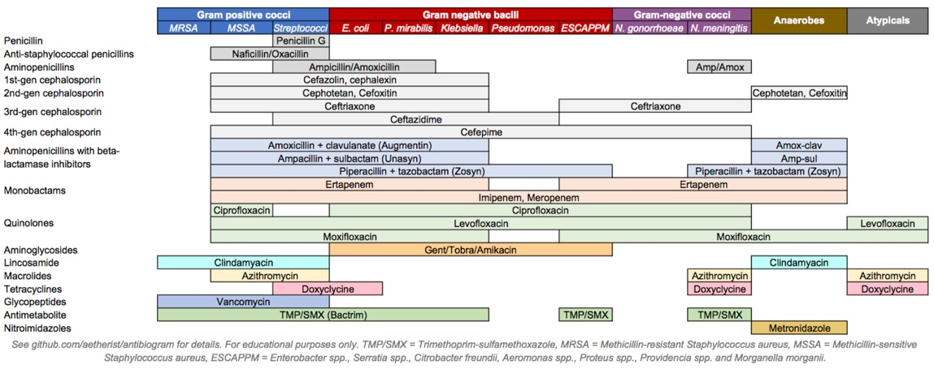

Slide 51
Excellent activity
Aminopenicillins + Beta Lactamase inhibitors
Extended spectrum penicillins + Beta Lactamase inhibitors
Carbapenems
Glycopeptides
Streptogramins
Linezolid
Daptomycin
Excellent activity
Extended spectrum penicillins + betalactamse inhibitors
3rd, 4th and 5th generation cephalosporins
Carbapenems
Monobactams
Aminoglycosides
Colistin
Quinolones → mainly ciprofloxacin and levofloxacin
Combination cephalosporins
Excellent activity
Aminopenicillins + Beta Lactamase inhibitors
Extended spectrum penicillins + Beta Lactamase inhibitors
Carbapenems
Metronidazole
Clindamycin
Chloramphenicol
Excellent activity
Tetracyclines
Quinolones
Macrolides

Slide 52
Empiric therapy (Syndromic approach)
Pneumonia
Urinary tract infection
Pelvic inflammatory disease
Cellulitis
Meningits
Infective endocarditis
Intravascular catheter related infections
Intraabdominal infections

Slide 53
Identify the infection syndrome
Suspect the bugs
Initiate empiric antibiotics

Slide 54
COMMUNITY ACQUIRED PNEUMONIA
PNEUMONIA
Bacteria | Incidence
Streptococcus pneumoniae | 42%
Mycoplasma pneumoniae | 19%
Chlamydophila pneumoniae | 10%
Haemophilus influenzae | 9%
Other aerobic gram negative bacteria | 7%
Legionella spp | 4%

Slide 55
HOSPITAL OR HEALTH CARE ACQUIRED
Bacteria | Incidence
EARLY ONSET HAP (WITHOUT RISK FACTORS FOR MDRO)
Methicillin sensitive Staphylococcus aureus | 29 % to 35%
Haemophilus influenzae | 23% to 33%
Enterobacteriaceae | 5% to 25%
Streptococcus pneumoniae | 7% to 23%
LATE ONSET HAP (HAP WITH RISK FACTORS FOR MDRO)
Pseudomonas aeruginosa | 39% to 64%
Acinetobacter spp | 6% to 26%
Enterobacteriaceae | 16% to 31%
Methicillin resistant staphylococcus aureus | 0% to 20%
PNEUMONIA

Slide 56
Out patient with no risk factors
Bacteria | Incidence
Streptococcus pneumoniae | 42%
Mycoplasma pneumoniae | 19%
Chlamydophila pneumoniae | 10%
Haemophilus influenzae | 9%
Other aerobic gram negative bacteria | 7%
Legionella spp | 4%
Streptococcus pneumoniae
Hemophilus influenzae
Chlamydophila pneumoniae
Mycoplasma pneumoniae
Legionella spp
Chlamydophila pneumonia
Staphylococcus aureus
Other aerobic gram negative bacteria
Beta lactam
Quinolone
Macrolide

Slide 57
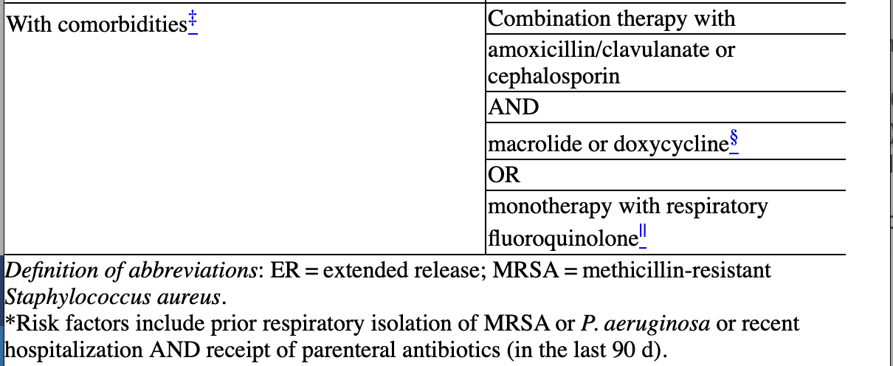
Out patient with risk factors
Bacteria | Incidence
Streptococcus pneumoniae | 42%
Mycoplasma pneumoniae | 19%
Chlamydophila pneumoniae | 10%
Haemophilus influenzae | 9%
Other aerobic gram negative bacteria | 7%
Legionella spp | 4%
Streptococcus pneumoniae
Hemophilus influenzae
Chlamydophila pneumoniae
Mycoplasma pneumoniae
Legionella spp
Chlamydophila pneumonia
Staphylococcus aureus
Other aerobic gram negative bacteria
Beta lactam
Quinolone
Macrolide

Slide 58
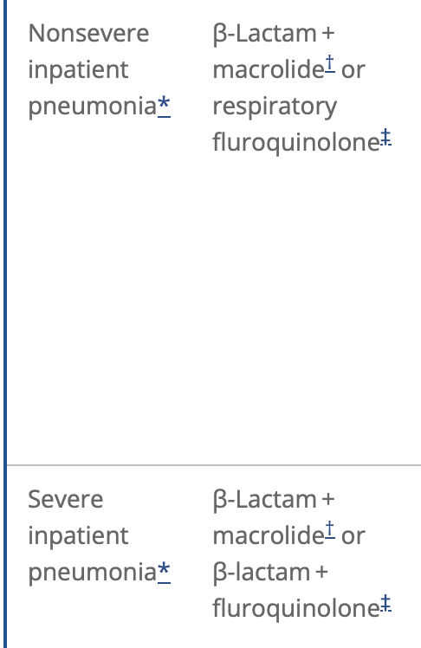
Bacteria | Incidence
Streptococcus pneumoniae | 42%
Mycoplasma pneumoniae | 19%
Chlamydophila pneumoniae | 10%
Haemophilus influenzae | 9%
Other aerobic gram negative bacteria | 7%
Legionella spp | 4%
Community Acquired Pneumonia
Streptococcus pneumoniae
Hemophilus influenzae
Chlamydophila pneumoniae
Mycoplasma pneumoniae
Legionella spp
Chlamydophila pneumonia
Staphylococcus aureus
Other aerobic gram negative bacteria
Beta lactam
Macrolide
Quinolone
If pseudomonas aeruginosa is suspected, add two antipseudomonal agents
If staphylococcus is suspected, add glycopeptide (vancomycin) or linezolid

Slide 59
Bacteria | Incidence
EARLY ONSET HAP (WITHOUT RISK FACTORS FOR MDRO)
Methicillin sensitive Staphylococcus aureus | 29 % to 35%
Haemophilus influenzae | 23% to 33%
Enterobacteriaceae | 5% to 25%
Streptococcus pneumoniae | 7% to 23%

Slide 60
Combination Antibiotic Therapy
Antipseudomonal cephalosporin (Cefepime, Ceftazidime) or Antipseudomonal Carbapenem (Imipenem or Meropenem) or Beta Lactam + Beta Lactamase inhibitor plus Antipseudomonal fluoroquinolone (Ciprofloxacin or Levofloxacin) or Aminoglycoside (Amikacin, gentamicin, or tobramycin) plus Linezolid or vancomycin
Late onset HAP
LATE ONSET HAP (HAP WITH RISK FACTORS FOR MDRO)
Pseudomonas aeruginosa
Enterobacteriacae
Acinetobacter
Methicillin resistant staphylococcus aureus
Antipseudomonal cephalosporin or piperacillin Tazobaxtam
Quinolone
Carbapenem
Aminoglycoside
Vancomycin or Linezolid

Slide 61
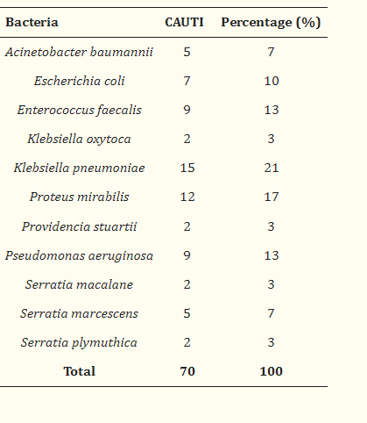
Urinary tract infections
Uncomplicated
E.coli | 53% to 79%
Proteus mirabilis | 4% to 5%
Staphylococcus saprophyticus | 3%
Klebsiella pneumoniae | 2% to 3%
Other enterobacteriaceae | 3%
Complicated
E.coli | 26% to 29%
Enterococci | 13% to 17%
Pseudomonas aeruginosa | 9 % to 16%
Klebsiella spp | 8% to 10%
Other enterobacteriaceae | 9% to 11%
Methicillin Sensitive and Methicillin Resistant staphylococcus aureus

Slide 62
Complicated UTI
Latest update →
Do not automatically consider patients with underlying urologic abnormalities , immunocompromising conditions , or poorly controlled diabetes mellitus to have a complicated UTI if they have no concerning symptoms for upper tract or systemic infection
They can be at higher risk for more serious infection and have not traditionally been included in studies evaluating the antibiotic regimens that are typically used for acute simple cystitis
Such patients are to followed more closely and/or have a low threshold to manage them as complicated UTI

Slide 63
Uncomplicated/ Acute simple cystitis
E.coli
Proteus mirabilis
Staphylococcus saprophyticus
Klebsiella pneumoniae
Other enterobacteriaceae
Oral Nitrofurantoin BD for 5 days
or
Oral Trimethoprim- Sulfamethoxazole DS BD for 3 days
or
Fosfomycin single dose parenteral
or
Oral Pivmecillinam BD for 5 days

Slide 64
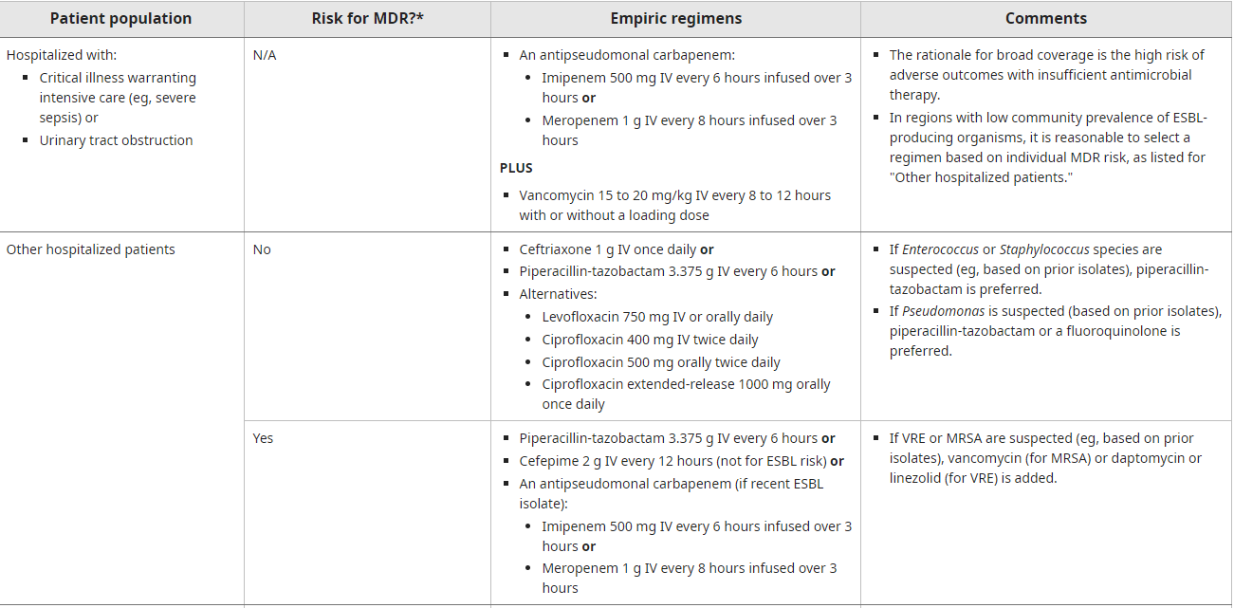
Complicated UTI
Complicated
E.coli
Enterococci
Pseudomonas aeruginosa
Klebsiella spp
Other enterobacteriaceae
Methicillin Sensitive and Methicillin Resistant staphylococcus aureus

Slide 65
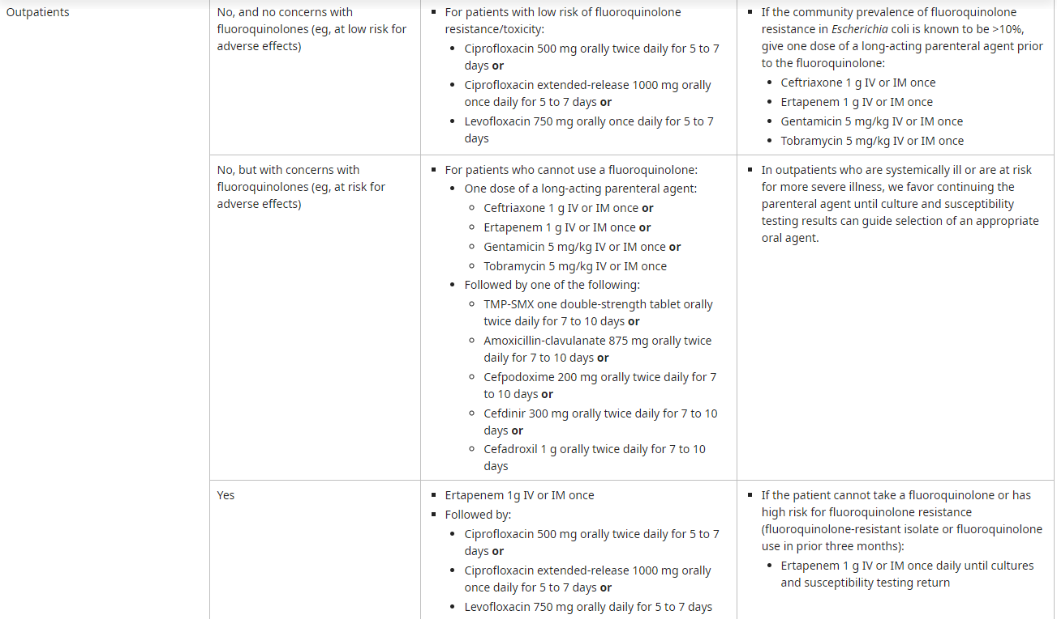
Outpatients with acute complicated UTI

Slide 66
Pelvic inflammatory diseases
Neisseria Gonorrhoeae | 27% to 56%
Chlamydia trachomatis | 22% to 31%
Anaerobic bacteria | 20% to 78%
Mild to moderate disease planned for outpatient treatment
Ceftriaxone IM single dose
plus Oral Doxycycline for 14 days
plus Oral Metronidazole for 14 days
Severe disease requiring hospitalisation
Ceftriaxone IV + Doxycycline + Metronidazole Or Cefoxitin + Doxycycline Or Cefotetan + Doxycycline | Cefoxitin, Cefotetan
Clindamycin + Aminoglycoside (gentamicin) → limited clinical data

Slide 67
Meningitis
Age | Bacterium
0 to 1 months | Streptococcus agalactiae E.coli Listeria monocytogenes Klebsiella spp | Ampicillin plus cefotaxime or Ampicillin plus an aminoglycoside
1 months to 23 months | Neisseria meningitidis Streptococcus pneumoniae Group B streptococcus Haemophilus influenzae type B E.Coli | Vancomycin plus a third-generation cephalosporin (Cefotaxime or ceftriaxone)
2 to 50 years | Streptococcus pneumoniae Neisseria meningitidis | Vancomycin plus a third-generation cephalosporin (ceftriaxone or cefotaxime )
>50 years | Streptococcus pneumoniae Listeria monocytogenes Aerobic gram negative bacilli | Vancomycin plus a third-generation cephalosporin plus ampicillin ( 2 g q4h hourly if Listeria is suspected)

Slide 68
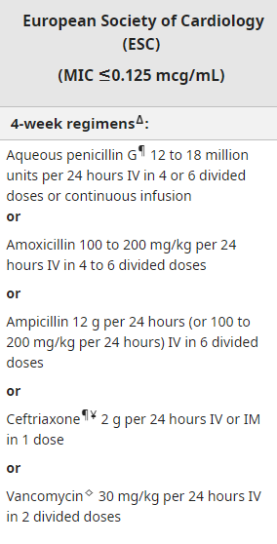
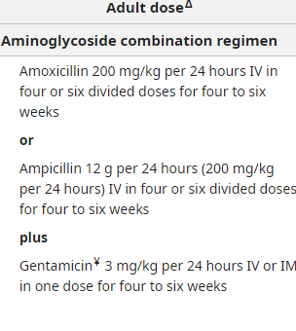
Infective endocarditis
Penicillin sensitive viridans and bovis streptococci
Bacteria | Incidence
Viridans group streptococci | 18% to 48%
Staphylococcus aureus | 22% to 32%
Enterococci | 7% to 11%
Coagulase negative staphylococci | 7% to 11%
HACEK organisms | 2% to 7%
Enterococcal strains susceptible to penicillin and gentamycin

Slide 69
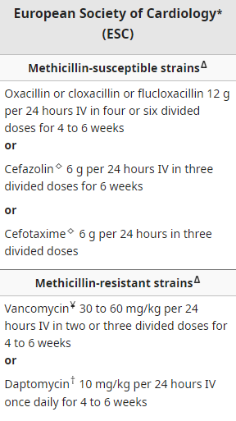
IE due to stpahylococcus

Slide 70
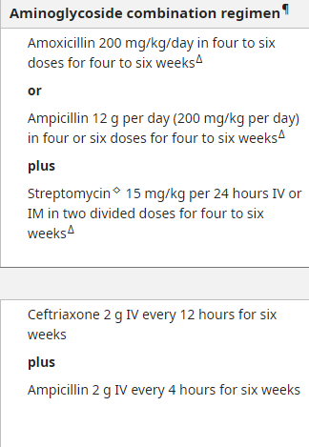
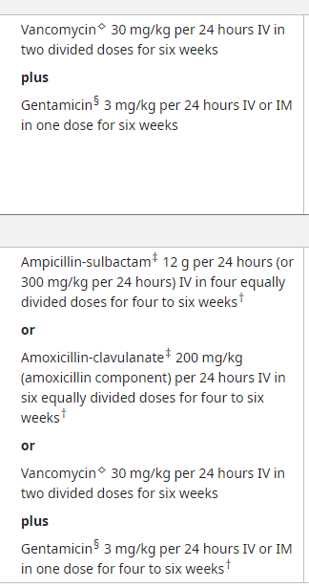
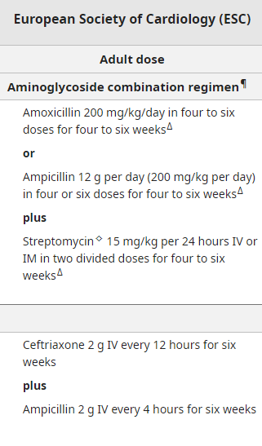
Native or prosthetic valve endocarditis resistant to penicillin but susceptible to vancomycin and aminoglycosides

Slide 71
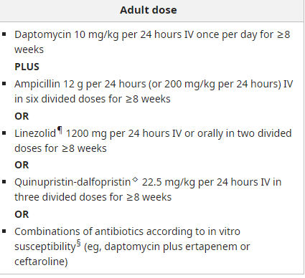
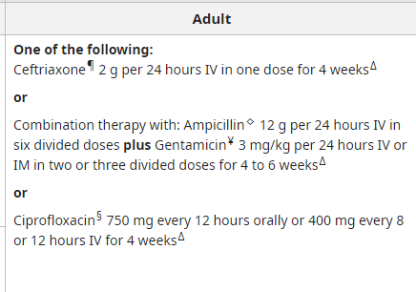
Enterococcal strains resistant to penicillin, aminoglycosides, and vancomycin*
Native or prosthetic valve endocarditis due to HACEK* microorganisms

Slide 72
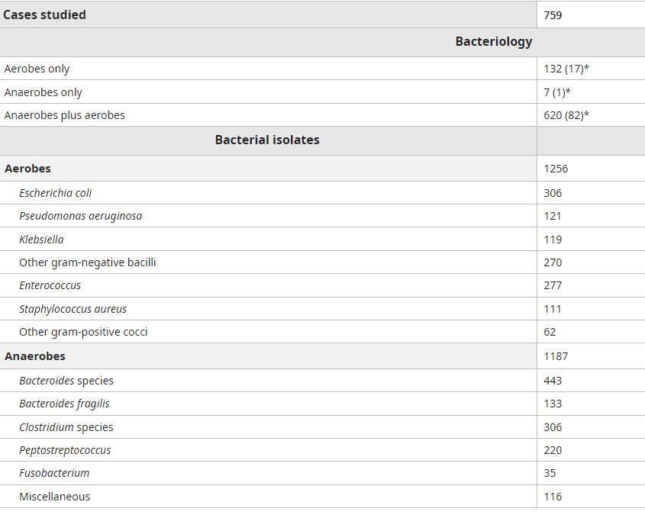
Complicated intraabdominal infections

Slide 73
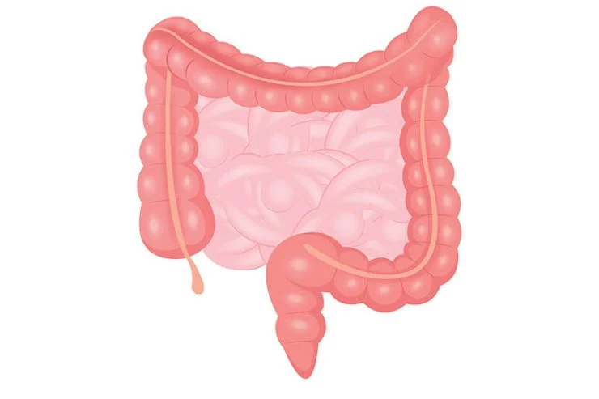
Carbapenems
or
Extended spectrum penicillins +
beta lactamase inhibitor combination
Gram negative Bacilli
Gram positive cocci
Anaerobic Bacteria
Cephalosporin
Metronidazole

Slide 74
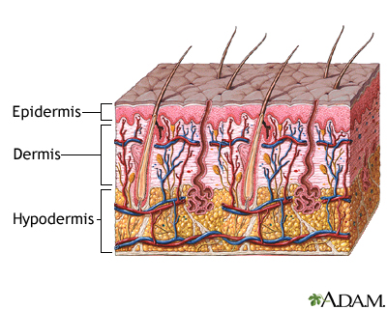
Cellulitis
First generation cephalosporins
Clindamycin
Macrolides
Glycopeptides
Linezolid
Daptomycin
Tetracycline like agents
Ceftaroline
Trimethoprim-Sulfamethoxazole
Antistaphylococcal penicillin
Bacterium | %
Staphylococcus aureus | 13 % to 37%
Streptococcus pyogenes | 4% to 17%
Other streptococci | 1% to 8%

Slide 75
Intravascular catheter related infections
Bacteria | Incidence
Coagulase Negative Staphylococci | 32% to 41%
Staphylococcus aureus | 5% to 14%
Enteric gram negative bacilli | 5% to 11%
Pseudomonas aeruginosa | 4% to 7%
Vancomycin
Ceftazidime and Cefepime
Anti staphylococcal penicillin

Slide 76
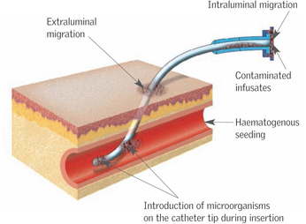
Antistaphylococcal penicillin
Coagulase Negative staphylococci
Staphylococcus aureus
Enteric gram negative bacilli
Pseudomonas aeruginosa
Vancomycin
Cefepime
Ceftazidime
Methicillin resistance uncommon
Antistaphylococcal penicillin | Nafcillin, oxacillin
Methicillin resistance common
Glycopeptide | Vancomycin
Immunocompromised or severely ill patient
Cephalosporin | Ceftazidime, cefepime

