Slide 1
Arterial Blood Sampling and Interpretation with ICU scenarios
Dr Ken Adegoke FRCA,FFICM (Uk)
16TH April 2023
At the Webinar of the I-CCSN .

Slide 2
Outline – 45 Mins
ABG- Current Clinical Concept – Arterial Stab, Artline (transduced), I Stat , ABG Analyser – 5 Mins
Normal ABG Values – 5 Mins
Ph Concept – Acidosis , Alkalosis -5 Mins
Clinical Interpretation of ABGs -15 Mins
ABG Quiz / Breakout groups 10 Mins
Questions- 5 Mins

Slide 3

Arterial Blood Gas ABG
Sampling and interpretation – A crucial skill Physicians, nurses , respiratory therapists and other allied personnel .
Especially in the critically ill

Slide 4
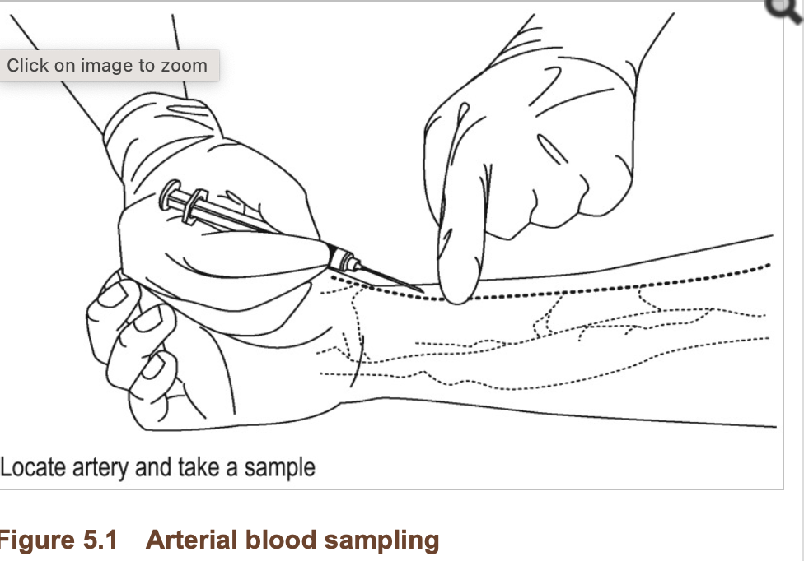

Slide 5
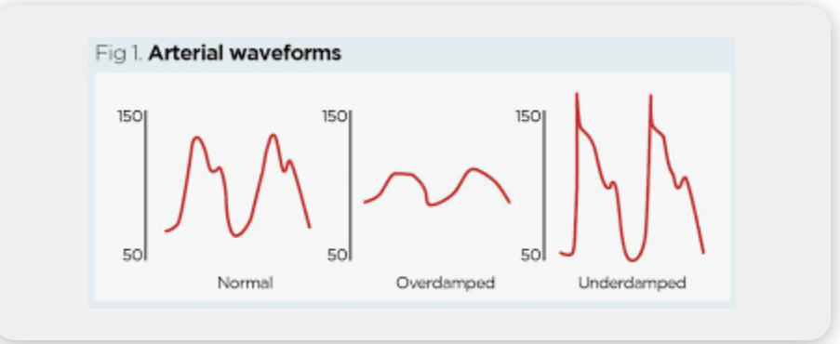

Slide 6
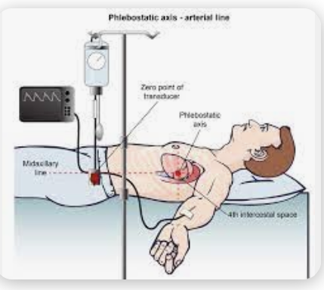

Slide 7
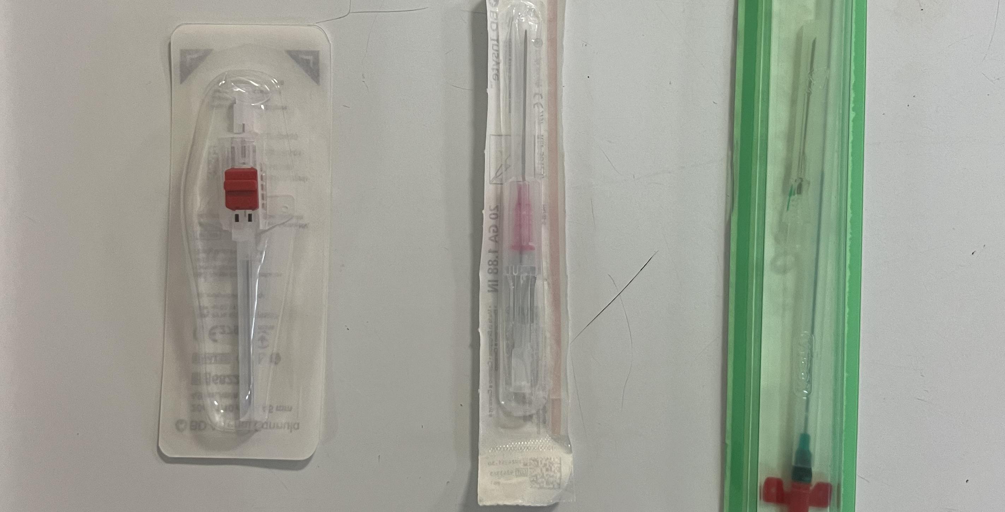

Slide 8


Presssure Monitoring set

Slide 9
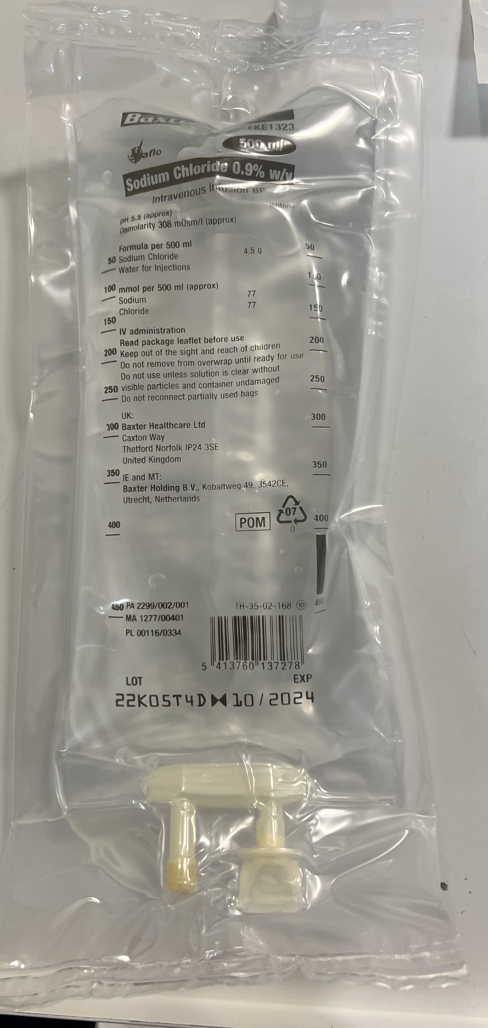

Slide 10


Slide 11
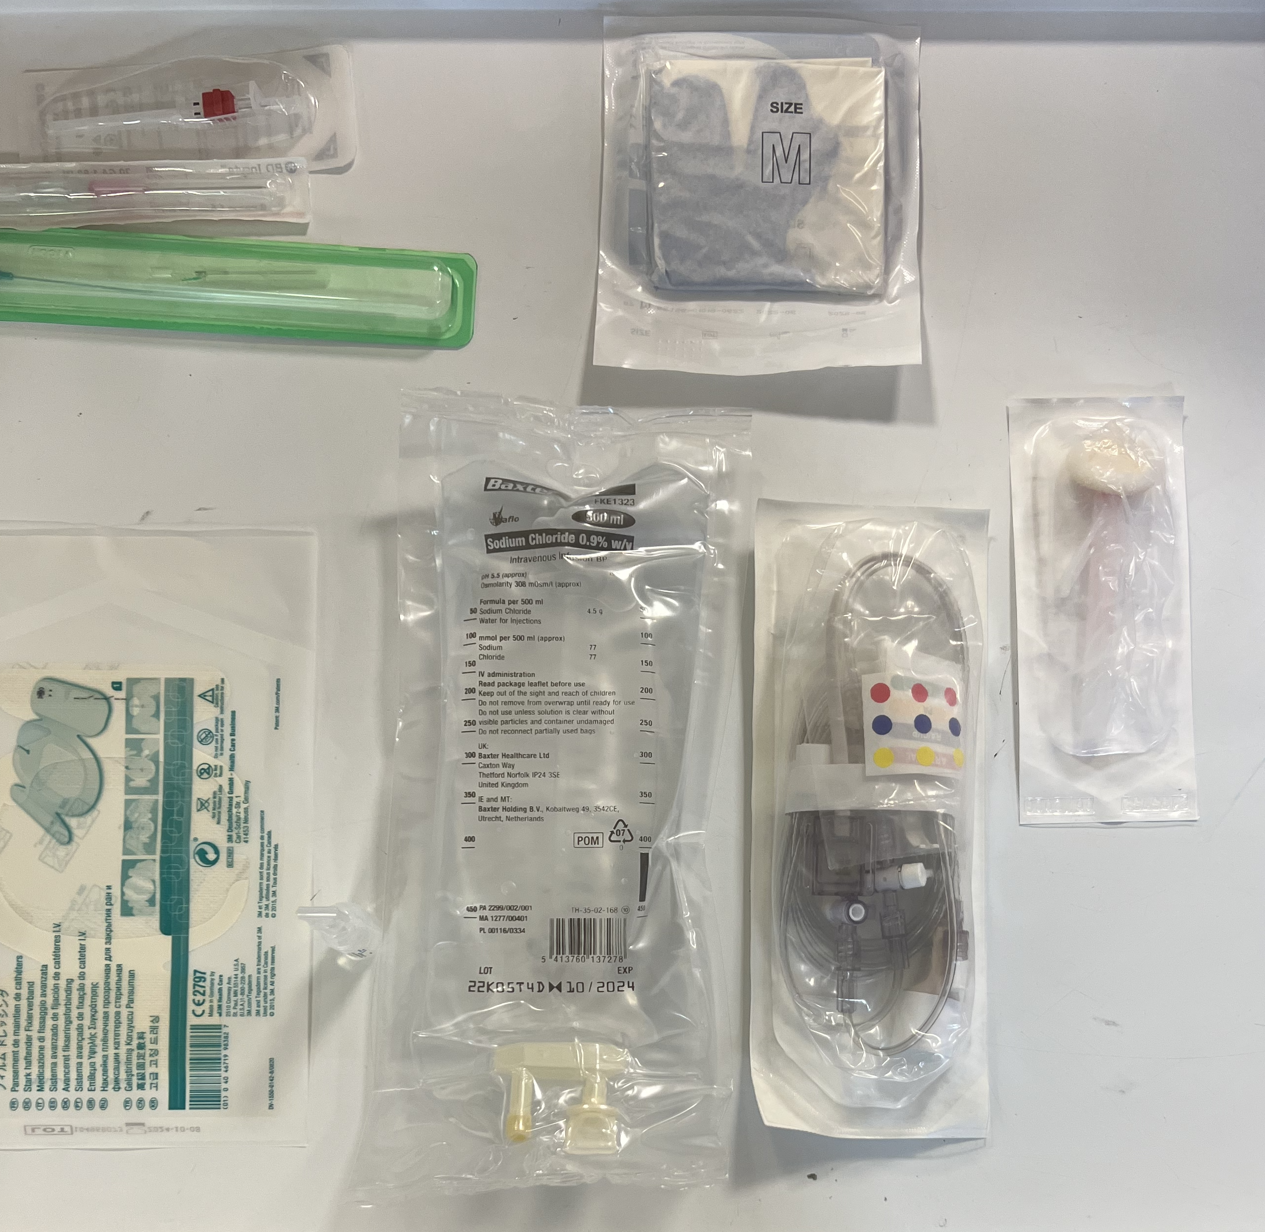

Slide 12
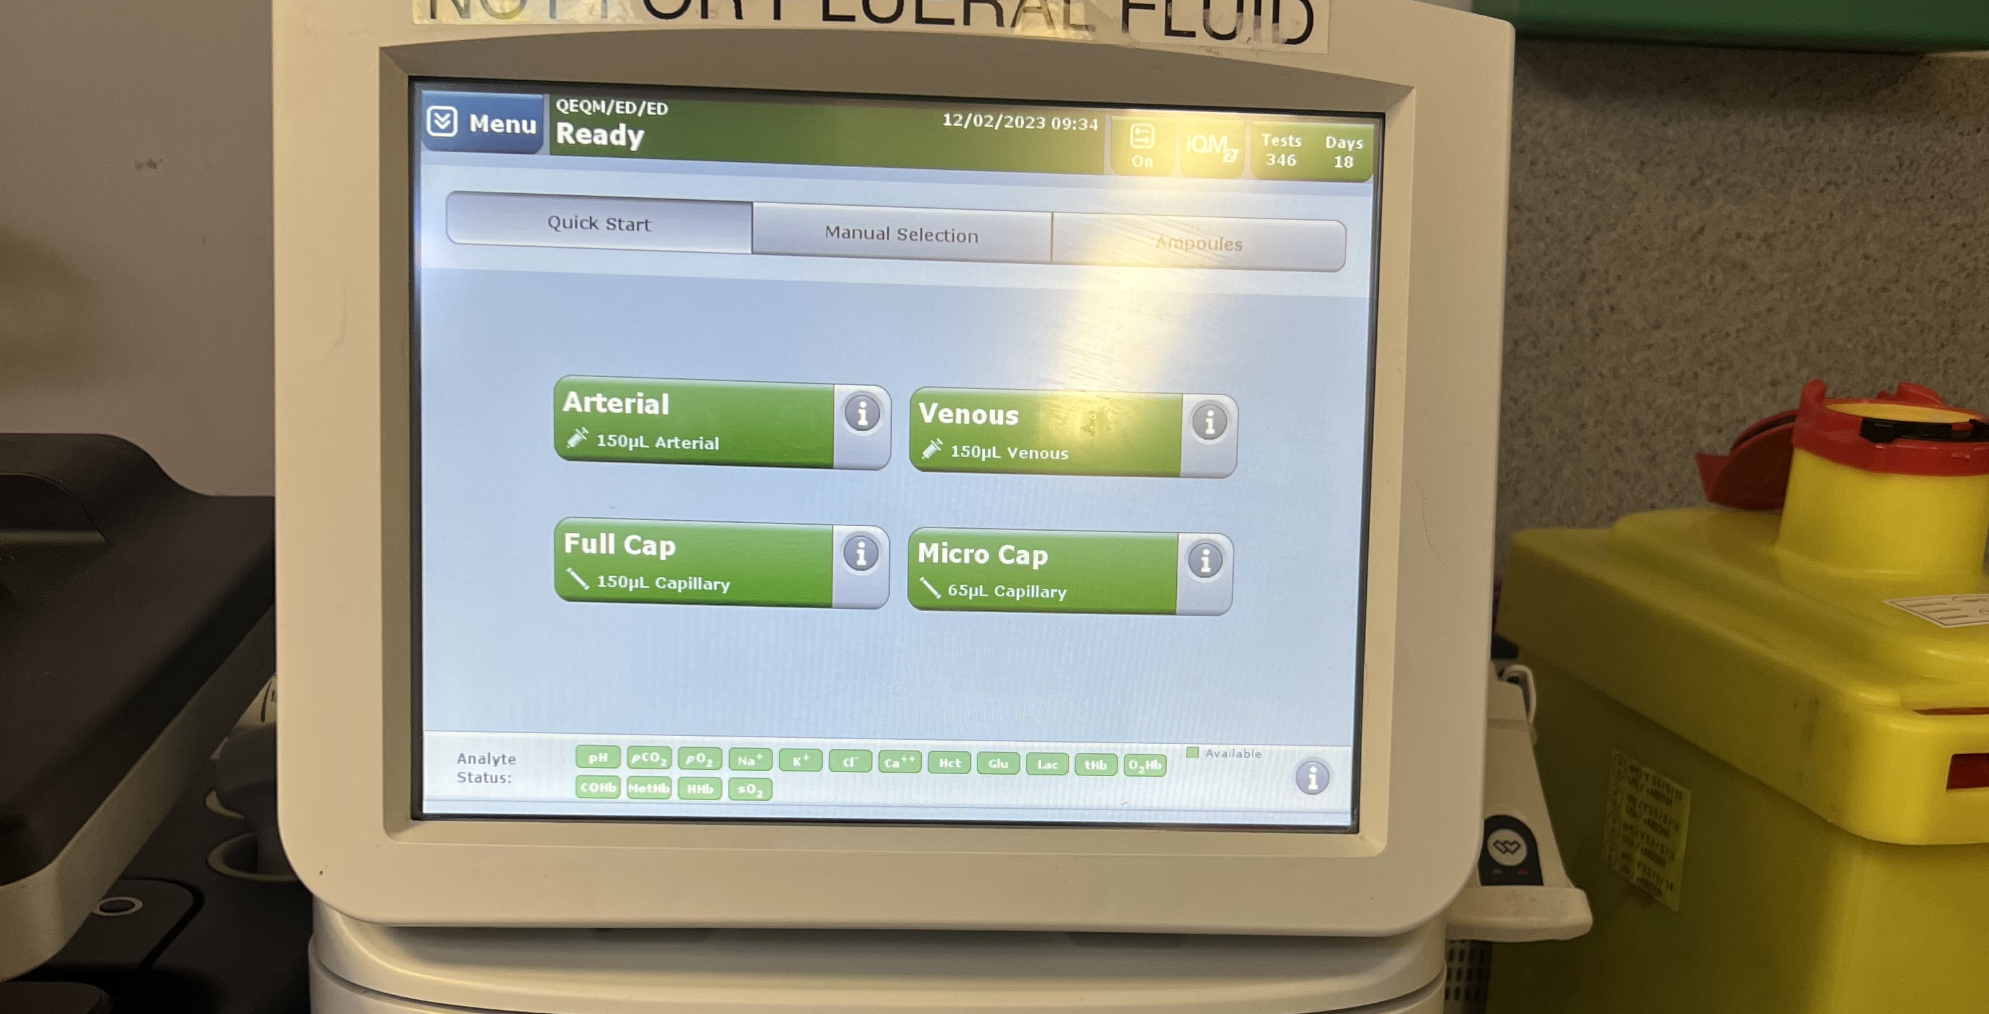

Slide 13

I-STAT Arterial Blood Gas Set Up.

Slide 14
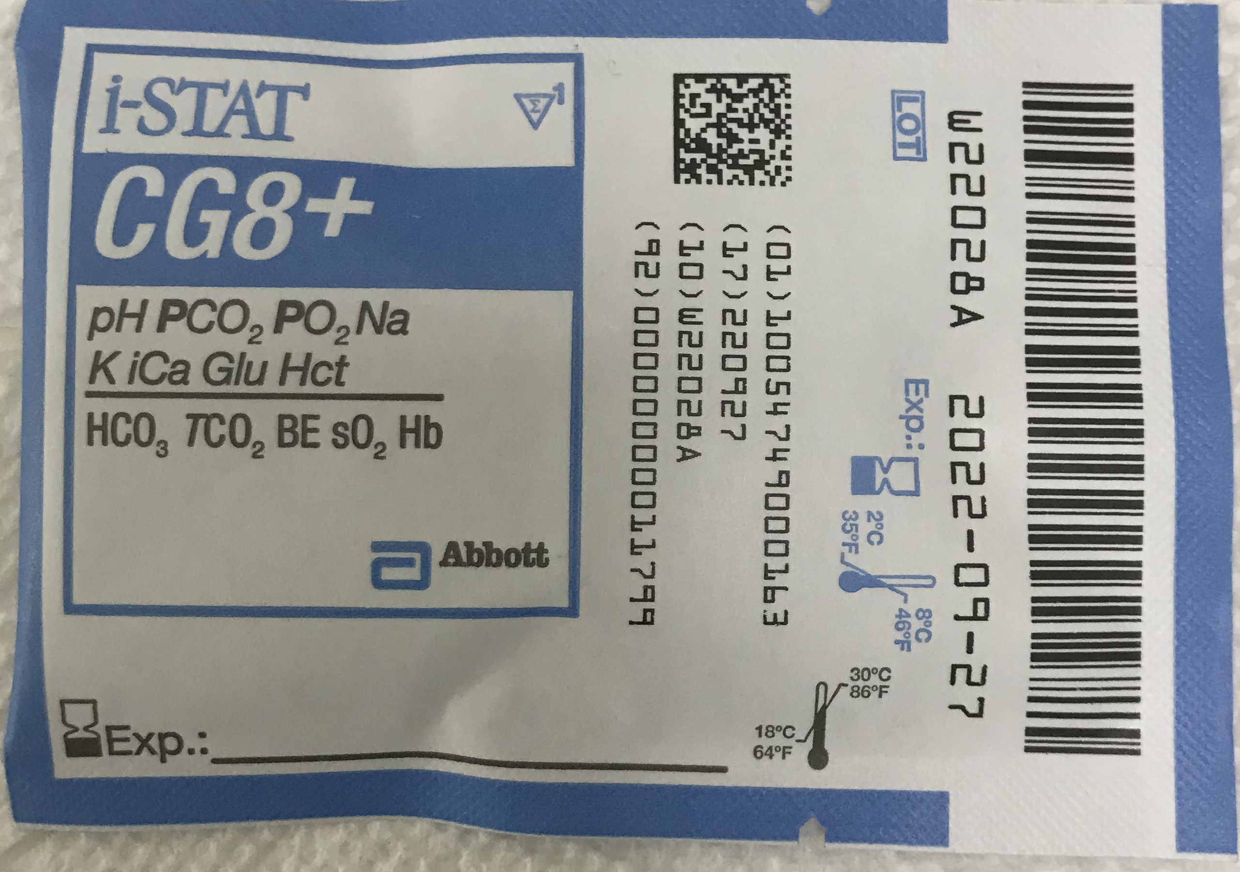

Slide 15
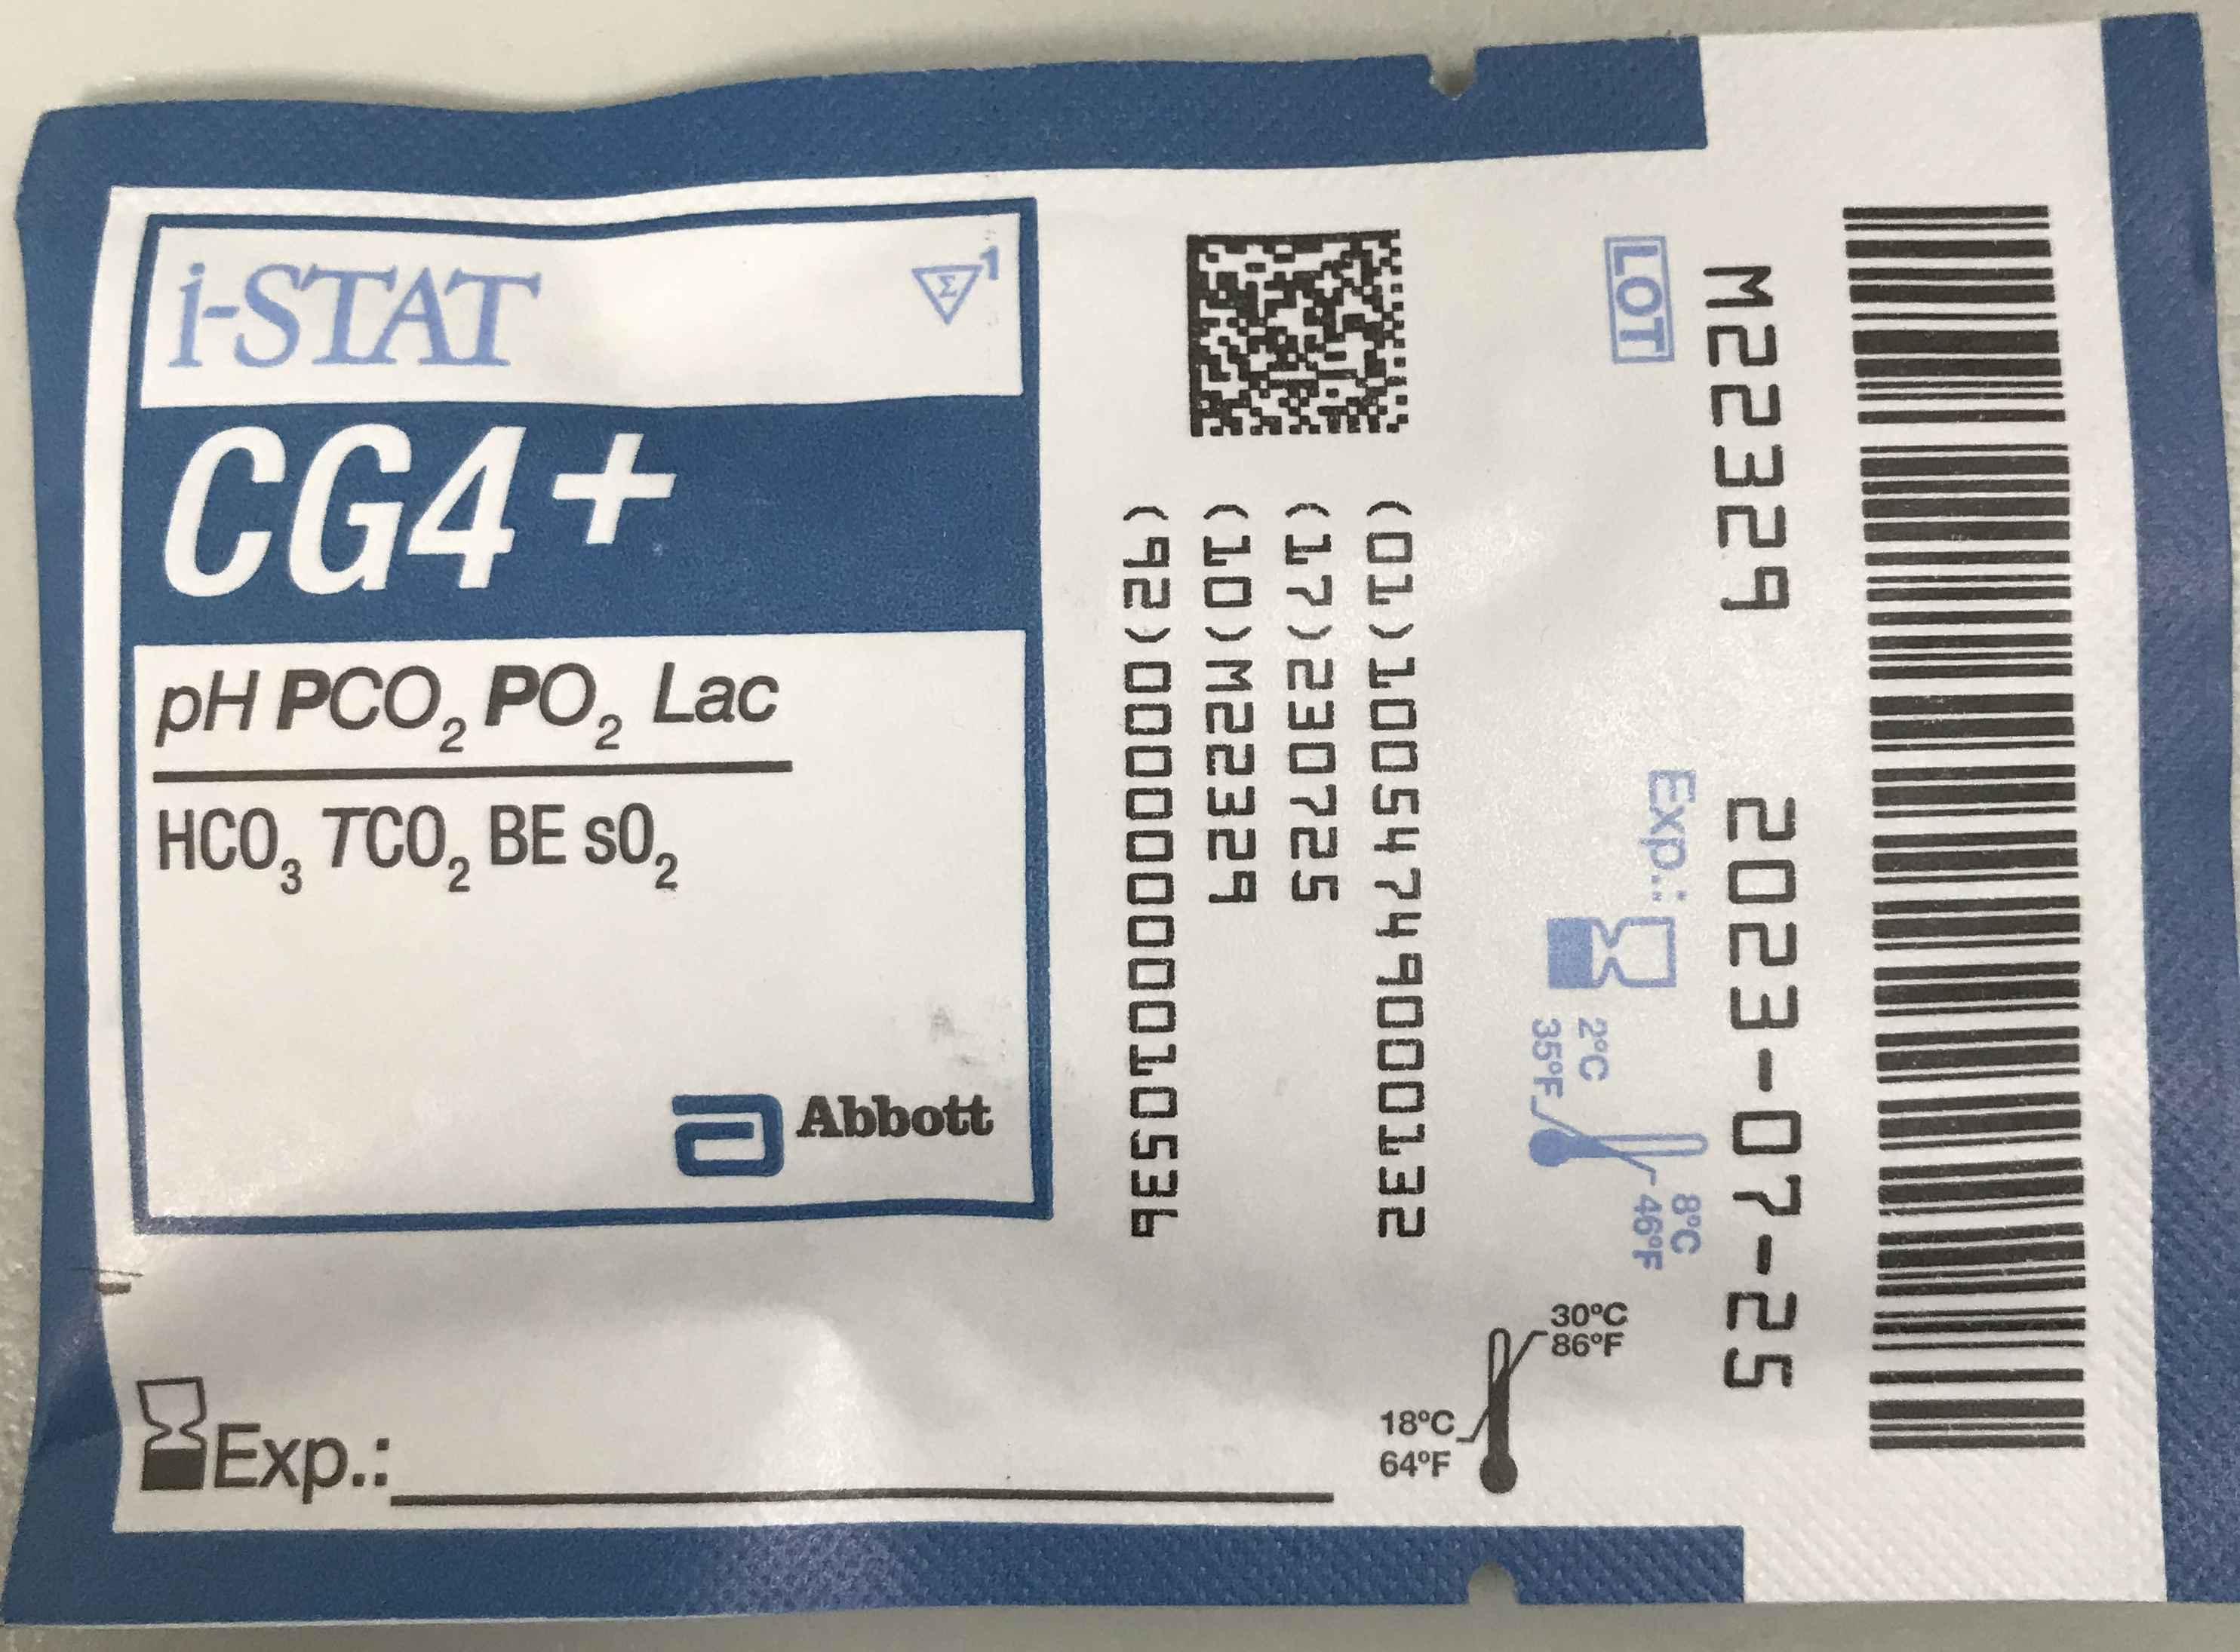

Slide 16
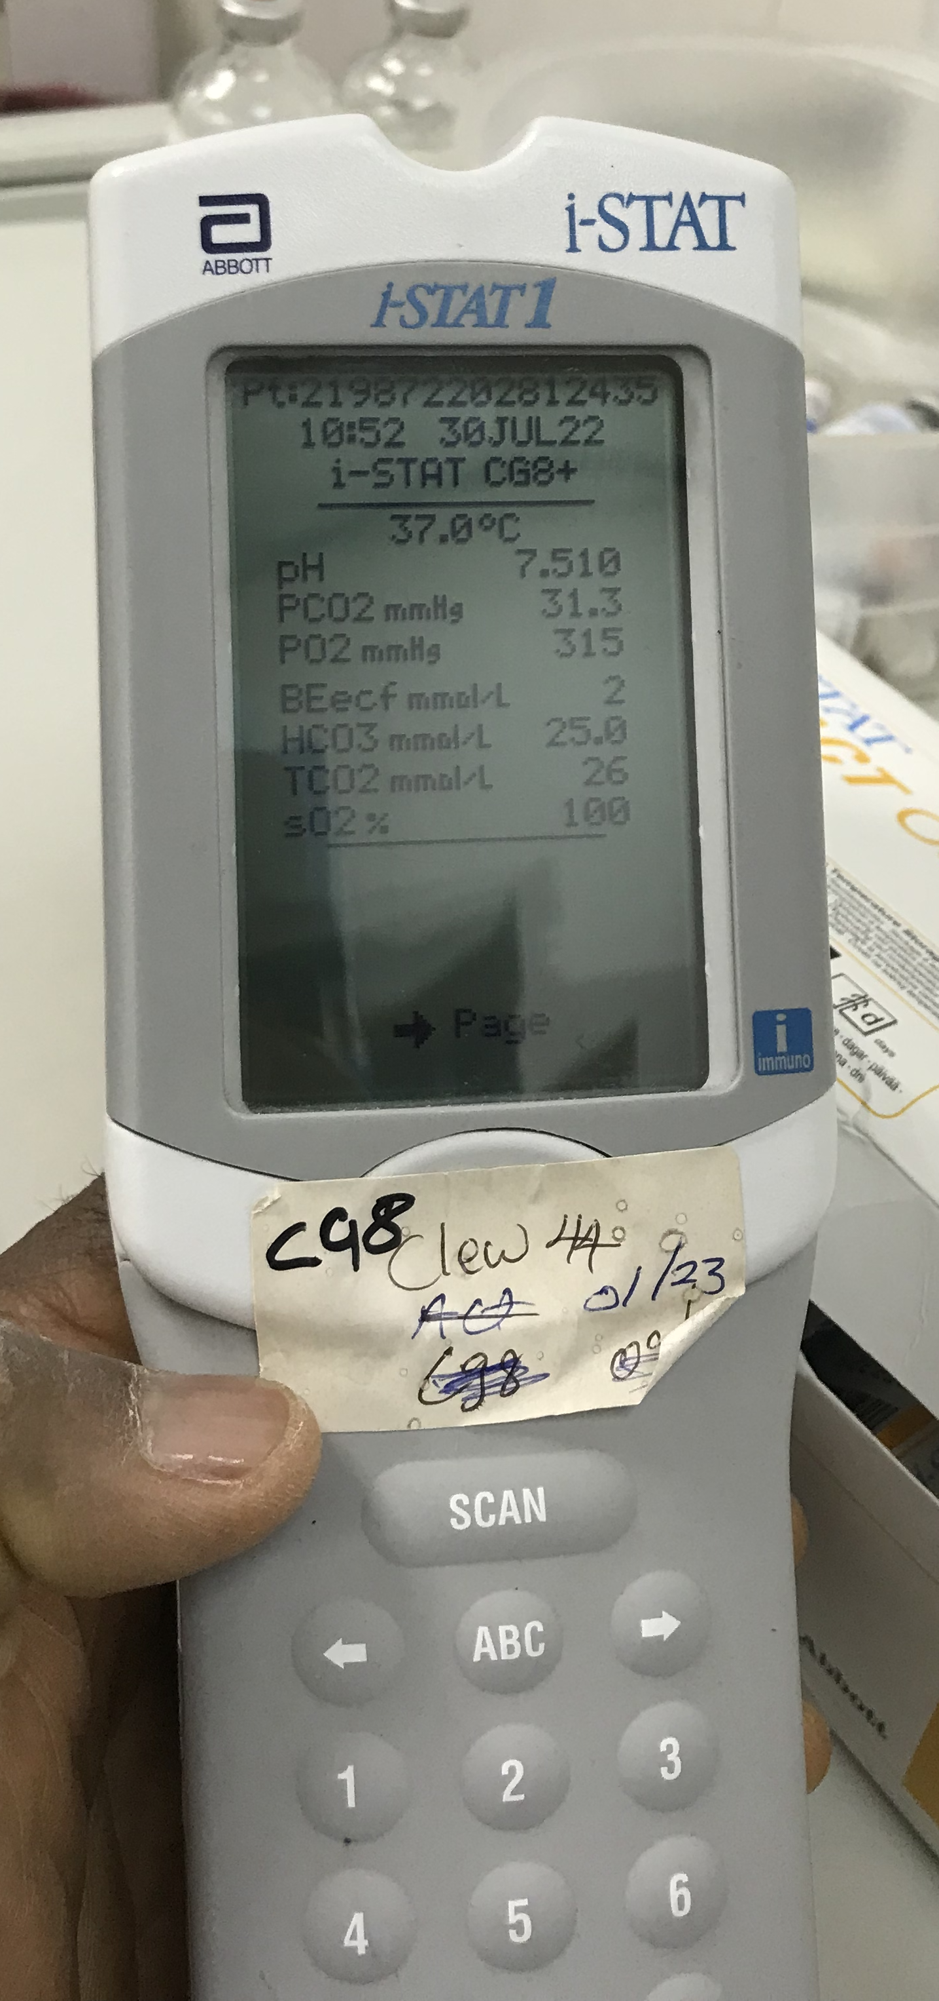
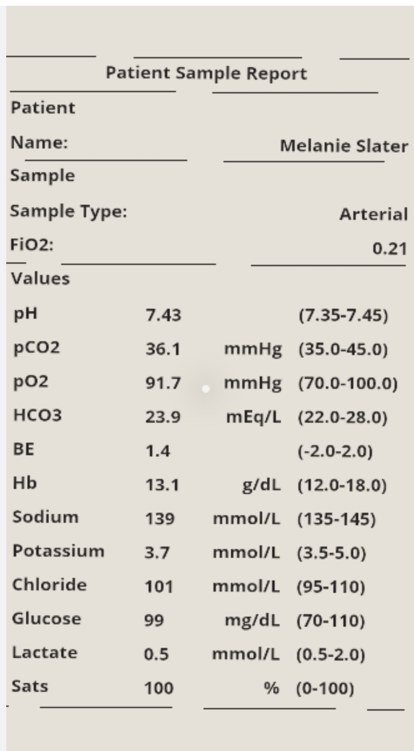

Slide 17
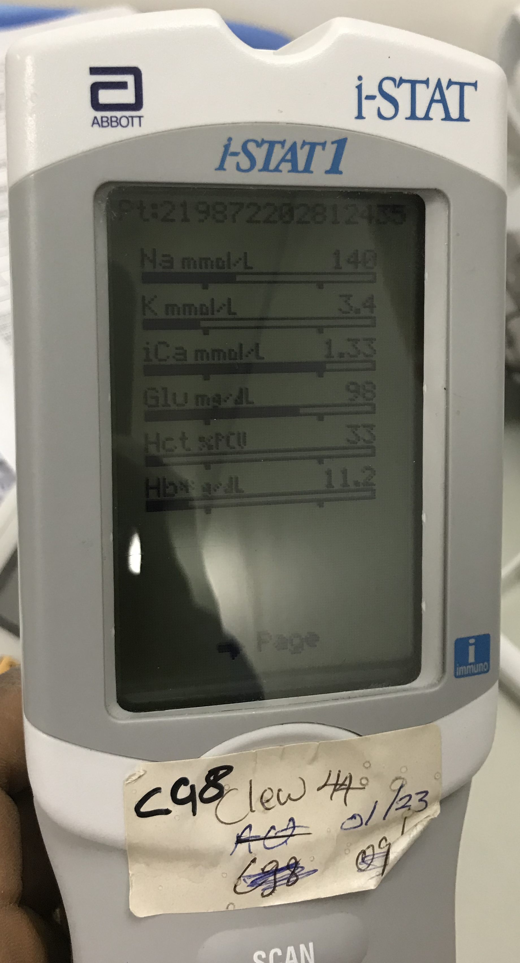

Slide 18
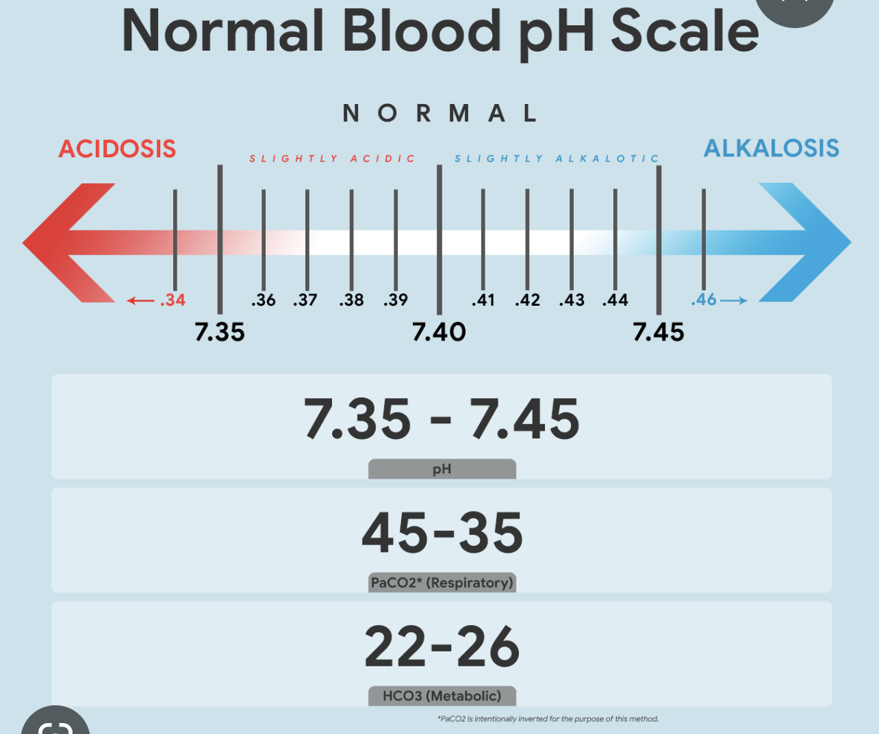

Slide 19
MODIFIED HADERSON HASSELBALCH EQUATION
pH = HCO3/PCO2

Slide 20

Use and interpretation of the Arterial Line
-Regular blood samples
Respiratory Status – Acute Respiratory Failure – Types 1 & 2
Cardiovascular -status
Metabolic – ( Acid – Base )- status
Primary disorder
Compensation

Slide 21
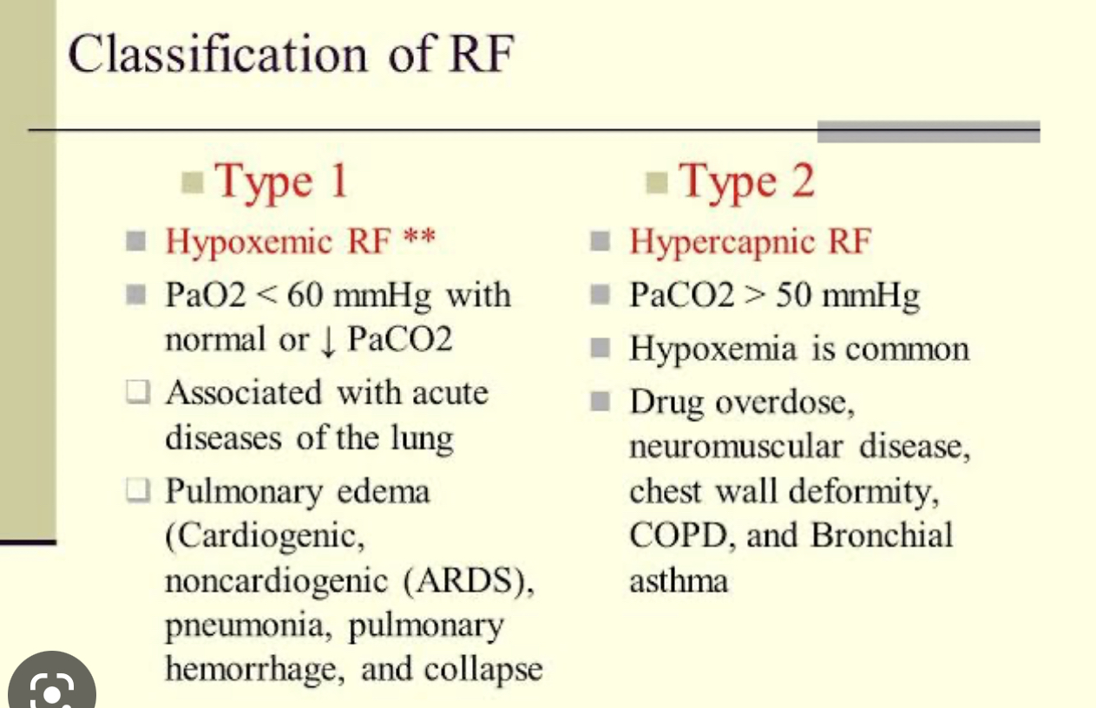

Slide 22
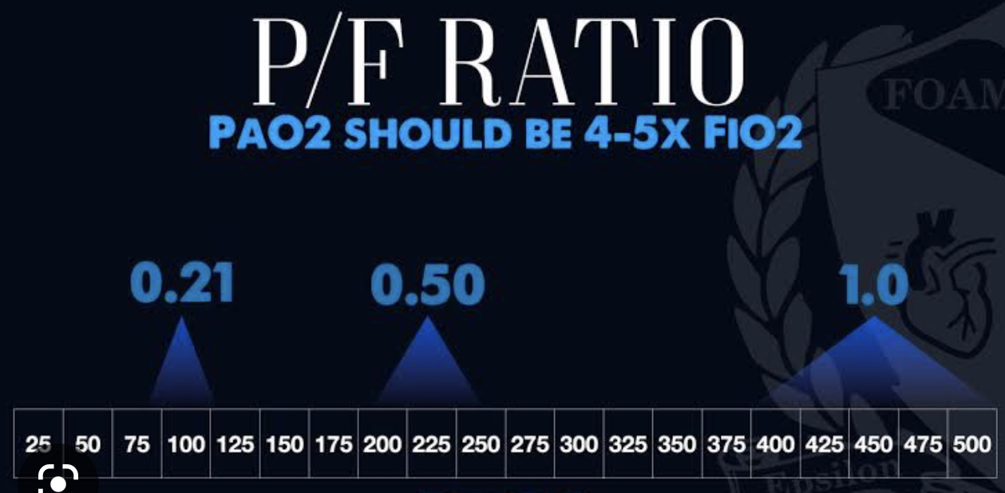

Slide 23
ABG – NORMAL VALUES
pH 7.35-7.45
Pao2 10.7-13.3 Kpa (80.3-99.8 mmHg )
PCo2 4.5-6.0 Kpa (33.8- 45 mmHg )
HCo3 22-26 mmol/l
BE -2- +2
AG 4-12 mEq/L

Slide 24
ABG Interpretation – 3 Steps
History
Confirm patient’s Identity
Make sure arterial sample – check Pao2 and O2sats
What Fio2 ?
Step 1 – check pH
Step 2 Check –PaCo2
Step 3 Check HCO3 or BE

Slide 25
Calculation of the Anion Gap
Na – (Cl+ Hco3)
Normal Anion gap is 4-12 mEq/L

Slide 26

- ABG -Compensation
Is there appropriate compensation for the primary disturbance ?
Usually , compensation does not return the pH to normal ( 7.35-7.45 )

Slide 27

ABG - Interpretation
Respiratory disturbance or Metabolic ?
Relationship between the direction of change in pH & the direction of change in the pCO2 ?
In Primary respiratory disorders – the pH & PaCo2 change in opposite directions
In Metabolic disorders the pH & PaCo2 change in the same direction
Mnemonic - ROME

Slide 28
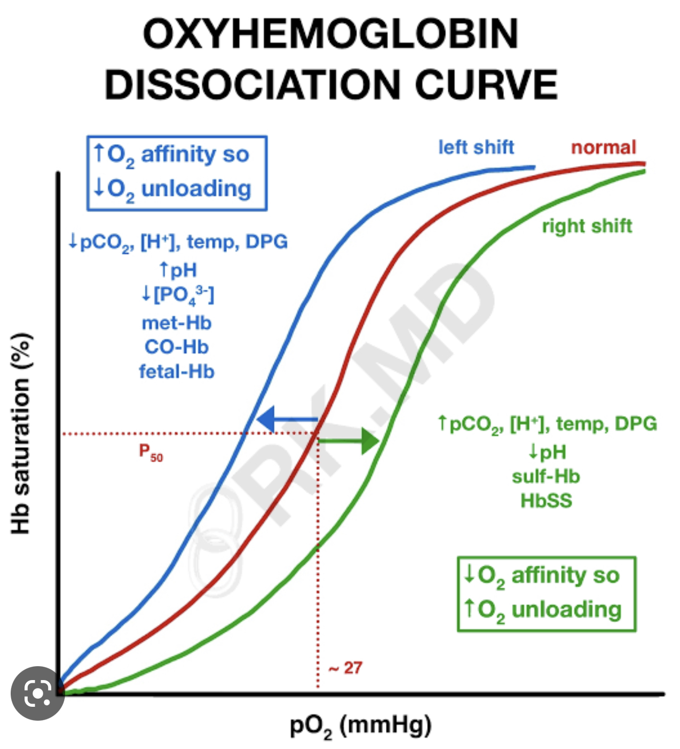

Slide 29
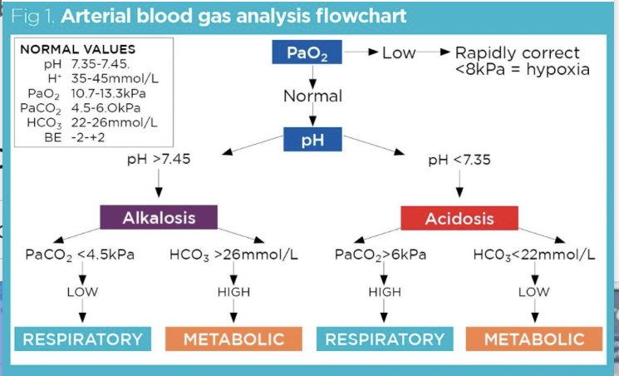

Slide 30
Some Common Medical Conditions –Presenting to Critical Care

Slide 31
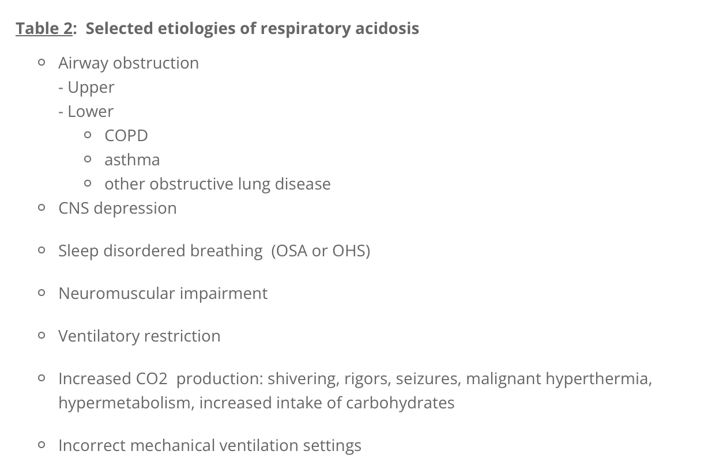
Some Causes of Respiratory Acidosis

Slide 32
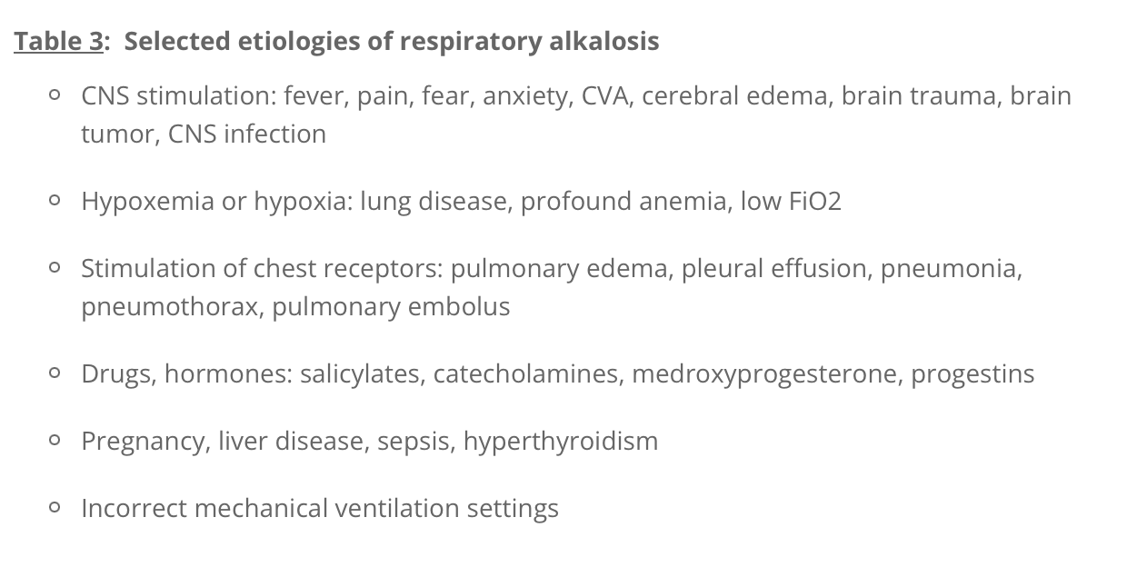
Some Causes of Respiratory Alkalosis

Slide 33
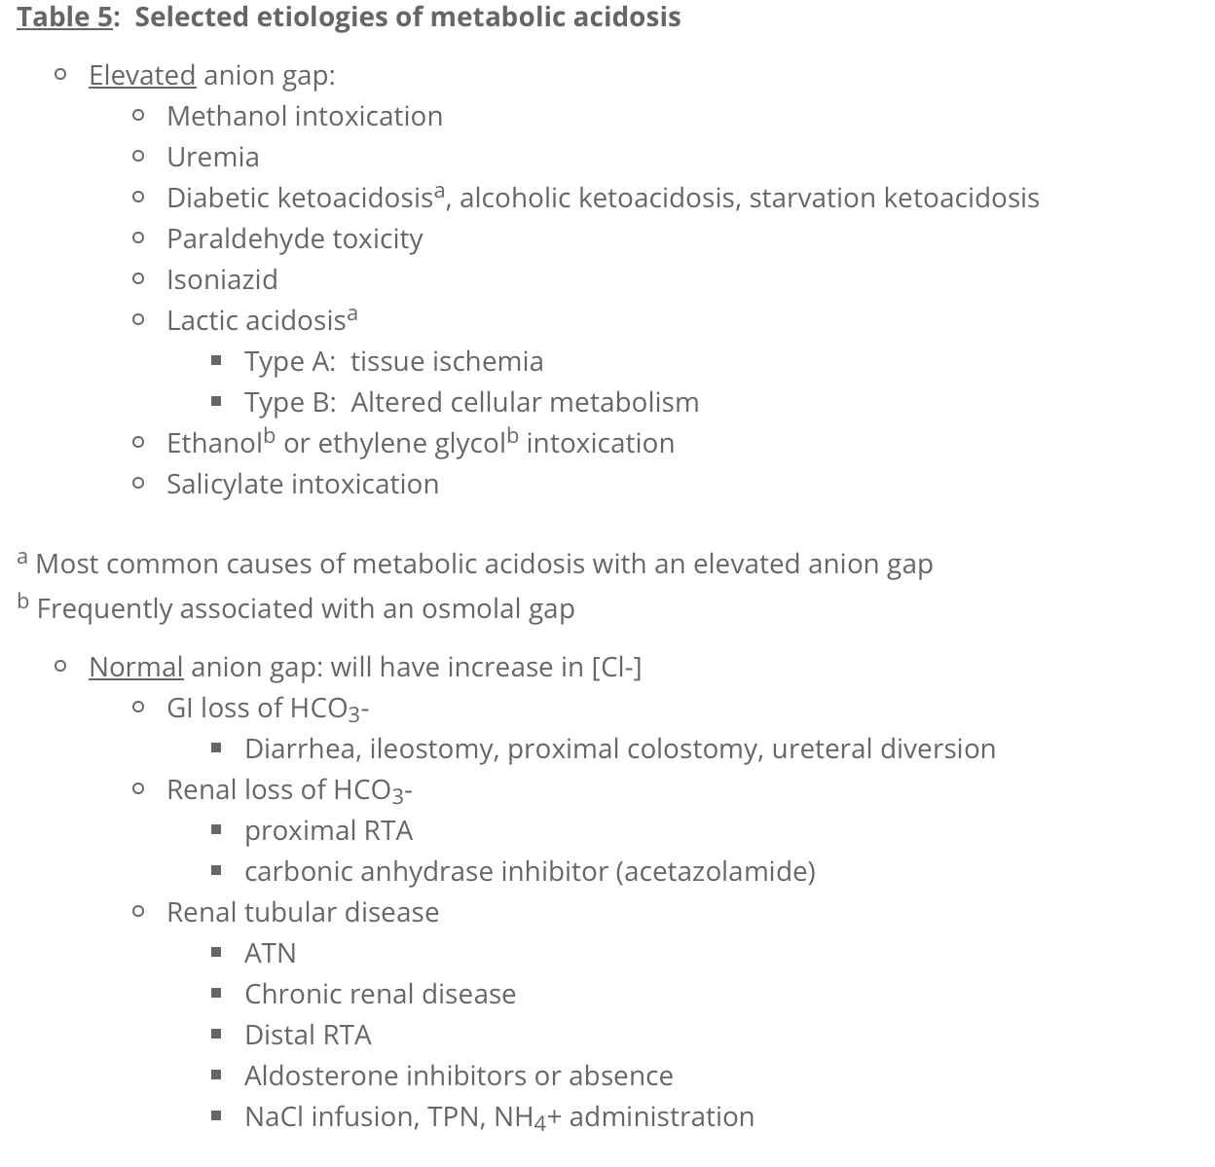
Some Etiologies of Metabolic Acidosis.

Slide 34
Metabolic Alkalosis
Vomiting
Over correction on ventilator
Mineralocorticoid excess - eg Conn syndrome
Iatrogenic ( NaHCo3)
Total Volume loss – dehydration , diuretics etc

Slide 35
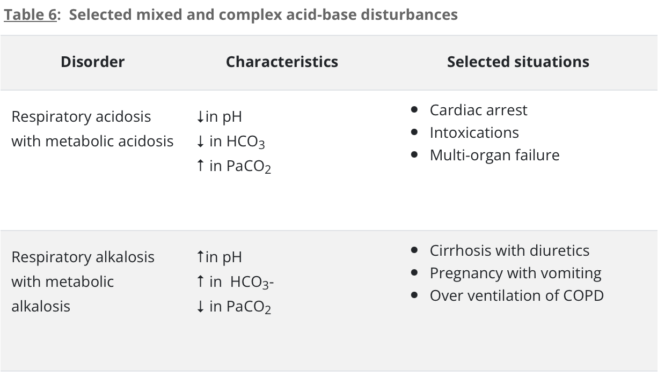
Mixed & Complex Acid Base Disturbances

Slide 36
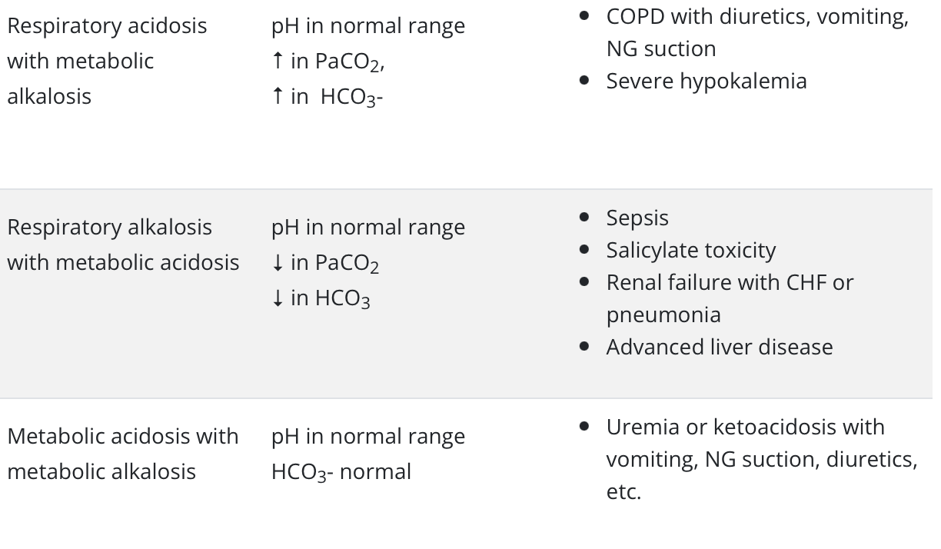
Mixed and complex Acid Base Disturbances- ctd

Slide 37
Some Clinical Cases- Go to Breakout Rooms.
ken Adegoke

Slide 38


Slide 39
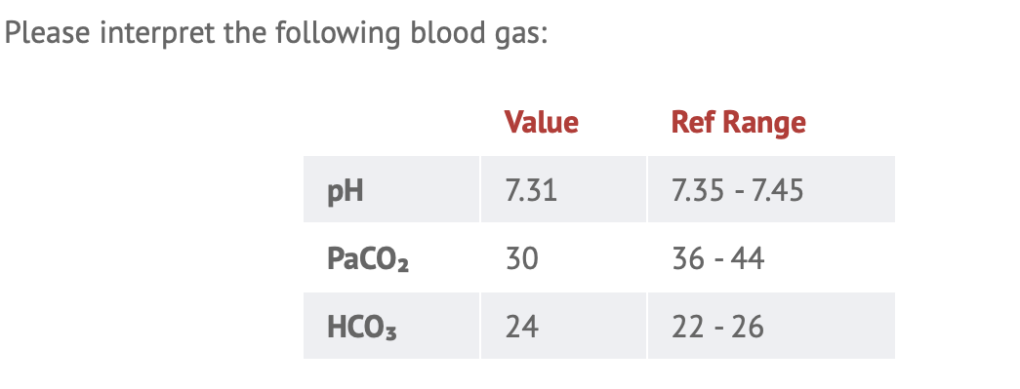

Slide 40
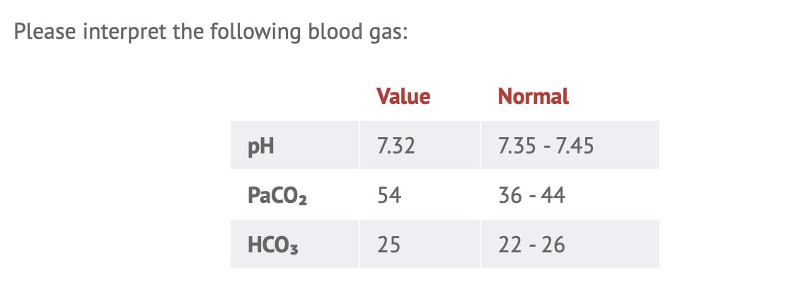

Slide 41
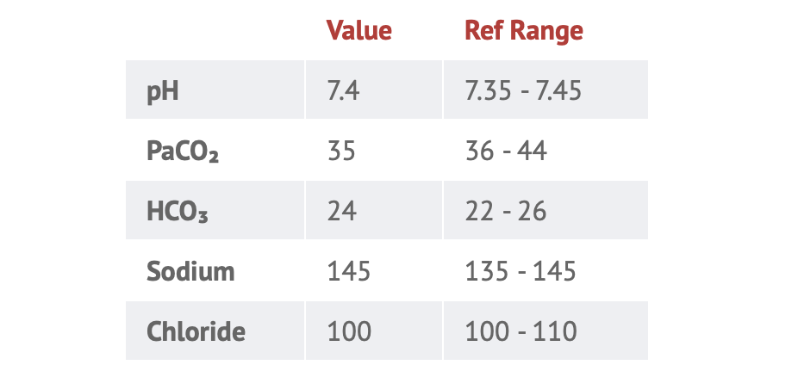

Slide 42


Slide 43
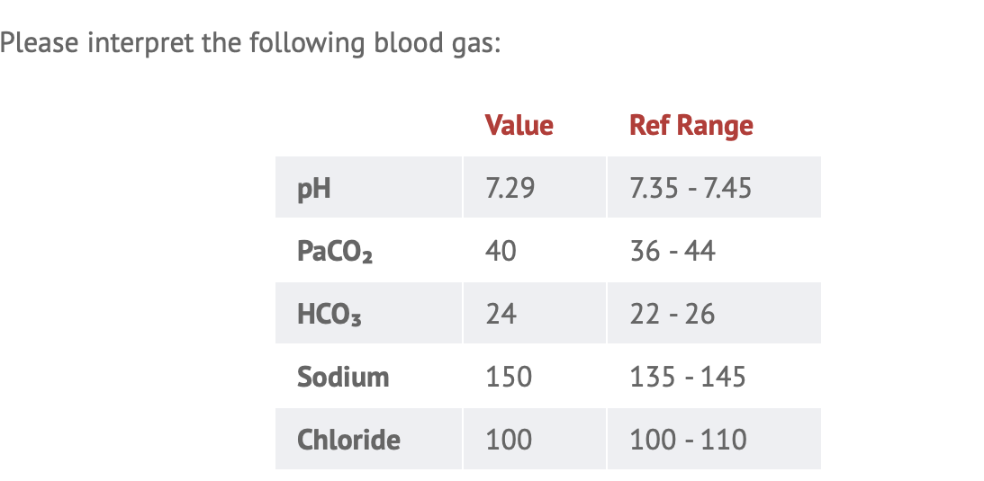

Slide 44
GT is a 54 yr old widower with a history of chronic obstructive Pulmonary disease ( COPD) and was rushed to the ED with increasing shortness of breath, pyrexia, and a productive cough with yellow- green sputum . He has difficulty communicating because of his inability to complete sentences. one of his sons, says he has been unwell for 3 days. Upon examination, crackles and wheezes can be heard in the lower lobes, he has tachycardia and a bounding pulse. Measurement of arterial blood gas shows.
pH 7.3, Paco2 68mmhg( 9.01 Kpa),Hco3 28mmol/l,Pao2 60mmHg (8kPa)
How would you interpret this?
RA,PC

Slide 45
An 11 year old child is brought to your ICU with vomiting and a decreased level of consciousness. The patient displays slow and deep ( kussmaul breathing ), and is lethargic and irritable in response to stimulation. He appears to be dehydrated- his eyes are sunken and the mucous membranes are dry – he has a 2 week history of polydipsia, polyuria and weight loss. Measurement of the ABG shows : pH 7.0, Pao2 90mmHg( 12 Kpa ), Paco2 23mmHg( 3.07kPa ) , and HCO3 12mmol/l ; Other results are Na 126mmol/l ,K 5 mmol/l,and Cl 95mmol/l. What is your assessment ? –
MA,PC

Slide 46
An office worker is brought to your ED after she fell on to the ground and hurt her left leg . She is noted to be tachycardic and tachypneic. Pain killers are administered to lessen her pain. Suddenly, she started complaining that she was still in pain and now experiences muscle cramps, tingling and paraesthesia. Measurement of her ABG is as shown. pH 7.6,Pao2 120mmHg ( 16 KPA), Paco2 31mmhg ( 4.13 Kpa ),and HCO3 25mmol/L. What does this mean?
RA . UC

Slide 47
An old woman has been suffering from persistent vomiting for 2 days now.
She appears to be lethargic and weak and has myalgia. She is noted to have dry mucous membranes and her capillary refill takes > 4secs. She is diagnosed as having gastroenteritis and dehydration.
Measurement of arterial blood gas shows :
pH 7.5, PaCO2 85mmHg (10.9kpa), PaCo2 40mmHg(5.3Kpa), HCO3 34mmol/l
MALK.U

Slide 48
Delta Ratio
= Change in Anion Gap / change in HCo3
= Measured AG- Normal AG/Actual HCO3(24)- Measured Hco3
< 1 = Pure AGMA
1-2 = Mixed AGMA +NAGMA
> 2 – Metabolic alkalosis + AGMA

Slide 49
Questions ?
Ken Adegoke 16/4/2023

